Slide 1
Covid-19 Communication and Mass Media
Rob Murphy, M.D
Professor of Medicine and Biomedical Engineering.
John P. Phair Professor of Infectious Diseases
Executive Director, Institute for Global Health
Feinberg School of Medicine, Northwestern University
Larry Potash
WGN-TV
Morning News Anchor
Chicago
CoVAXCEN Seminar
August 9, 2021
August 9, 2021

Slide 2
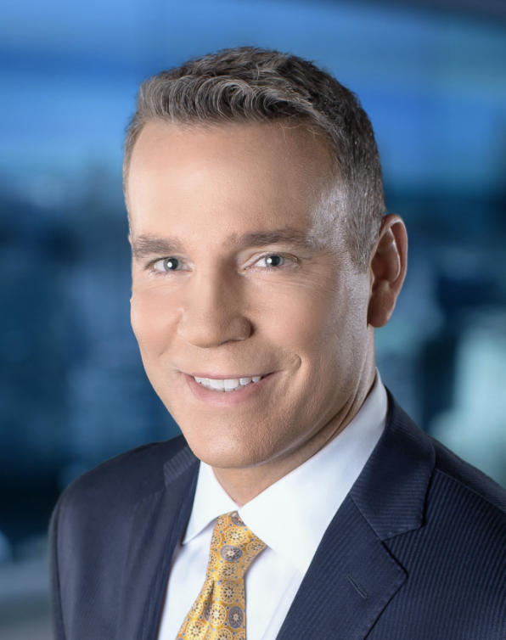
Background
Larry Potash
History
Larry Potash
Native of Lynn, Massachusetts
BS in Mass Communications, Emerson College
Weekend anchor and political reporter in Tulsa, OK, Evansville, IN and Longview, TX
Joined WGN-TV in 1994; Anchor since 1995
The WGN Morning News show will be 27 years old in September, 2021
WGN TV News, #1 in Chicago by far for years
14 Emmy Award winner, including 6 for best anchor
11 Silver Dome awards for best anchor
Awardee for “Backstory with Larry Potash”

Slide 3
Background
Rob Murphy, MD
History
Media Experience
Infectious Diseases trained MD
Full Professor since 1998
NIH-funded for >30 years
Extensive lecturing and research training experience
Mentor of the Year: 2021
HIV/AIDS
Ebola
Covid-19
$9.3 million NIH/NIBIB award for Rapid Acceleration of Diagnostics for Covid-19 (RADx)
>300 peer-reviewed publications
Minor theater work, modeling, radio commercials in college
HIV/AIDS era – first media experience
Had one week media emersion training in the 1980s

Slide 4
And then came Covid-19!
And WGN-TV!
January and February 2020: invited 3 times in the WGN studio for Covid-19 information
March 16, 2020: started every weekday Skype appearances on WGN-TV Morning News with Larry Potash and Robin Baumgarden
Completed 331 weekday morning shows without a break
June 21, 2021, Cut back to twice weekly, total appearances: 346
Accepted other TB, radio and print appearances and interviews

Slide 5
Northwestern Metrics
Northwestern University Health Sciences Communications
January 2020 – July 2021 statistics for R Murphy, MD
WGN-TV: the most important and biggest exposure
2482 media entries total
  2277 quotes, Includes TV, Radio, print
Total potential reach: 173,293,692
State of Illinois: ~50 billboards/commercials supporting vaccination, 62,400,000 reach (7.3% of total)
Most significant (>1 million potential viewers/readers and of interest)
  WGN-TV Daily Mail (UK) Associated Press
  New York Times Times of India NBC News
  Washington Post NPR Japan Times
  Chicago Tribune WGN Radio WTTW
  Yahoo.com CNN.com Times of Israel
  MSN.com USA Today NBC – LA
  Bloomberg TV

Slide 6
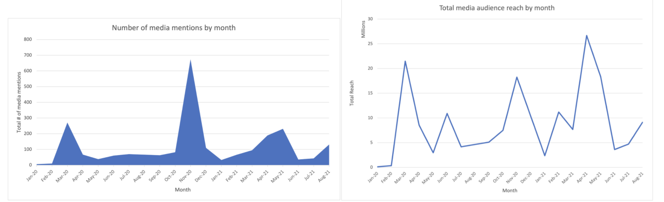
Media Mentions/Audience Reach by Month

Slide 7
Media Advisories help drive the results
01/21/20 Coronavirus in the US: ‘This is going to be a really big disaster’
02/28/20 What could a coronavirus outbreak in the US look like?
03/15/20 ’Appalled’ by O’Hare scene: ‘This not poor planning, this is no planning’
03/22/20 Three feet, not six: A new norm for physical distancing
06/24/20 Safely expanding your COVID-19 Bubble
12/07/20 Vaccine playbook: What to expect and when
01/28/21 ‘Put needles in arms as quickly as possible’
03/09/21 You’re vaccinated, Now what?
05/11/21 Worried your vaccinated pre-teen will become infertile? Don’t be.
07/27/21 Worried about Delta variant?
07/30/21 Lollapalooza is ‘recipe for disaster’

Slide 8
Questions for the panel
How did WGN end up with a long term, academic covid-19 expert, Dr. Murphy for so long? How did it happen and why?

Slide 9
Questions for the panel
How did WGN-TV end up with a long term, academic covid-19 expert, Dr. Murphy for so long? How did it happen and why?
How does WGN-TV measure effectiveness of the Covid-19 reporting?

Slide 10
Questions for the panel
How did WGN-TV end up with a long term, academic covid-19 expert, Dr. Murphy for so long? How did it happen and why?
How does WGN-TV measure effectiveness of the Covid-19 reporting?
How does WGN-TV handle adverse/negative comments, including death threats including those on social media?

Slide 11
Questions for the panel
How did WGN-TV end up with a long term, academic covid-19 expert, Dr. Murphy for so long? How did it happen and why?
How does WGN-TV measure effectiveness of the Covid-19 reporting?
How does WGN-TV handle adverse/negative comments, including death threats including those on social media?
How will WGN-TV handle the evolving endemic, long term nature of the pandemic?

Slide 12
Questions for the panel
How did WGN-TV end up with a long term, academic covid-19 expert, Dr. Murphy for so long? How did it happen and why?
How does WGN-TV measure effectiveness of the Covid-19 reporting?
How does WGN-TV handle adverse/negative comments, including death threats including those on social media?
How will WGN-TV handle the evolving endemic, long term nature of the pandemic?
How do you keep politics in or out of the Covid-19 news discussion?

Slide 13
Questions for the panel
How did WGN-TV end up with a long term, academic covid-19 expert, Dr. Murphy for so long? How did it happen and why?
How does WGN-TV measure effectiveness of the Covid-19 reporting?
How does WGN-TV handle adverse/negative comments, including death threats including those on social media?
How will WGN-TV handle the evolving endemic, long term nature of the pandemic?
How do you keep politics in or out of the Covid-19 news discussion?
The Wuhan Lab story is quite controversial and is being pushed primarily by right wing news outlets such as Fox News and Wall Street Journal. What formula is WGN-TV taking in this story?

Slide 14
Thank you!
Questions?

