Slide 1
The promise of biosensors and AI in COVID patient care and clinical development
  CoVAXCEN
  March 8, 2021

Slide 2
physIQ TEAM
Gary Conkright, CEO
Dr. Steve Steinhubl, CMO
Stephan Wegerich, CSO
Chris Economos, CCO
John Varaklis, physIQ Advisor

Slide 3
physIQ: Extracting Insight from Biosensor Data
1. Platform for continuous biosensor data collection and processing
2. Portfolio of digital biomarkers

Slide 4


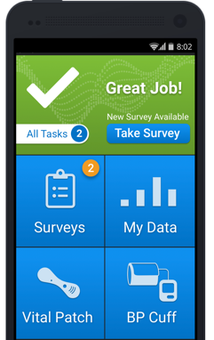
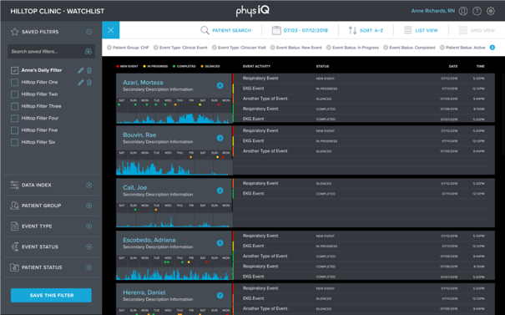
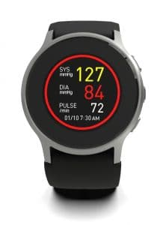


(Near) Real-time, Real-world data collection and analytics

Slide 5
physIQ’s Leadership in FDA Cleared Digital Biomarkers
Digital Bio-Marker Development Stages
physIQ Therapeutic and Chronic Diseases Market Opportunities for Life Sciences and Healthcare
Target Research
Feasibility
Algorithm Development
Clinical Validation
Release in Product
US FDA Clearance
Cardiology & Metabolism & Endocrinology
Oncology
Pulmonology, Dermatology
Immunology, Rheumatology & Infectious Diseases
Neurology &
Ophthalmology
Urology,
Gastroenterology & Hematology & Women’s Health
Orthopedics
Psychiatry & Substance Abuse
Multivariate Change Index
K142512
6/11/2015
✔️
✔️
✔️
✔️
✔️
✔️
✔️
✔️
Change from personalized multivariate physiological baseline
Atrial Fibrillation
K180234
8/10/2018
✔️
✔️
Continuous A-Fib burden with ambulatory single-lead ECG
✔️
✔️
✔️
Heart Rhythm / QRS
K180234
8/10/2018
✔️
✔️
Basis for all heart rate analyses
Respiration Rate
K183322
7/10/2019
✔️
✔️
✔️
Ambulatory respiration rate
HRRM (3.0)
K193415
6/11/2020
✔️
✔️
✔️
Improved AI-enabled Heart Rhythm / QRS, A-Fib and Respiration
Sleep Quantity/Stage
Discussions with FDA
✔️
✔️
✔️
✔️
✔️
✔️
✔️
✔️
Wake/asleep/REM/deep/light sleep staging
e-VO2max
Functional capacity estimation to replace 6-minute walk test
✔️
✔️
✔️
✔️
✔️
Pulse Rhythms / A-Fib
Pulse rate & A-Fib screening on wrist PPG
✔️
✔️
✔️
✔️
✔️
Cough Burden
Detect & quantify coughing
✔️
✔️
e-Cardiac Output
Cardiac output estimation
✔️
✔️
✔️
✔️
e-FEV1 / e-Residual Volume
Pulmonary capacity estimation
✔️
✔️
Notes:
Move sleep up, so that should be after HRRM
Make this overall slide to have ideae

Slide 6
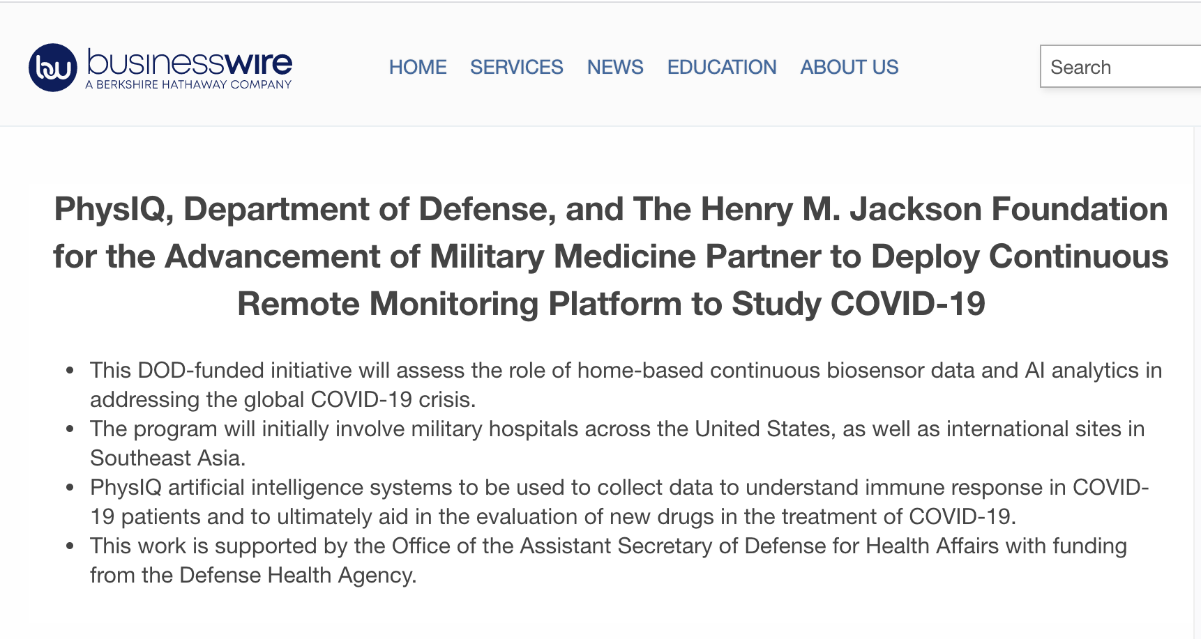
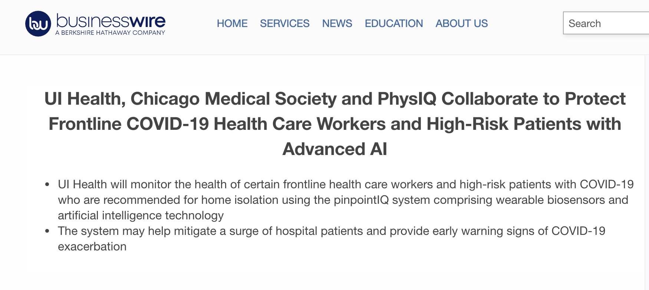
Our work in supporting COVID research and patient care
Notes:
Move sleep up, so that should be after HRRM
Make this overall slide to have ideae

Slide 7
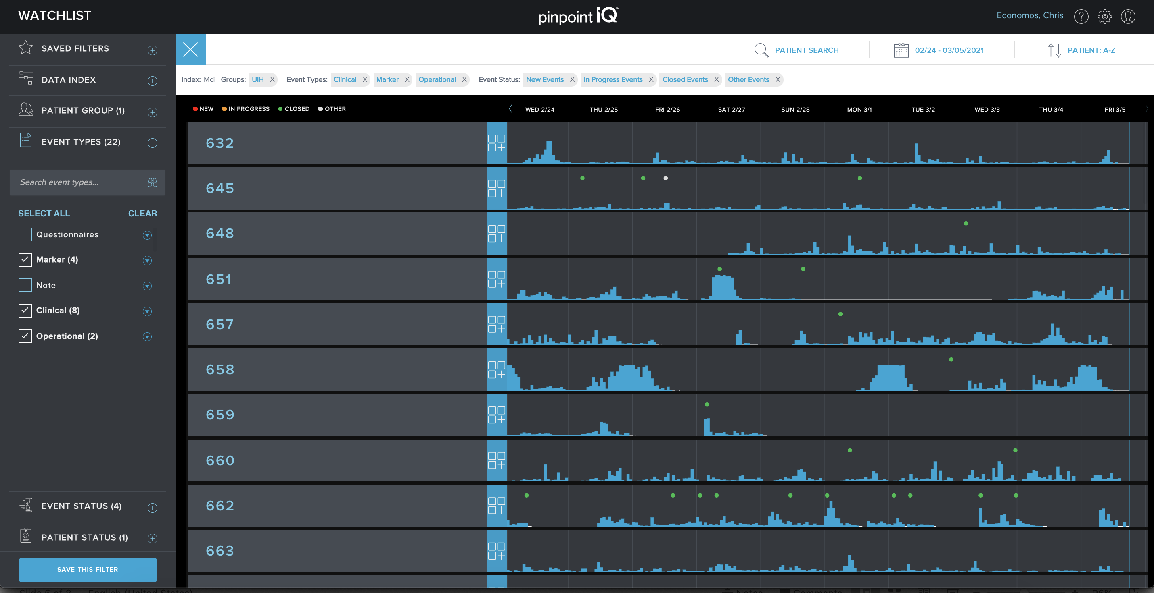
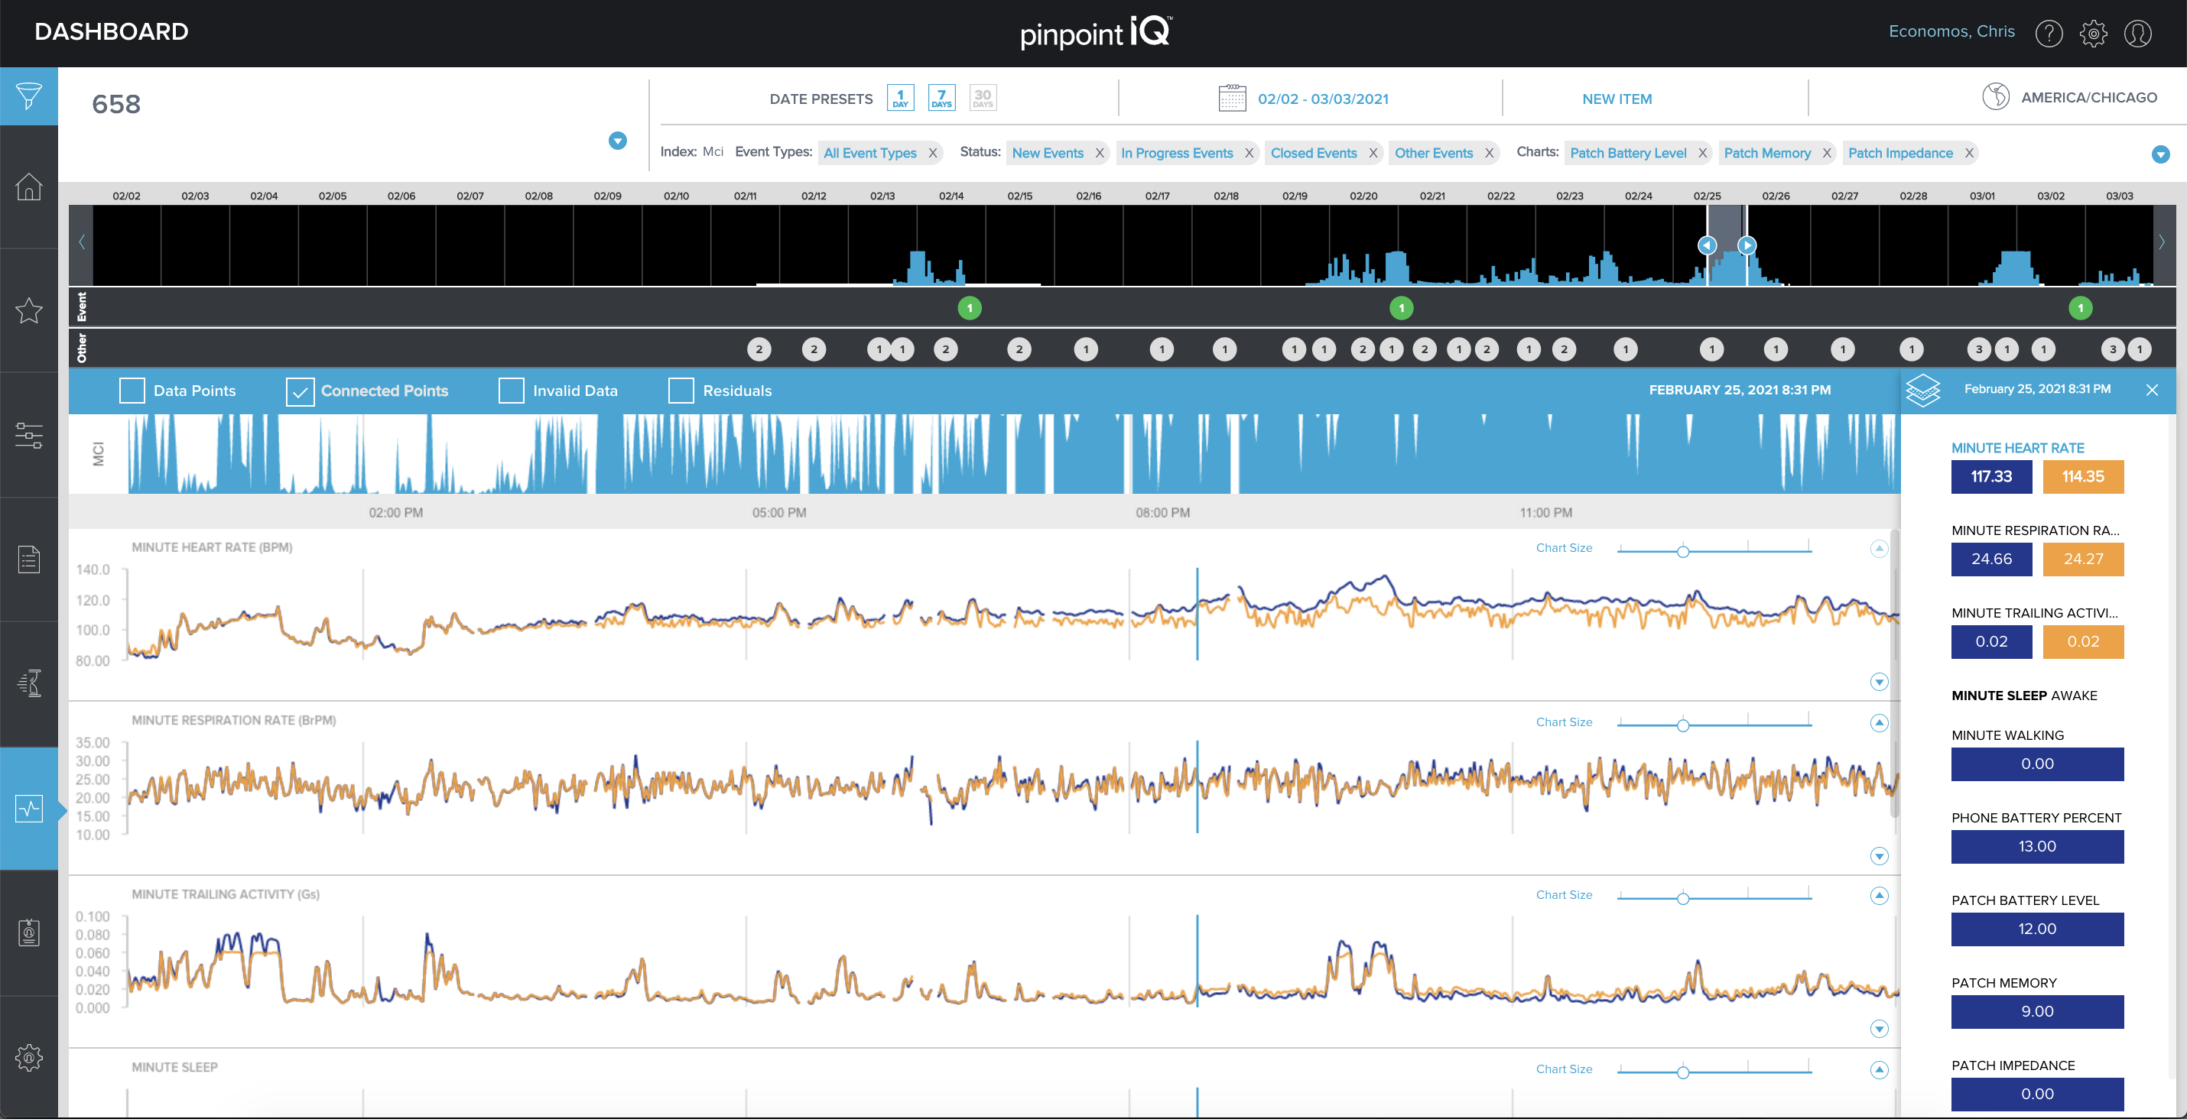
NIH-sponsored DECODE study
Develop and validate a COVID-19 decompensation biomarker that builds off existing analytics generated by physIQ’s end-to-end cloud platform
In partnership with UI Health in Chicago
Phase 1 = 400 patients
  Enrolled all 400 between October and December, which triggered…
Phase 2 = 1200 patients
In addition to collecting data to develop the COVID biomarker, the solution was used by UIH clinicians to actively monitor and care for high-risk COVID+ patients

Slide 8
NIH-sponsored DECODE timeline
Protocol, ICF, and supporting documents approved by IRB 9.9.20
Contract with NIH executed 9.11.20
DeCODe portal “live” 9.28.20
Training material developed and staff training completed 9.29.20
Contract with sub-contractor (UIH) executed 9.30.20
First enrolled participant 10.5.20
First participant started monitoring 10.7.20
First 100 participants enrolled 10.30.20
End first reporting period 10.30.20
Halfway point for enrollment, 200 participants, 11.20.20
End second reporting period 11.30.20
Enrollment N = 400, 12.22.20
Third and Final Reporting Period for Phase I 1.22.21
Protocol approval to preliminary digital biomarker based on 400 patients’ data…<5 months

Slide 9
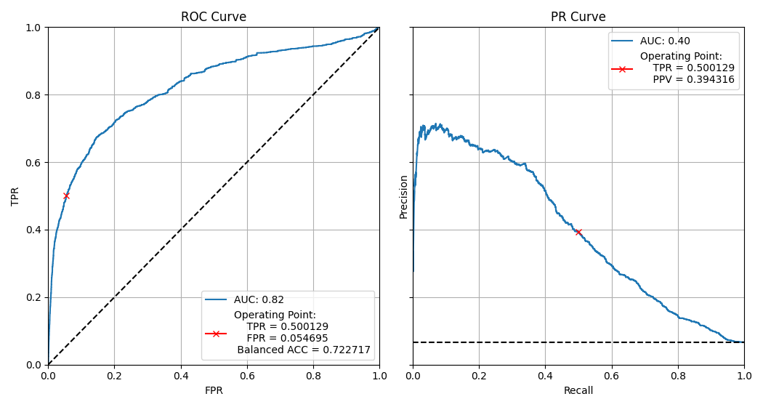
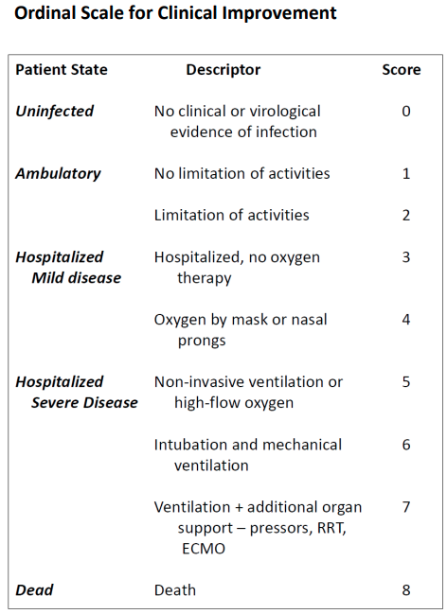
COVID biomarker performance
COVID-19 Decompensation Event:
WHO Ordinal ≥ 3 as positive for COVID decompensation
Regression Tree ensemble approach
Biomarker based on biosensor derived inputs only
50 derived features (selected from 374)
Event Cases

Slide 10
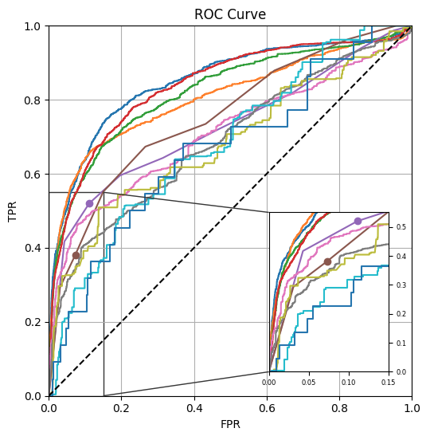
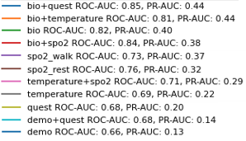
COVID biomarker performance
Biomarker Input Modality | False Positive Rate | True Positive Rate | Positive Predictive Value | ROC AUC
Biosensor Analytics + Wellness Quest. + All Manual SpO2 | 5% | 51% | 42% | 0.85
Biosensor Analytics + Skin Temp.** | 5% | 52% | 43% | 0.81
Biosensor Analytics | 5% | 50% | 40% | 0.82
Biosensor Analytics + All Manual SpO2 | 5% | 50% | 39% | 0.84
Manual SpO2 after Walking | 5% | 42% | 37% | 0.73
Manual SpO2 at Rest | 5% | 33% | 29% | 0.76
Skin Temp. + All Manual SpO2 | 5% | 40% | 32% | 0.71
Skin Temp. | 5% | 31% | 29% | 0.69
Wellness Quest. + All Manual SpO2 | 5% | 32% | 25% | 0.68
Demographics + Wellness Quest. + All Manual SpO2 | 5% | 21% | 21% | 0.68
Demographics | 5% | 19% | 20% | 0.66
** Skin Temp. acquired from biosensor

Slide 11
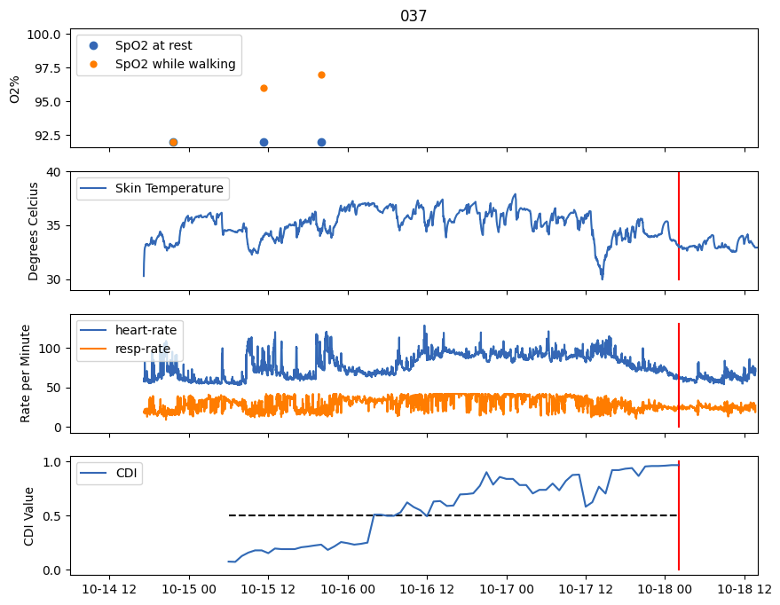
COVID biomarker performance – Participant 37
First Alert ~48 hours before event

Slide 12
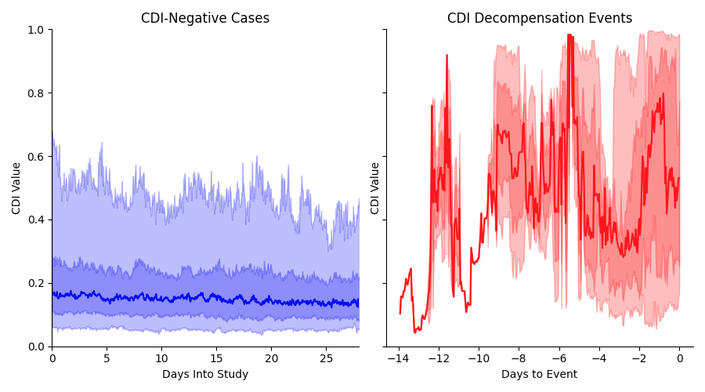
COVID biomarker performance
Hourly biomarker values across population for negative and positive Decompensation cases
Median
25th to 75th Percentile Range
5th to 95th Percentile Range

Slide 13
Leveraging continuous ambulatory biosensor data coupled with AI/ML analytics offers tangible benefits for vaccine development.
DECODE and PROMETHEUS studies have demonstrated how continuous ambulatory biosensor data, when coupled with AI/ML analytics, can detect COVID-related physiological signal
  DECODE: Biomarker for COVID Decompensation Event detection
  PROMETHEUS: Biomarker for continuous assessment of symptom severity (i.e., biosensor-derived FLU-PRO scores)
The solution has been well tolerated by patients and proven to be rapidly scalable in a real-world environment
Patient-to-clinician ratio is an exemplary 75:1
Beyond patient care implications, we see opportunity in clinical development related to:
  Safety monitoring at scale in future vaccine trials
  Support of efficacy endpoints for ambulatory/outpatient COVID therapeutics
  Remote monitoring of high-risk/immunocompromised patients in era of COVID (eg. chemotherapy)

Slide 14
Follow-up contact details: steve.steinhubl@physiq.com

