Slide 1
A portable cell culture system for measuring the cellular immune response to SARS-CoV-2
Thom McDade, PhD
Northwestern University, Department of Anthropology and Institute for Policy Research

Slide 2
Overview
Out of the lab and into the field: Insights into human biology and health from the application of novel methods in community-based settings
Development of miniaturized and portable cell culture protocols for studying inflammation and cell-mediated immunity
Application: Northwestern students in quarantine

Slide 3
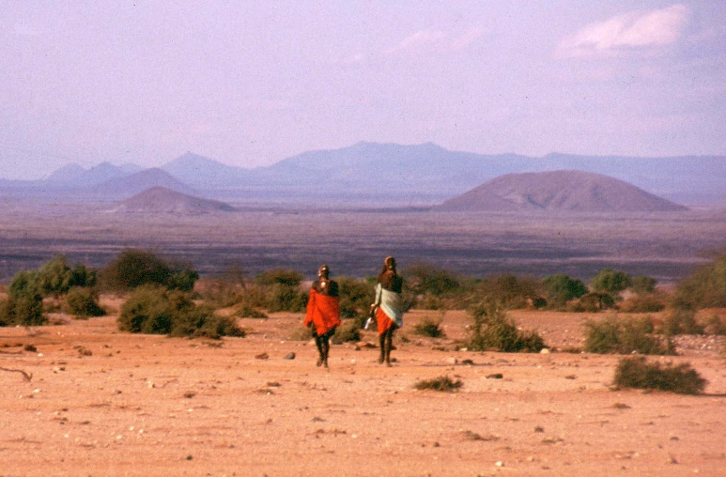
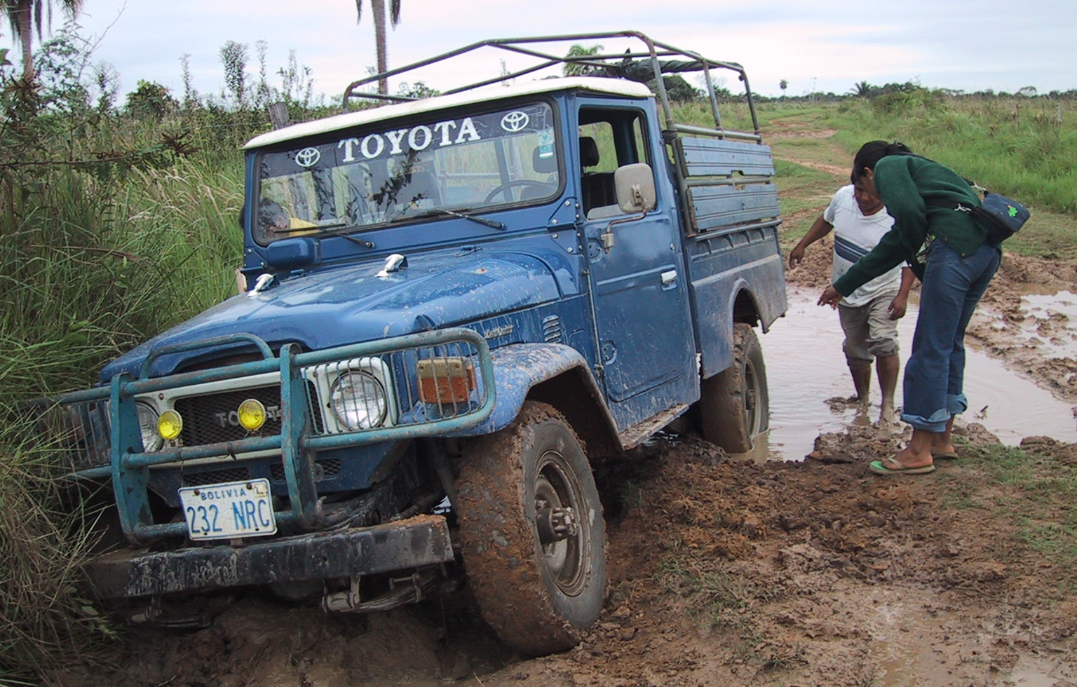
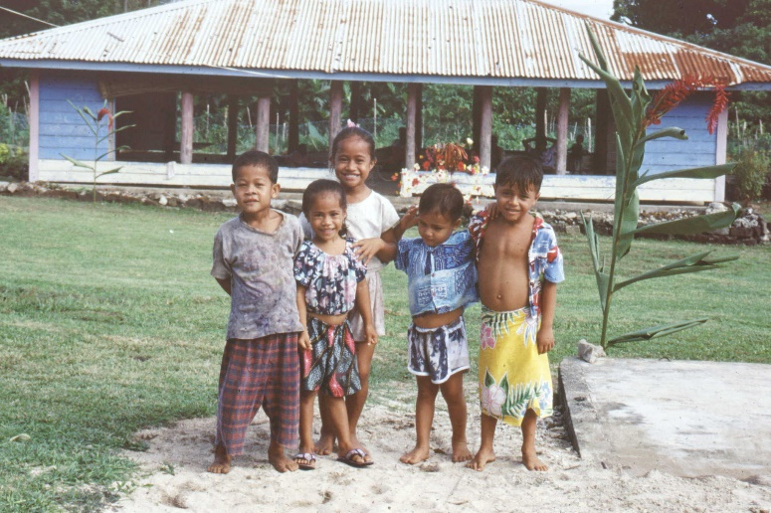
These are the kinds of places where I work. . .
. . . that allow me to investigate how ecological factors shape human physiology and health
Notes:
Field constraints:
Collection: large quantities of serum; must be immediately analyzed or deep frozen; venipuncture may be problematic, especially with kids;
Processing: require centrifuge, freezer, cold chain; but may not even have electricity!
Confounders: nutritional status (macro and micro); pathogen load, infectious disease burden
PNI: deals with these problems by studying mice, or healthy individuals exclusively; high degree of control that is not possible in the field

Slide 4
These are the kinds of places where I work. . .
. . . that allow me to investigate how ecological factors shape human physiology and health
. . . but also impose substantial challenges to the collection of blood
  Logistical and cultural issues
  Costs of collection, shipping
  Infrastructure for sample processing, storage, transportation (ie, no lab, no electricity!)
Notes:
Field constraints:
Collection: large quantities of serum; must be immediately analyzed or deep frozen; venipuncture may be problematic, especially with kids;
Processing: require centrifuge, freezer, cold chain; but may not even have electricity!
Confounders: nutritional status (macro and micro); pathogen load, infectious disease burden
PNI: deals with these problems by studying mice, or healthy individuals exclusively; high degree of control that is not possible in the field

Slide 5
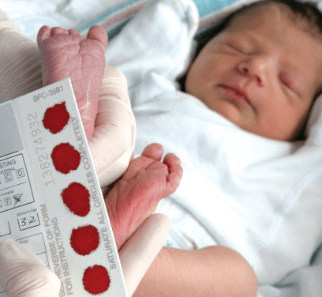
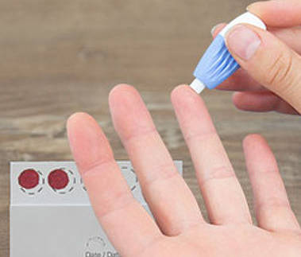
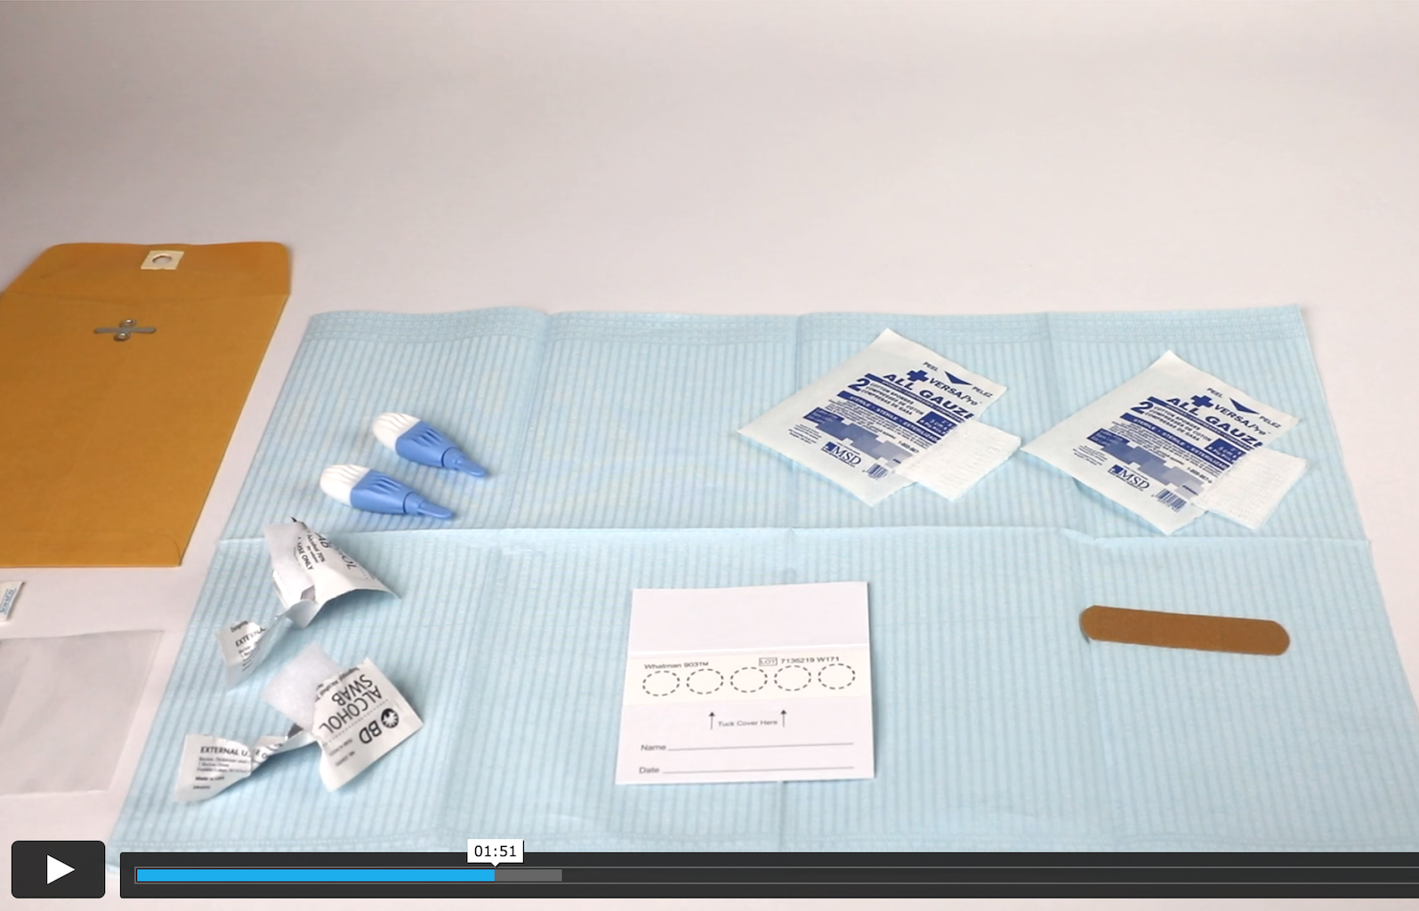
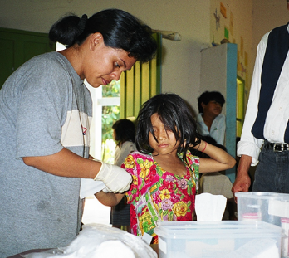
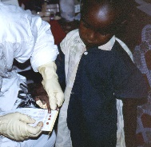
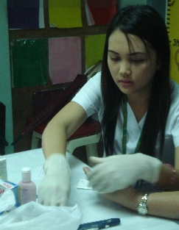

Dried blood spots (DBS):
Tool for bridging the field and the lab
Low burden/cost of collection
Store/ship at ambient temperatures
Low biohazard risk/safe to ship

Slide 6
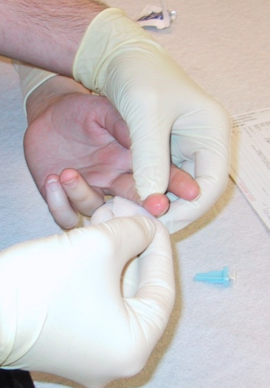
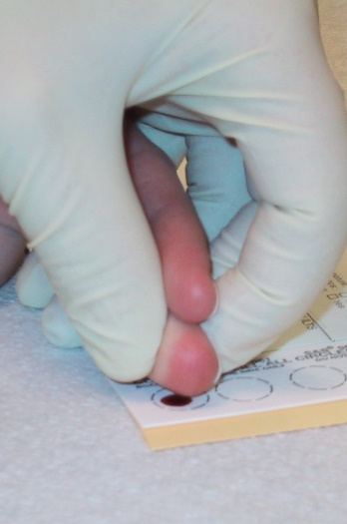
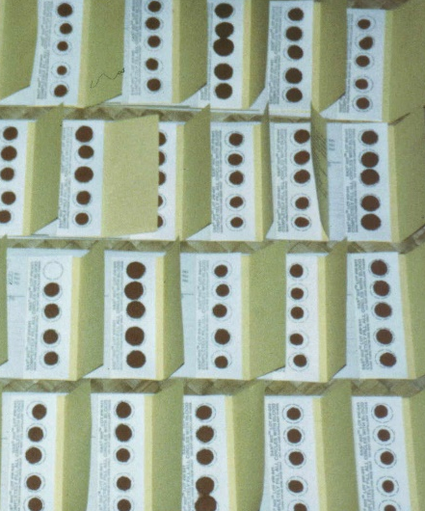
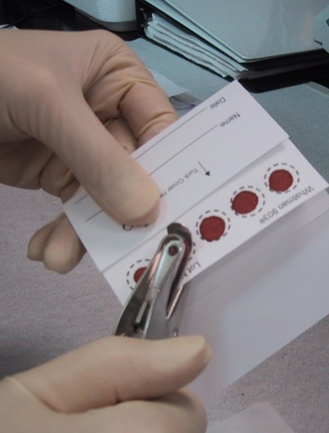
Dried blood spots (DBS):
Tool for bridging the field and the lab
Convenience and reach of community-based sampling
+
Accuracy and quantitation in the lab

Slide 7
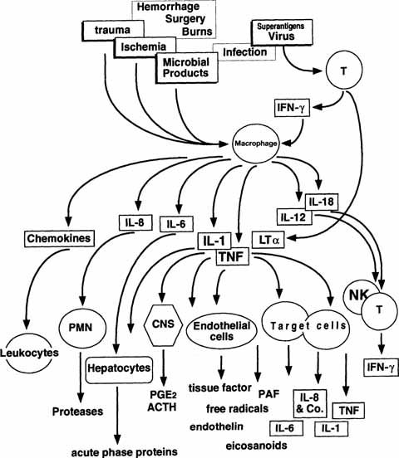
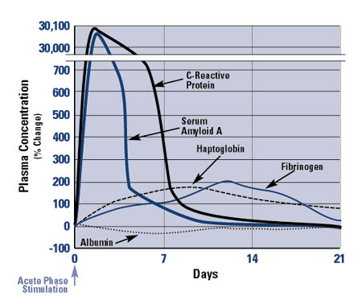
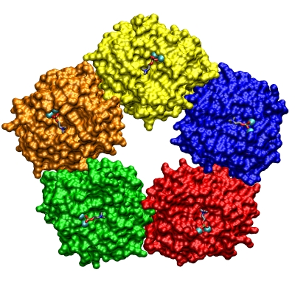
Why do we care about inflammation?
CRP
Cavaillon JM., Adib-Conquy M. (2002). The pro-inflammatory cytokine cascade.

Slide 8

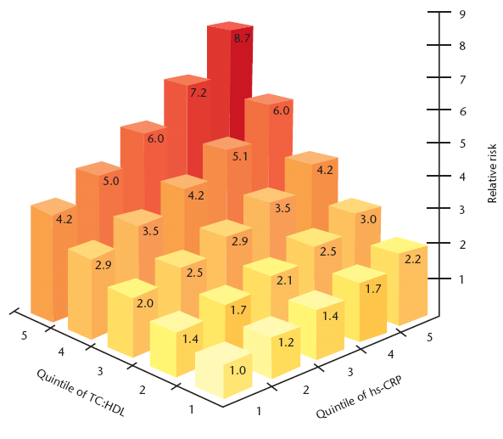
Why do we care about inflammation?
February 23, 2004
Libby et al. (2002). Circulation 105:1135-42
Notes:
But recently it has been labeled the “secret killer”. Ironic, because without it you would die. But when inflammation becomes chronically elevated, contributes to . . .

Slide 9
Why do we care about inflammation?
increased CRP→
↑
all cause mortality
RR = 1.75 (1.55-1.98)
↑
CVD mortality
RR = 2.03 (1.65-2.50)
Li et al (2017) Atherosclerosis 259: 75-82.
Notes:
Background and aims
Inconsistent findings have been reported on the association between high-sensitivity C-reactive protein (hs-CRP) and mortality risk. The objective of this meta-analysis was to investigate the association of elevated baseline hs-CRP levels with all-cause, cardiovascular, and cancer mortality risk in the general population.
Methods
PubMed and Embase were systematically searched for studies published from inception to October 2016. Prospective observational studies were eligible if they reported the effects of elevated baseline hs-CRP levels on cancer-related, cardiovascular or all-cause mortality in the general population. The pooled adjusted risk ratio (RR) with 95% confidence interval (CI) comparing the highest to the lowest category of hs-CRP levels was used as association measures.
Results
A total of 83,995 participants from 14 studies were identified. When comparing the highest to the lowest category of hs-CRP levels, the pooled RR was 1.25 (95% CI 1.13–1.38) for cancer-related mortality, 2.03 (95% CI 1.65–2.50) for cardiovascular mortality, and 1.75 (1.55–1.98) for all-cause mortality, respectively. Subgroup analysis showed that the effect of elevated hs-CRP levels on cancer-related mortality was observed in men (RR 1.26; 95% CI 1.11–1.43) but not in women (RR 1.03; 95% CI 0.83–1.27).
Conclusions
Elevated hs-CRP levels can independently predict risk of all-cause, cardiovascular mortality in the general population. However, the gender differences in the predictive role of hs-CRP on cancer mortality should to be further investigated.

Slide 10
Why do we care about inflammation?
smoking
CVD
death
adipose tissue
autoimmunity
latent infection
cancer
chronic
inflammation
birth outcomes
psychosocial stressors
dementia
toxic exposures
depression
brain structure/ function?
depression

Slide 11
The chronic low-grade inflammation model
Macy et al. (1997) Clin Chem.
Notes:
What is this understanding? What does inflammation look like when we study it places like the US? This paper, by Macy et al about 20 years ago, is foundational to what I’m calling here the chronic low-grade inflammation model.

Slide 12
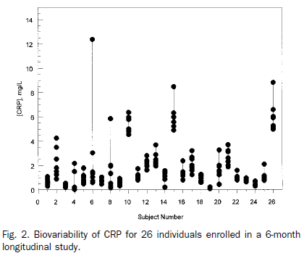
The chronic low-grade inflammation model
Macy et al. (1997) Clin Chem.

Slide 13
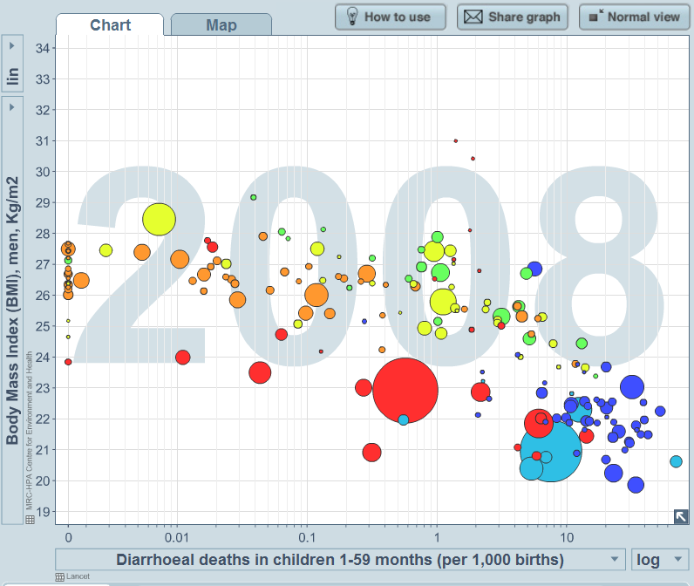
What are we missing?
Can we assume these associations are universal?
US
high
energy
balance
low
infectious
exposures
low
high
www.gapminder.com
Notes:
One of my responsibilities as an anthropologist is to challenge assumptions of universality, challenge definitions of normality, that are based solely on research conducted in people living in affluent industrialized settings.
I would argue that by studying inflammation exclusively in overfed, under-infected populations like the US we tie our hands by limiting the range of meaningful ecological variation.
Go to graph.
A priori, we expect that . . .
What if chronic inflammation model is product of unique western environment?
Joe Henrich 2010 critique of psychology:
The
comparative
findings
suggest
that
members
of
Western,
educated,
industrialized,
rich,
and
democratic
societies,
including
young
children,
are
among
the
least
representative
populations
one
could
find
for
generalizing
about
humans

Slide 14
Does limited ecological variation limit our understanding of inflammation?
US
high
Ecuador
energy
balance
low
Philippines
infectious
exposures
low
high
www.gapminder.com
Notes:
One of my responsibilities as an anthropologist is to challenge assumptions of universality, challenge definitions of normality, that are based solely on research conducted in people living in affluent industrialized settings.
I would argue that by studying inflammation exclusively in overfed, under-infected populations like the US we tie our hands by limiting the range of meaningful ecological variation.
Go to graph.
A priori, we expect that . . .

Slide 15
Back to basics
What does inflammation look like across populations, across ecologies?
What factors contribute to variation in the regulation of inflammation?
What are the implications for the effects of inflammation on dx?
Notes:
First order question: Natural history and variation of inflammation
Second: how does development matter?
Third: Only after addressing 1 and 2 can we understand how social environments matter to inflammation and chronic dx

Slide 16
Epidemiologic transition in the Philippines
~ ½ homes had electricity
> ¾ collected water from an open source
< ½ used a flush toilet
> ½ had animals under, around, or in the house
Infectious
Chronic
1983

Slide 17
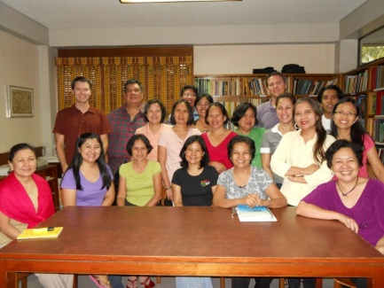
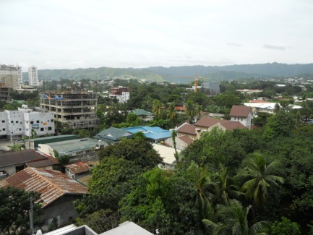
CRP in young adulthood: The Philippines and the U.S.

Slide 18
CRP in young adulthood: The Philippines and the U.S.
median CRP = 0.3
median CRP = 0.9
McDade et al (2009) AJCN
Notes:
Here we have another paradox of inflammation—low CRP in high infectious dx environment.

Slide 19
CRP and waist circumference: Cebu and U.S.
Waist circumference
McDade et al (2009) AJCN
Notes:
means logcrpnozero if crp10==0&preg2005~=1&paasample3==1&infectious==0
Waistcat: 0 < 65; 1 < 75; 2 < 85; 3 < 95, 4 > 95
Question: What explains this difference? Why is CRP lower in Cebu? Why is the per unit fat mass production of CRP lower in Cebu?
Argues for changes in regulatory setpoints. . . .

Slide 20
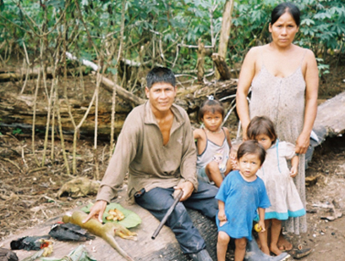
CRP and waist circumference: Ecuador and U.S., 18-50 year-olds
median CRP = 0.5
median CRP = 1.3
Waist circumference
Notes:
Need to update this slide with Ecuador data…

Slide 21
The chronic low-grade inflammation model:
What are we missing?
Macy et al. (1997) Clin Chem.

Slide 22
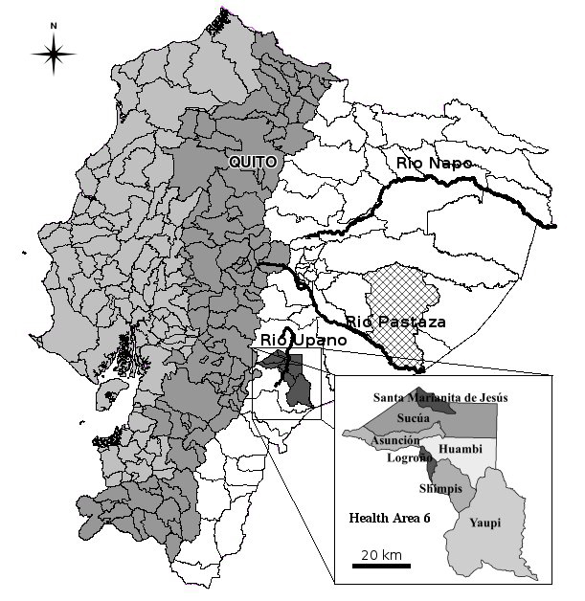
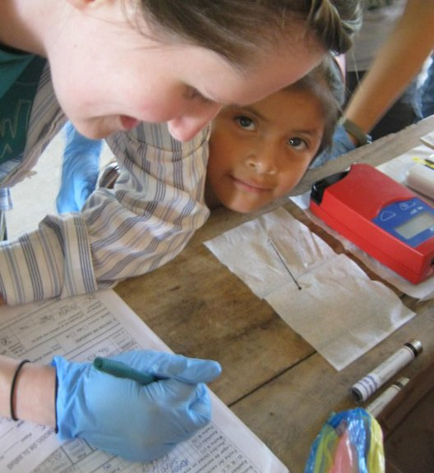
What is the pattern of CRP biovariability in a high infectious disease environment?
Upano River valley, lowland Ecuador
>1 in 4 child deaths due to infectious diarrhea
Primary causes of morbidity:
Acute respiratory infection
Gastrointestinal illness
Vector-borne disease
Notes:
southeastern region of the Ecuadorian Amazon (Descola 1996). The Shuar live in small villages with scattered clusters of households, their economy based on horticulture, hunting, and fishing. Despite accelerating economic and infrastructural development, Shuar continue to depend on subsistence horticulture for daily dietary needs, while also engaging in a mix of small scale agro-pastoralist production for market sale. Regionally, infectious and parasitic diseases account for more than 15 percent of all deaths, compared to less than 3 percent in the US and Canada (WHO 2011). Mortality risk for children under 5 years is more than three times higher in Ecuador than in the US, with 1 in 4 child deaths attributable to infectious diarrhea (WHO Report 2005; Kosek et al.). Across all ages, acute respiratory infection, gastrointestinal illness, and vector-borne disease are the primary sources of morbidity in the Ecuadorian Amazon, with higher rates of infectious disease among indigenous groups compared to colonists (Pan et al. 2010). Recent research among the Shuar indicates a high degree of growth stunting, likely due to synergistic influences of infectious disease and marginal nutrition (Blackwell et al. 2009; Pelletier).

Slide 23
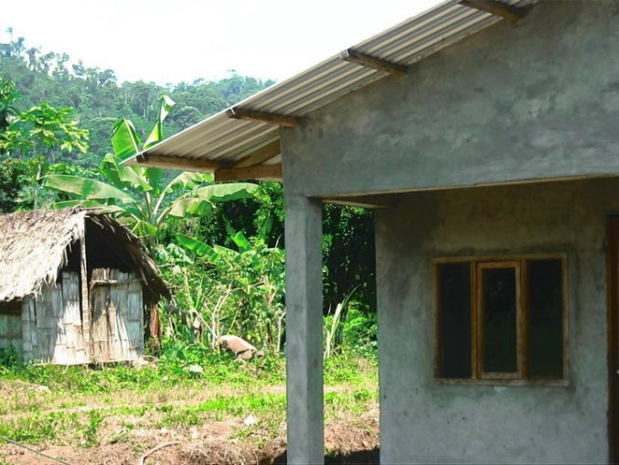
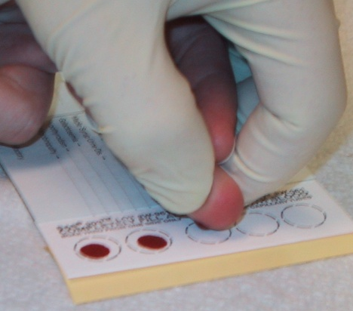
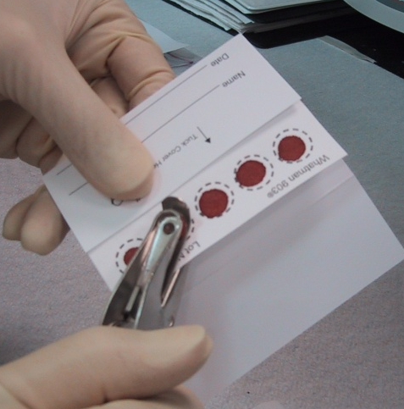
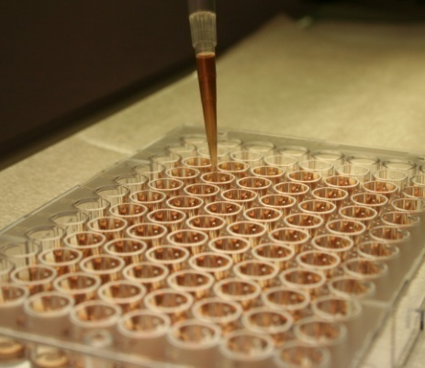
What is the pattern of CRP biovariability in a high infectious disease environment?
N=52 adults, 18-50 yrs
4 weekly sampling intervals

Slide 24
Pattern of CRP variabililty in low infectious disease environments
Macy et al. (1997) Clin Chem.

Slide 25


What is the pattern of CRP biovariability in a high infectious disease environment?
?
?
?
McDade et al. (2012) Am J Hum Bio 5: 675-81.

Slide 26
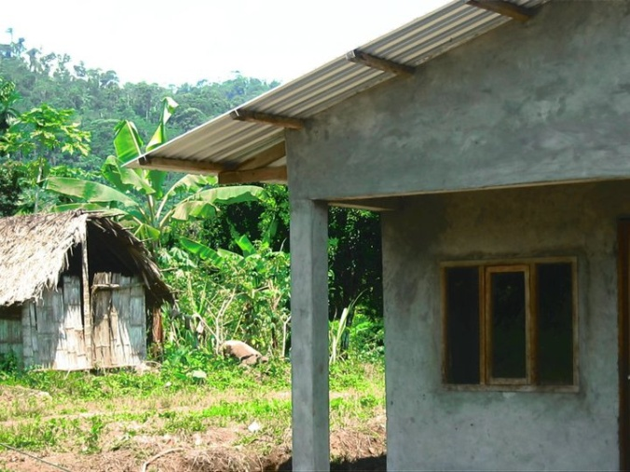
No evidence for chronic low-grade inflammation in this high infectious dx environment!
Same prevalence,
different people!
McDade et al. (2012) Am J Hum Bio 5: 675-81.

Slide 27
Limited ecological variation = limited understanding of inflammation
What are we missing?
1. CRP concentrations are relatively high in the US, and not necessarily “normal”
2. Inflammation is “chronic” in the US, but not necessarily so in different epidemiologic contexts
3. “Field-friendly” methods generate important insights into human biological variation and health.
US
Ecuador
Philippines
Notes:
What do we gain from a comparative perspective on inflammation?

Slide 28
A working model: Early environments as moderators of inflammatory responses in adulthood
infection
sensitive periods
vaccination
pregnancy
pre/post-natal nutrition
adipose tissue
pro-inflammatory
stimuli
smoking
psychosocial stress
regulation of inflammation
inflammatory
response
levels of microbial exposure
disease?
gestation infancy childhood adolescence adulthood

Slide 29
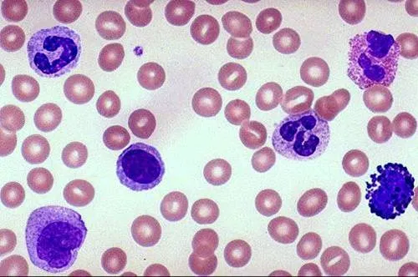
Out of the lab and into the field:
Miniaturized cell culture protocols to advance research on the regulation of inflammation
ligand (LPS, TLRs, etc.)
Response
(cytokines; mRNA)
down-regulatory signal
(glucocorticoid)

Slide 30
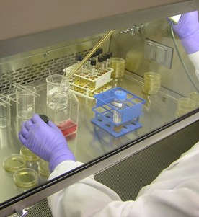
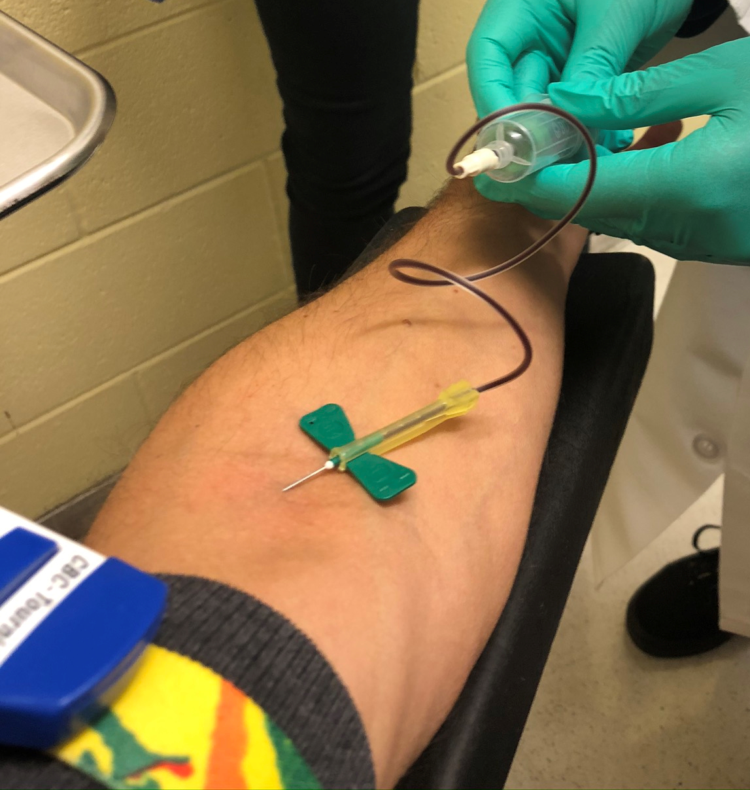
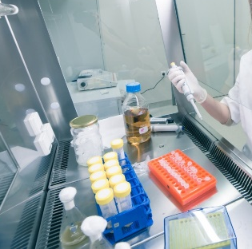
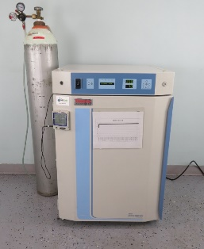
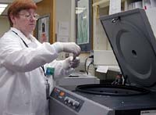
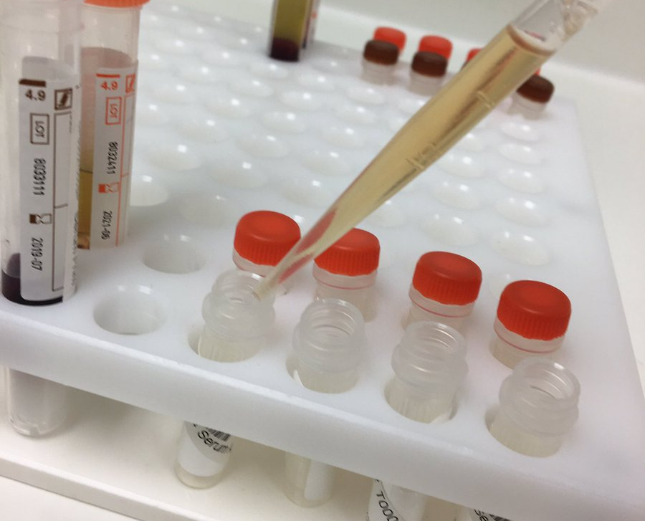
Culturing cells is hard to do outside of the clinic. . .

Slide 31
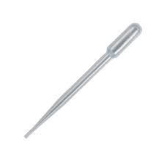
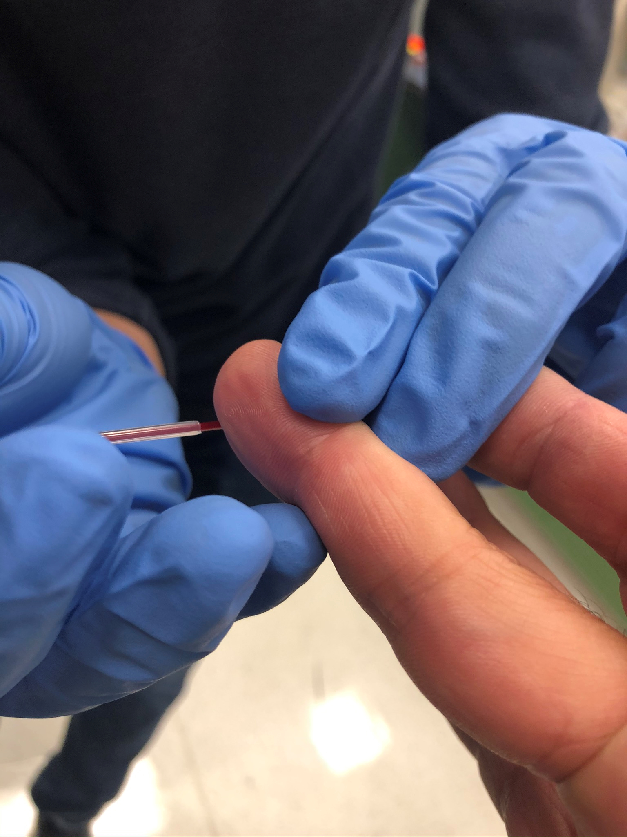
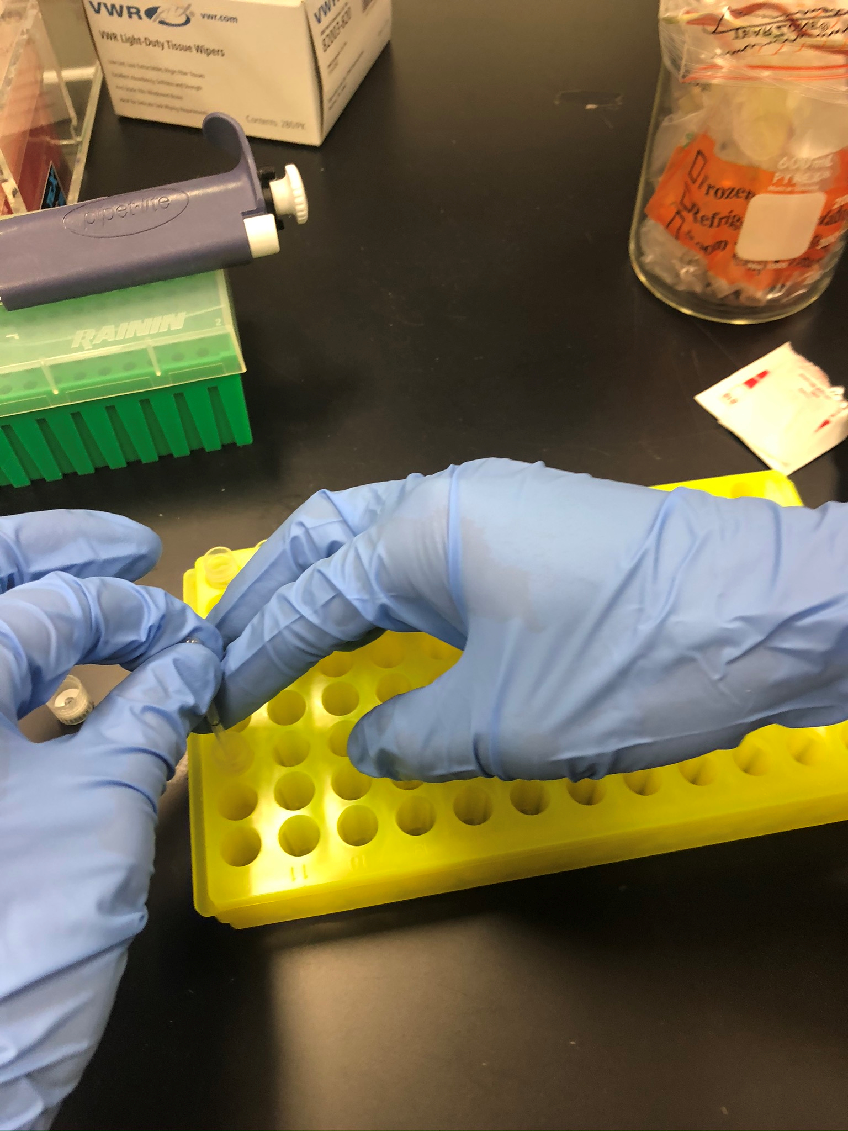
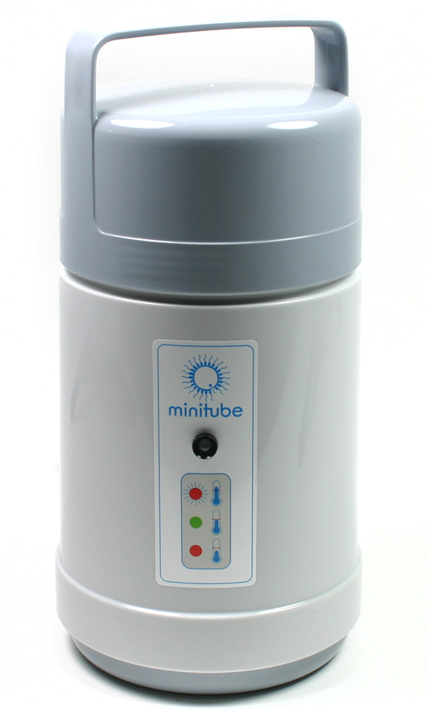
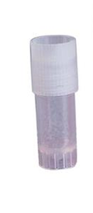
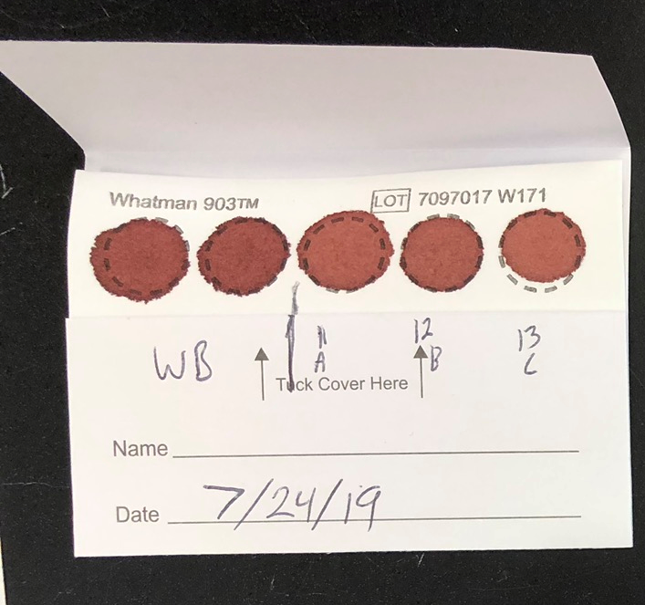
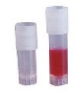
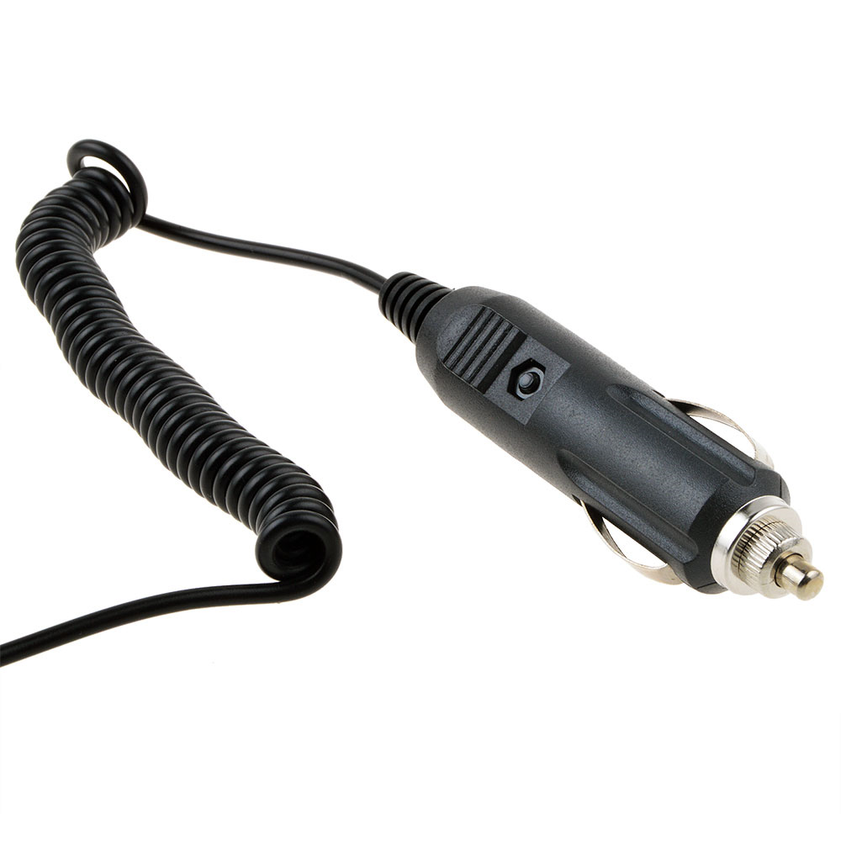
Culturing cells is hard to do outside of the clinic. . .
. . . but not impossible.

Slide 32
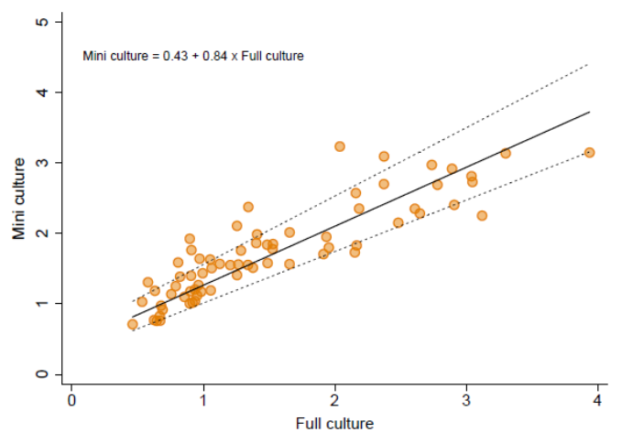
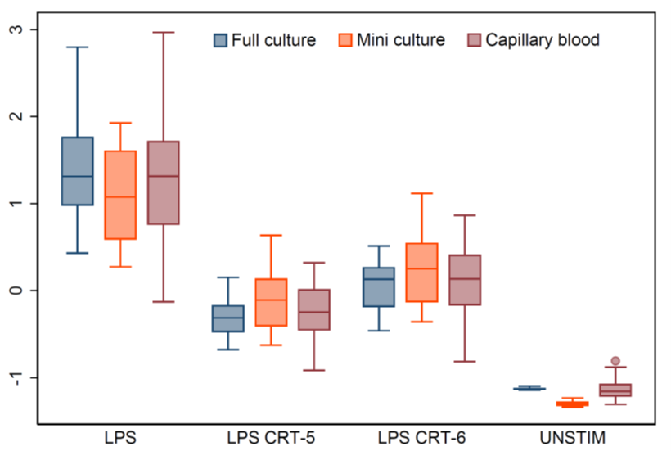
Agreement in results across culture protocols
McDade, Aronoff, Leigh, Finegood, Weissman-Tsukamoto, Brody, Miller (2021). Psychosom Med 83: 283-90.

Slide 33

Photo: https://www.niemanlab.org/2020/05

Slide 34
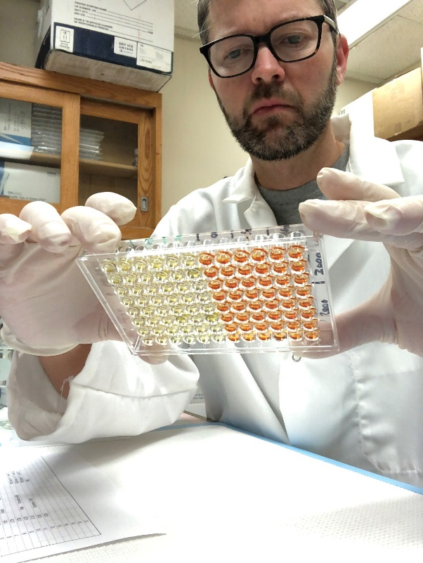
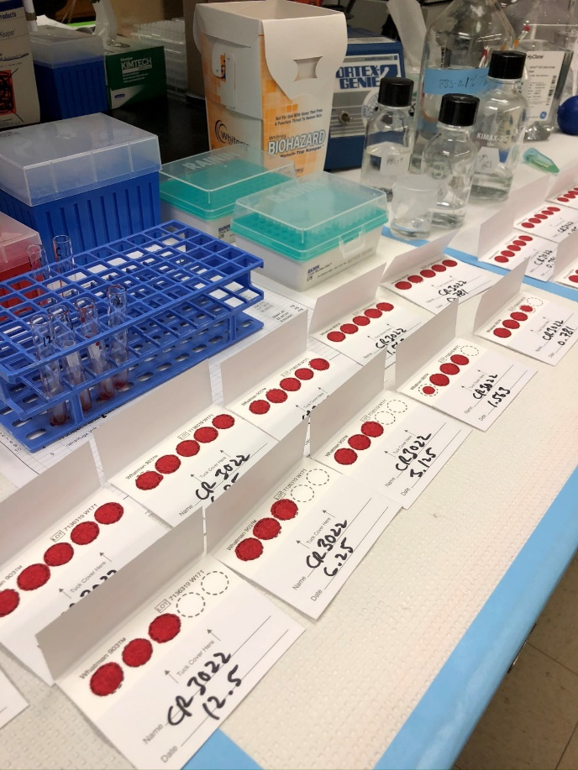
Developing a DBS immunoassay for measuring SARS-CoV-2 antibodies

Slide 35
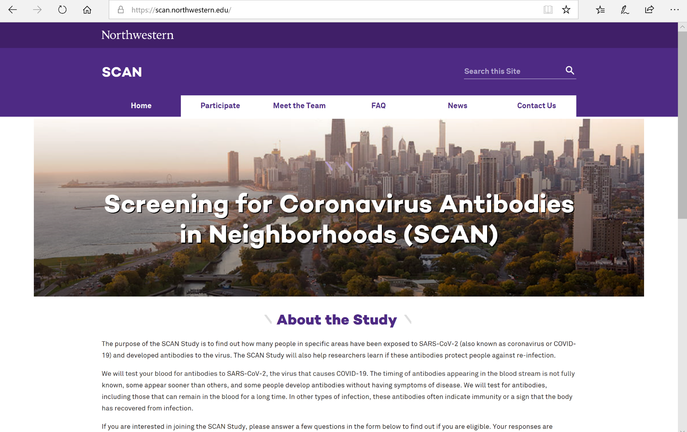

Slide 36

More than antibodies: Cellular immunity to SARS-CoV-2

Slide 37
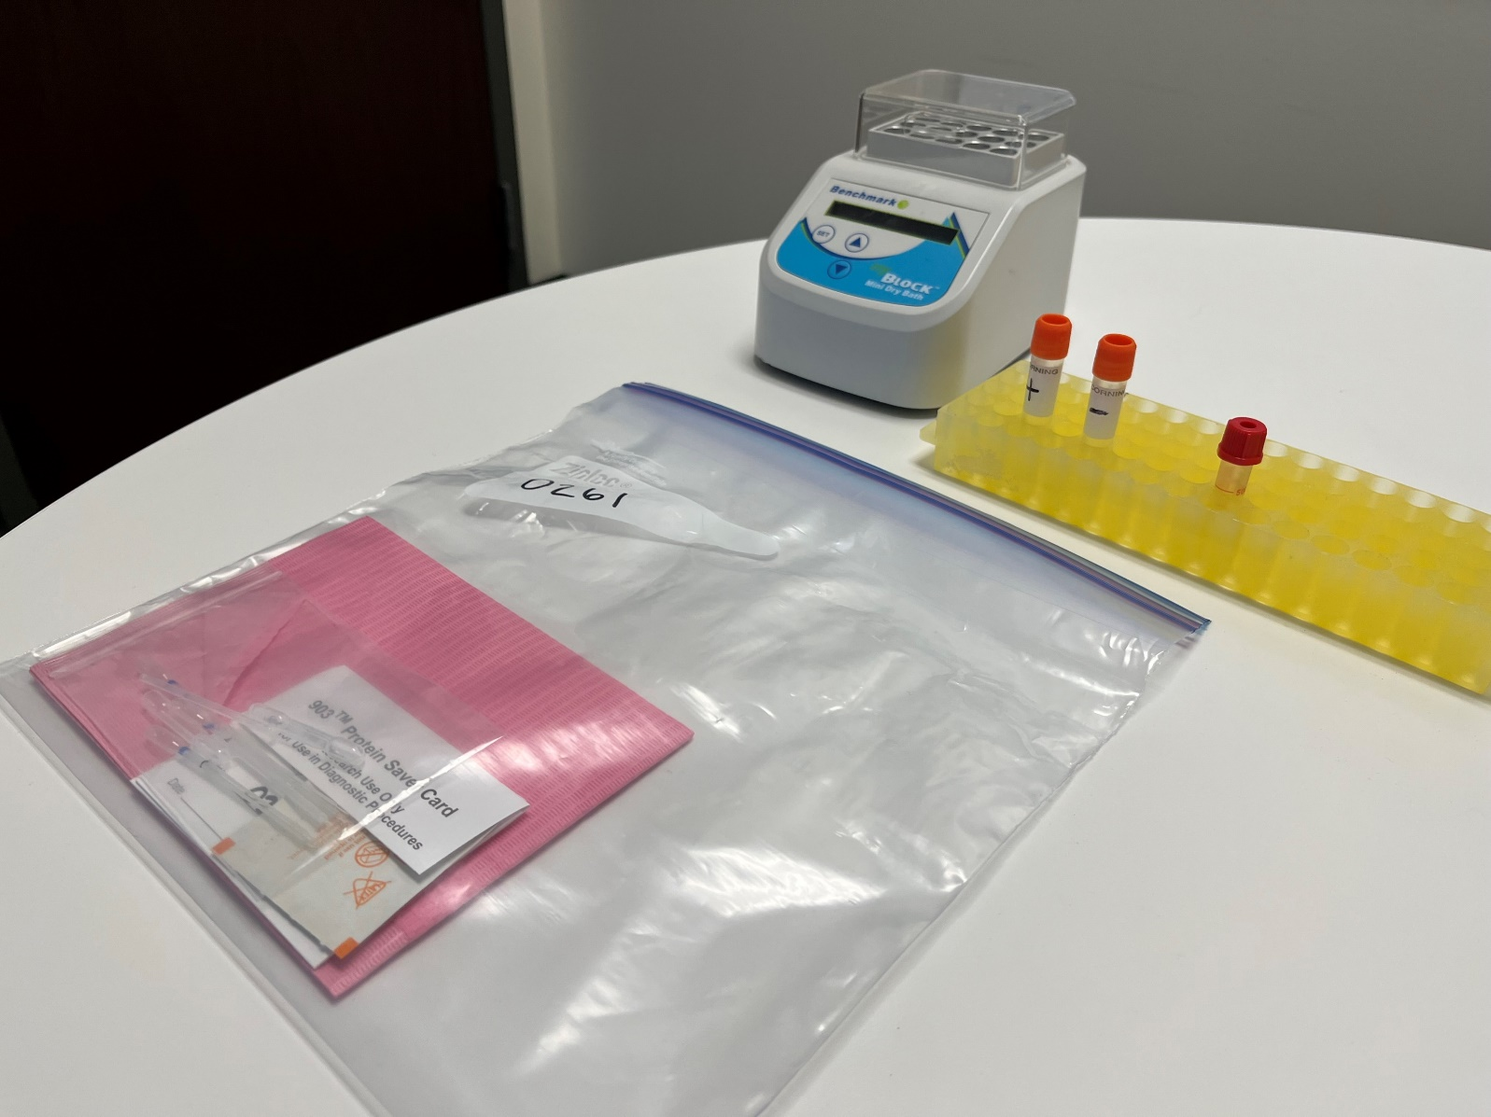
A miniaturized and portable cell culture system for SARS-CoV-2
Materials for blood collection and handling
Pre-loaded culture tubes
  Spike peptide pool @ 2 ug/mL
  Saline control
Portable incubator
Supported by:
The Center for Innovation in Point-of-Care Technologies for HIV/AIDS at Northwestern University (C-THAN) RADx Supplemental Request (PI: R. Murphy)

Slide 38

A miniaturized and portable cell culture system for SARS-CoV-2
Blood collection: Tasso+ autosampler
DBS cards
  Cultures transferred to DBS after incubation
  Reaction stops at transfer
  Sample preserved after collection
  Safe transport to lab

Slide 39

A miniaturized and portable cell culture system for SARS-CoV-2
Blood collection: Tasso+ autosampler
~500 uL whole blood collected in microtainer with NaHep

Slide 40

A miniaturized and portable cell culture system for SARS-CoV-2
100 uL whole blood transferred to each culture condition (volumetric pipet)

Slide 41

A miniaturized and portable cell culture system for SARS-CoV-2
Culture tubes loaded into incubator (37C) for 6 hours

Slide 42

A miniaturized and portable cell culture system for SARS-CoV-2
Cultures transferred to filter paper as DBS

Slide 43

A miniaturized and portable cell culture system for SARS-CoV-2
Cultures transferred to filter paper as DBS

Slide 44




A miniaturized and portable cell culture system for SARS-CoV-2
Samples quantified for cytokine concentrations as measure of cell-mediated immune response

Slide 45



Application: Long Immuno-DASH (LID)
Northwestern students in quarantine/isolation following COVID-19 exposure
Daily self-swabbing for viral testing on DASH platform
Self-collected whole blood on Day 0 and Day 7
sVNT (neutralizing antibodies)
Cell culture with
SARS-CoV-2 peptide pool
Anti-spike IgG

Slide 46

Application: Long-Immuno-DASH (LID)
sVNT (% neutralization)
Cytokine response (pg/mL)
ID |  | WT | Omicron | Delta |  | IL1b | IL2 | IL6 | TNFa | IFNg
277 |  | 0.868068 | 0.17861 | 0.726227
282 |  | 0.965882 | 0.470644 | 0.916439
272 |  | 0.996942 | 0.942265 | 0.992649 |  | 100.4587 | 0.847846 | 24.24619 | 5.318708 | 5.470804
295 |  | 0.996064 | 0.921088 | 0.990553 |  | 6.46873 | 0.023254 | 0.99018 | 0.442862 | 0.162663
299 |  | 0.996203 | 0.771823 | 0.991131 |  | 11.38758 | 0.503808 | 0.80542 | 0.6755 | 4.071425
302 |  | 0.967556 | 0.321446 | 0.916361 |  | 5.586212 | 0.093981 | 4.037702 | 2.187303 | 10.29946
276 |  | 0.997334 | 0.901681 | 0.993387 |  | 41.25075 | 0.605554 | 3.227516 | 2.173298 | 75.16714
275 |  | 0.993024 | 0.821989 | 0.985602 |  | 61.86978 | 3.426175 | 10.80864 | 2.84539 | 7.414807
284 |  | 0.826085 | 0.057353 | 0.658457
280 |  | 0.99802 | 0.917852 | 0.995762 |  | 6.728096 | 2.159978 | 1.091245 | 1.040232 | 7.2814
269 |  | 0.999042 | 0.989886 | 0.998181 |  | 15.84613 | 0.664261 | 1.153617 | 1.090313 | 19.77179
271 |  | 0.98939 | 0.634301 | 0.966952 |  | 1.723487 | 0.054416 | 0.31284 | 0.240125 | 0.435144
268 |  | 0.99942 | 0.984383 | 0.998824 |  | 10.12876 | 0.273355 | 0.453291 | 0.914009 | 10.27737

Slide 48


CRP response to vaccination and risk for CVD/peripheral artery disease
disease
Ankle-Brachial Index (ABI)
→ Measure of general CVD
→ Diagnostic for peripheral artery disease.
Notes:
Ratio of SBP in ankle to SBP in arm.

Slide 49
 | Model 1 |  | Model 2 |  | Model 3
 | B | 95% CI | B | 95% CI | B | 95% CI
CRP, baseline | -0.018* | -0.034, -0.001 | -0.005 | -0.023, 0.012 | -0.0100 | -0.027, 0.008
CRP response |  |  | 0.037** | 0.011, 0.063 | 0.033* | 0.008, 0.059
Age | 0.000 | -0.001, 0.001 |  |  | 0.000 | -0.001, 0.001
Fat free mass | 0.002* | 0.000, 0.004 |  |  | 0.002* | 0.000, 0.004
Education | -0.001 | -0.003, 0.001 |  |  | -0.001 | -0.003, 0.001
Assets | 0.001 | -0.004, 0.005 |  |  | 0.001 | -0.004, 0.005
Daily smoker | -0.033* | -0.060, -0.006 |  |  | -0.031* | -0.058, -0.005
Anti-inflam meds | -0.009 | -0.042, 0.024 |  |  | -0.009 | -0.042, 0.024
Cardiovascular meds | -0.033** | -0.053, -0.014 |  |  | -0.034** | -0.054, -0.015
?
ABI
?
Change in CRP (mg/L)
Higher CRP response to vaccine
Lower CVD/PAD

Slide 50
Back to basics
What does inflammation look like across populations, across ecologies?
What factors contribute to variation in the regulation of inflammation?
What are the implications for the effects of inflammation on dx?
Notes:
First order question: Natural history and variation of inflammation
Second: how does development matter?
Third: Only after addressing 1 and 2 can we understand how social environments matter to inflammation and chronic dx

