Slide 1
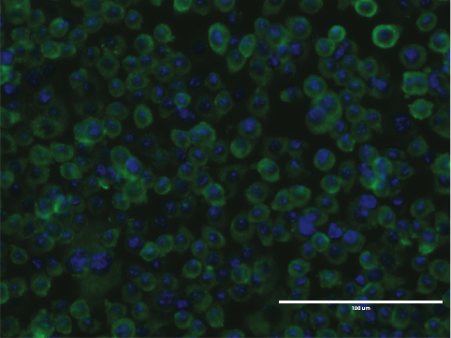
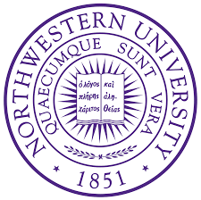
Improving vaccines for SARS-CoV-2 and other coronaviruses
Pablo Peñaloza-MacMaster
Assistant Professor
Northwestern University
11-08-2021

Slide 2
Questions on SARS-CoV-2 vaccines…
1. Does inclusion of another viral antigen (nucleocapsid) improve vaccine efficacy?
2. What is the effect of vaccine fractionation?
3. Can current vaccines protect against other CoVs?

Slide 3
Does inclusion of another viral antigen (nucleocapsid)
improve vaccine efficacy?

Slide 4
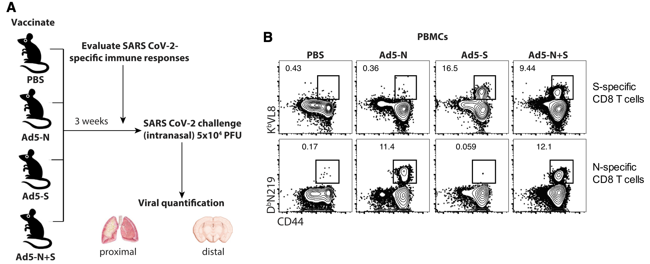
Does inclusion of another viral antigen (nucleocapsid)
improve vaccine efficacy?
K18-hACE2 mice
Dangi, Cell Reports, 2021

Slide 5
CD8 T cell responses following vaccination
K18-hACE2 mice
Dangi, Cell Reports, 2021

Slide 6
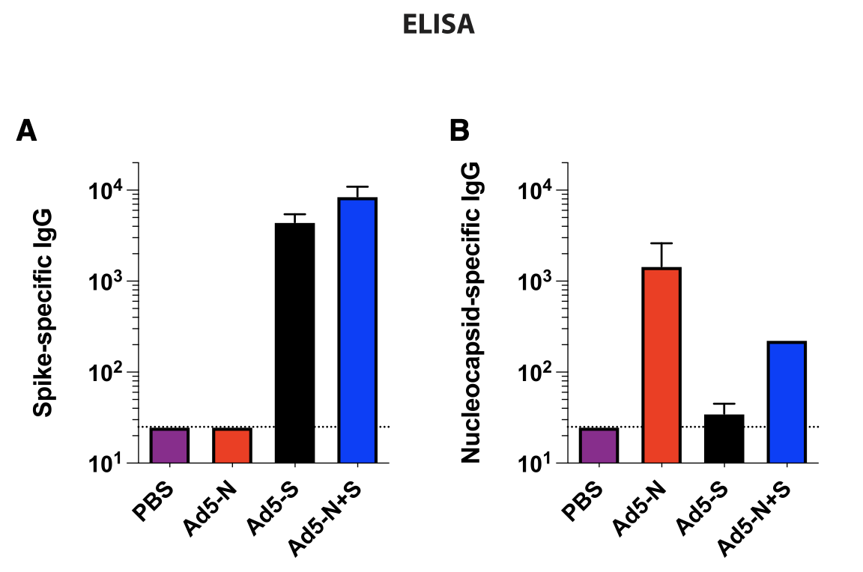
Antibody responses following vaccination
K18-hACE2 mice
Dangi, Cell Reports, 2021

Slide 7
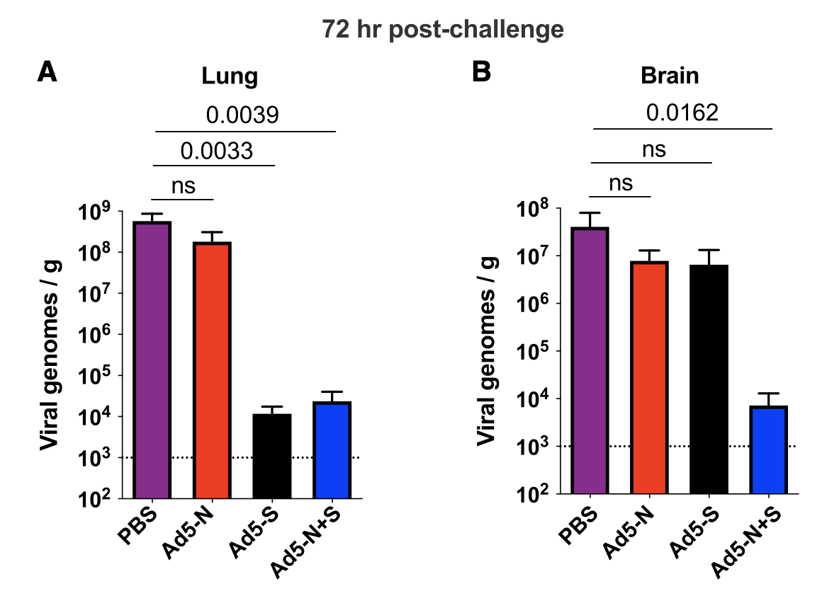
Inclusion of both spike and nucleocapsid improves the control of a
breakthrough SARS-CoV-2 infection
K18-hACE2 mice
Dangi, Cell Reports, 2021

Slide 8
Inclusion of both spike and nucleocapsid improves the control of a
breakthrough SARS-CoV-2 infection
K18-hACE2 mice
Dangi, Cell Reports, 2021

Slide 9
These data warrant the inclusion of nucleocapsid (and perhaps other Ag) in next generation SARS-CoV-2 vaccines.

Slide 10
What is the effect of vaccine fractionation?
Vaccine doses are still limited in many parts of the world,
leading health authorities to consider vaccine fractionation
(Dose Sparing).

Slide 11
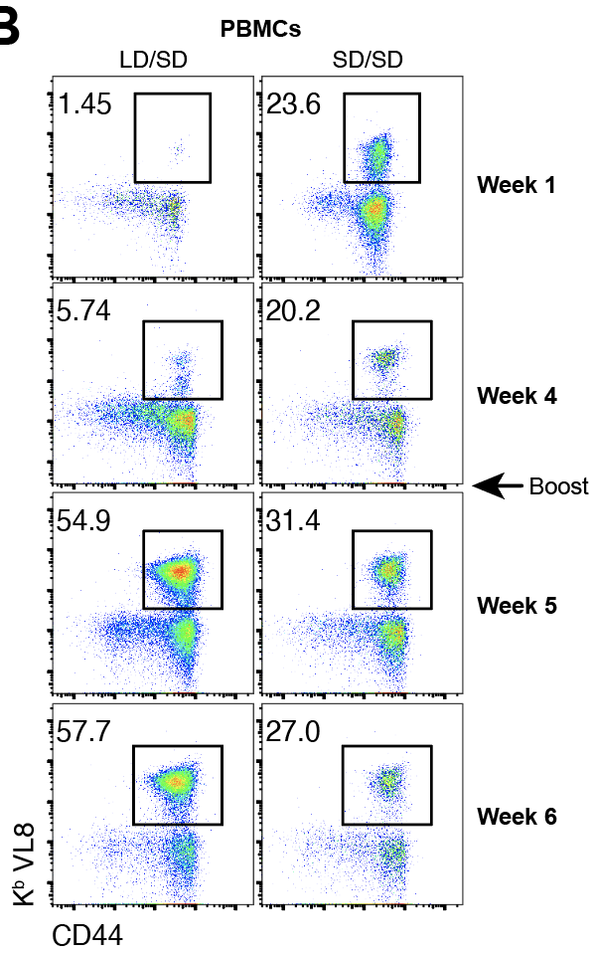
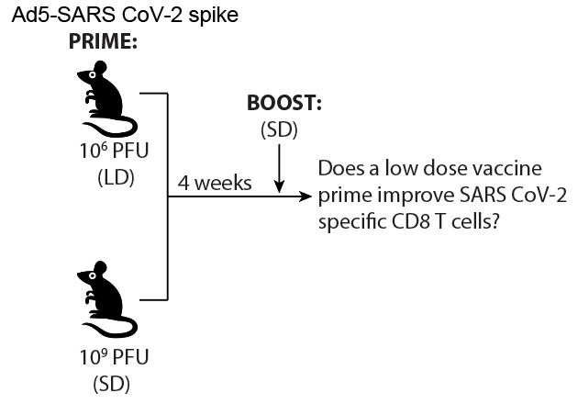
CD8 T cell responses following vaccine fractionation

Slide 12
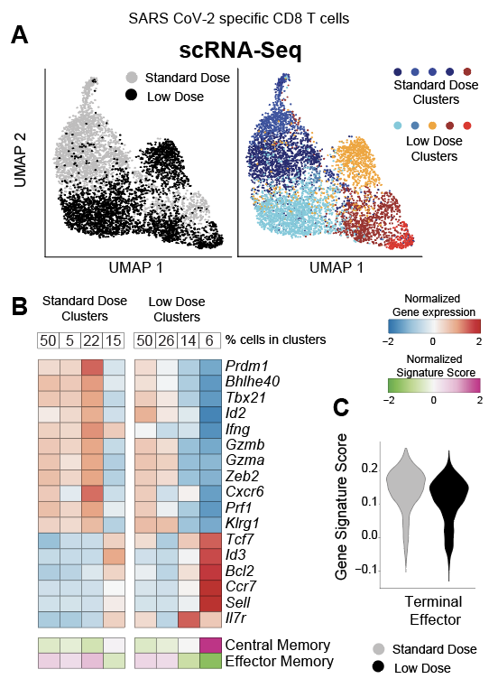
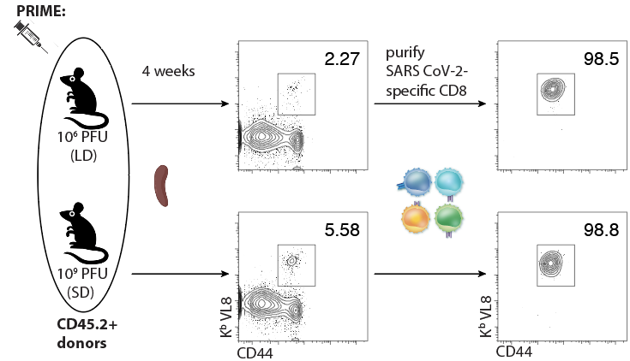
A low dose (LD) vaccine prime elicits a biased Tcm>Tem response
Gene expression analyses (scRNA-seq)
K^{b}VL8+ CD8 T cells (SARS-specific)

Slide 13
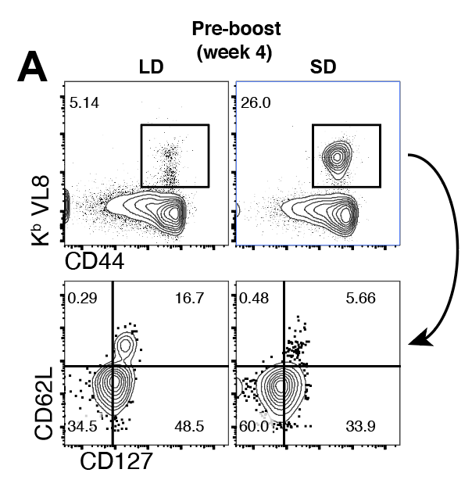
A low dose (LD) vaccine prime elicits a biased Tcm>Tem response
K^{b}VL8+ CD8 T cells (SARS-specific)

Slide 14
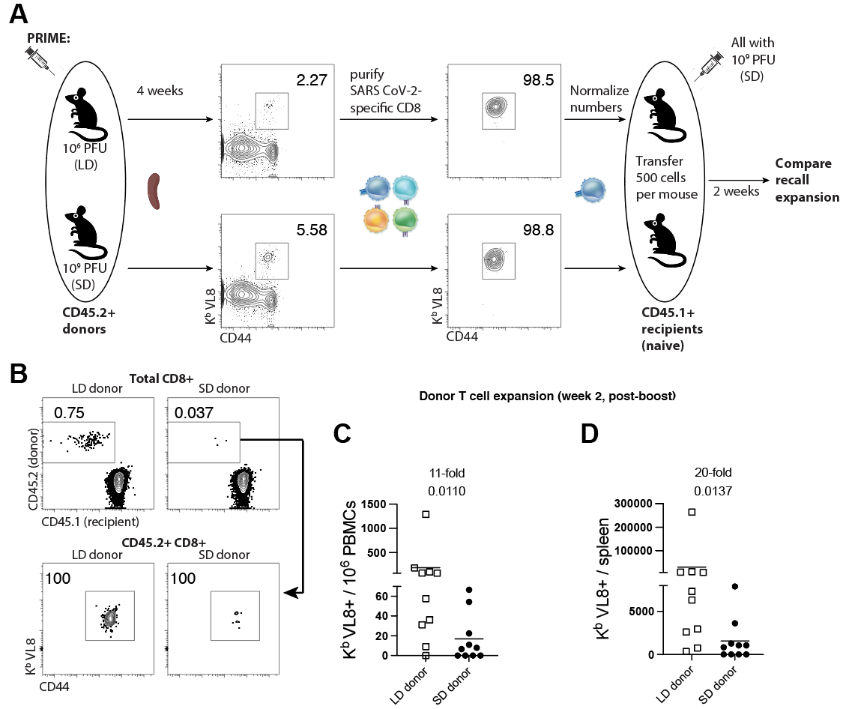
A low dose (LD) vaccine prime elicits CD8 T cells with improved anamnestic capacity

Slide 15
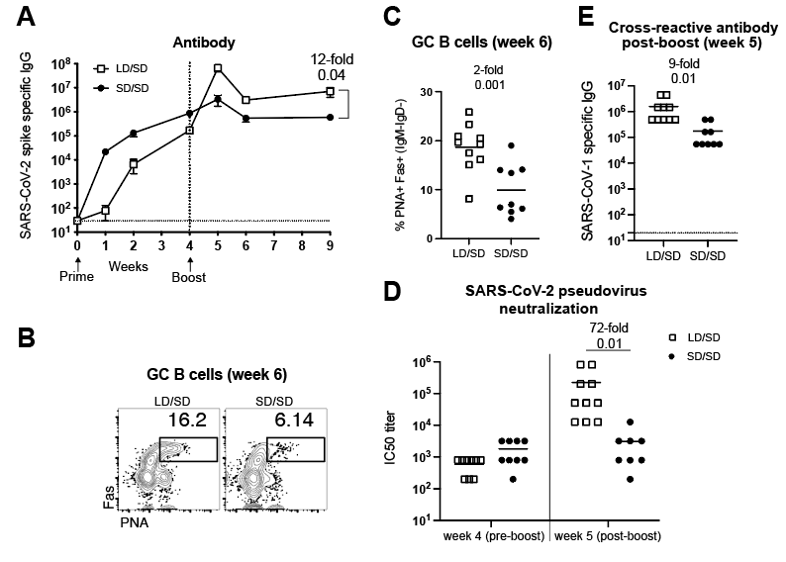
Antibody responses following vaccine fractionation

Slide 16
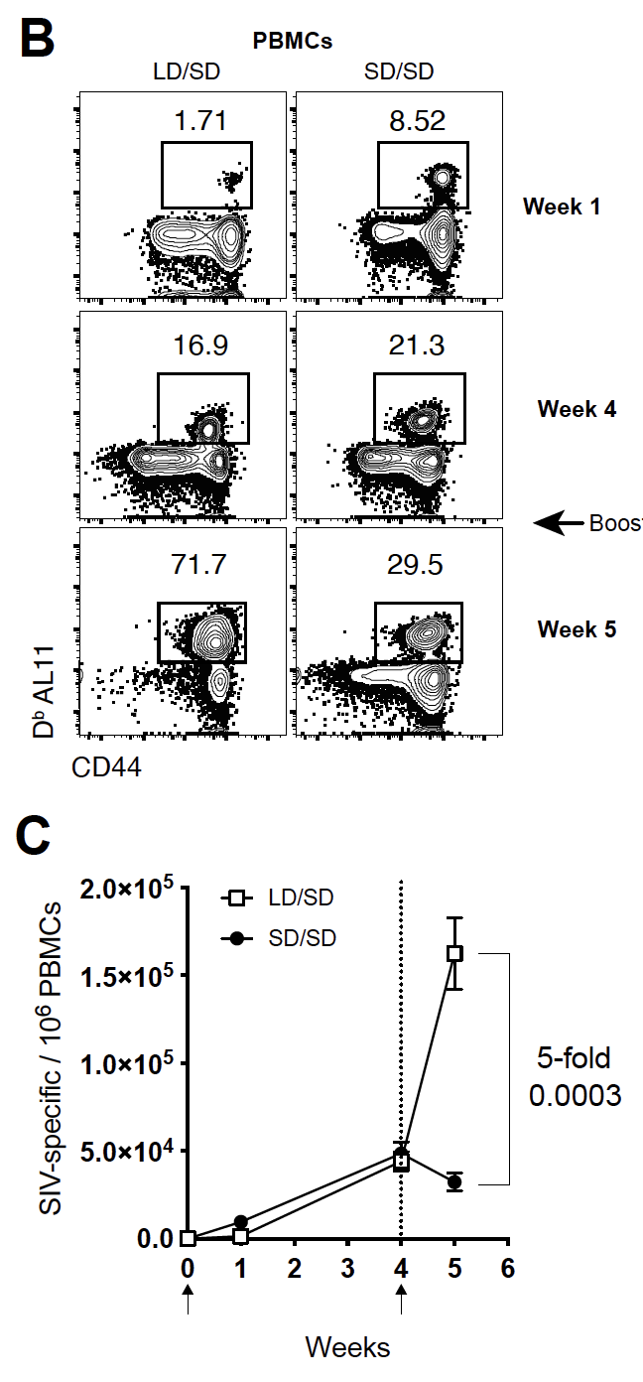
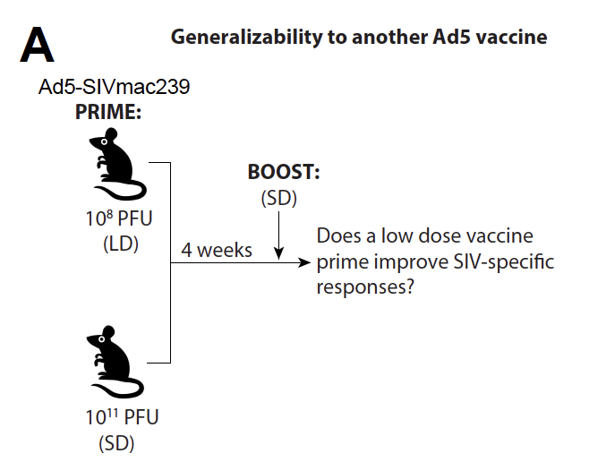
Can this effect be observed with another Ad5 vector?

Slide 17
These data suggest that fractionating Ad5-vectored vaccines (SARS or SIV) may confer an immunological advantage.
However, an important consideration is that starting with a LD may allow more breakthrough infections before the boost.

Slide 18
Can current vaccines protect against other CoVs?
Collaboration with Drs. Igor Koralnik and Lavanya Visvabharathy
(Division of Neuro-Infectious Diseases & Global Neurology)

Slide 19
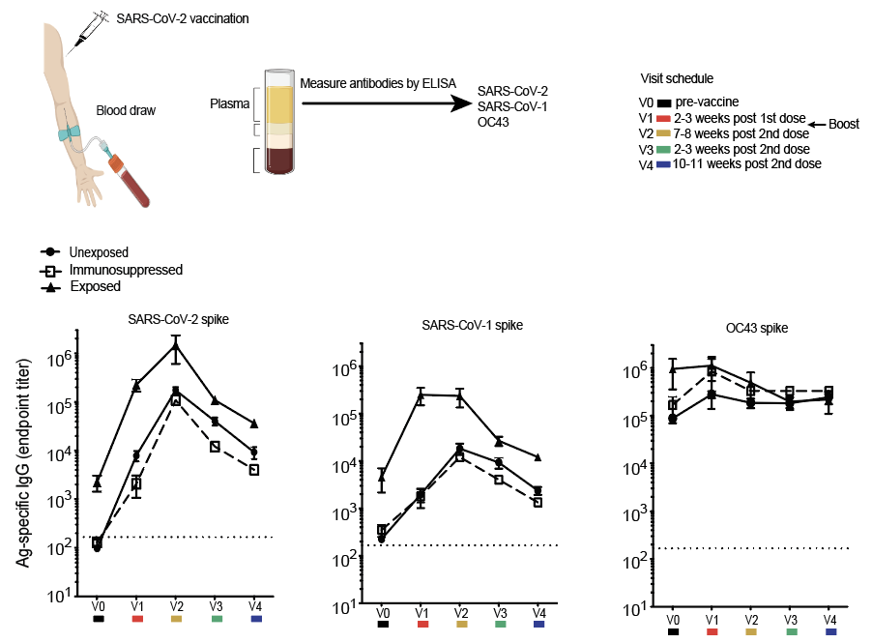
SARS-CoV-2 vaccines induce cross-reactive antibody in humans

Slide 20
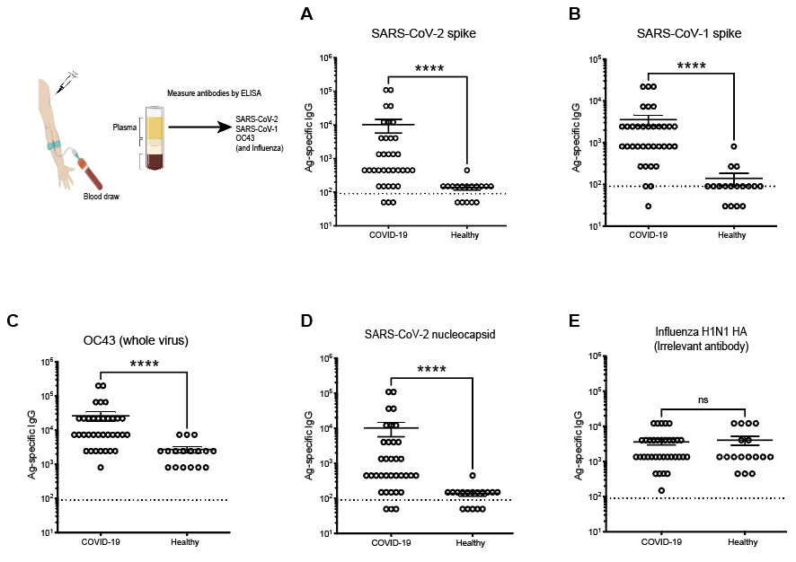
SARS-CoV-2 infection induces cross-reactive antibody in humans
COVID-19
patients

Slide 21
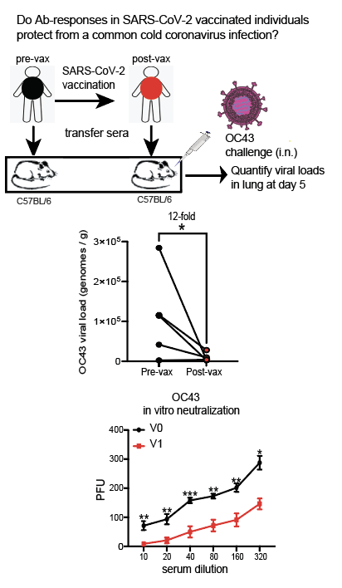
Sera from vaccinated people protect against OC43
PRNT

Slide 22
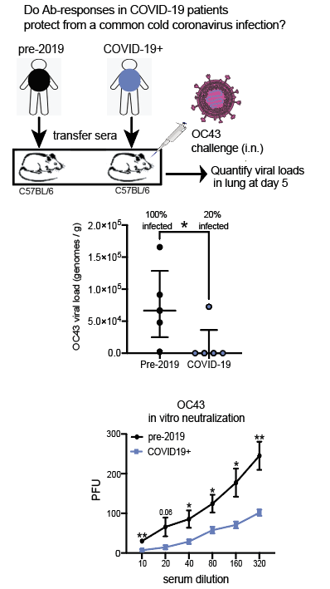
Sera from COVID-19 patients protect against OC43
PRNT

Slide 23
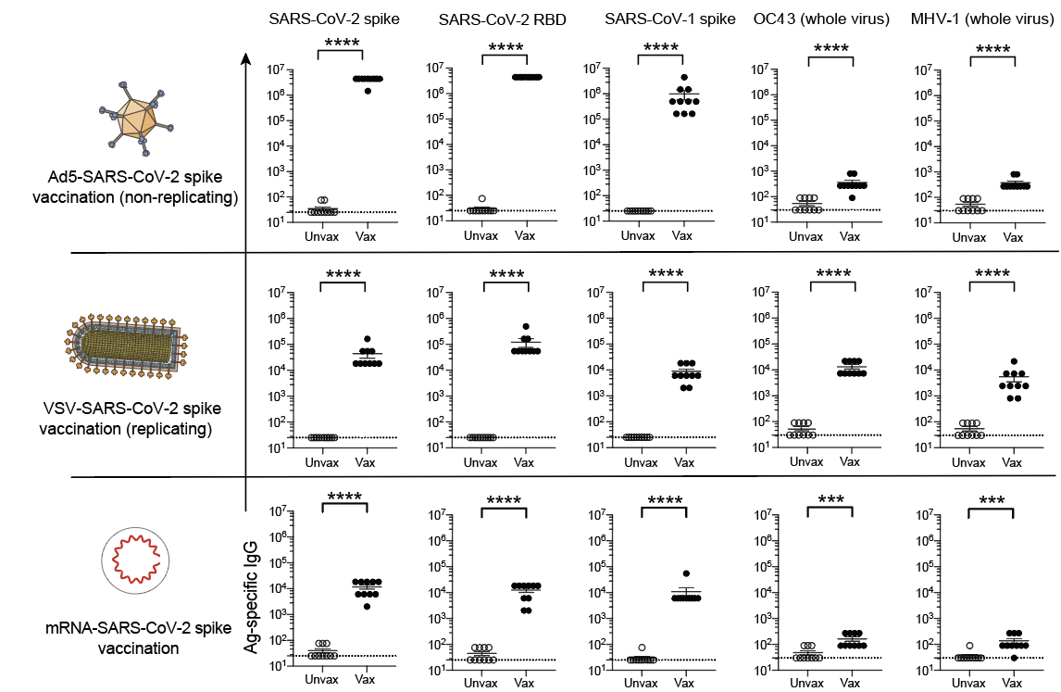
SARS-CoV-2 vaccines also induce cross-reactive antibody in mice

Slide 24
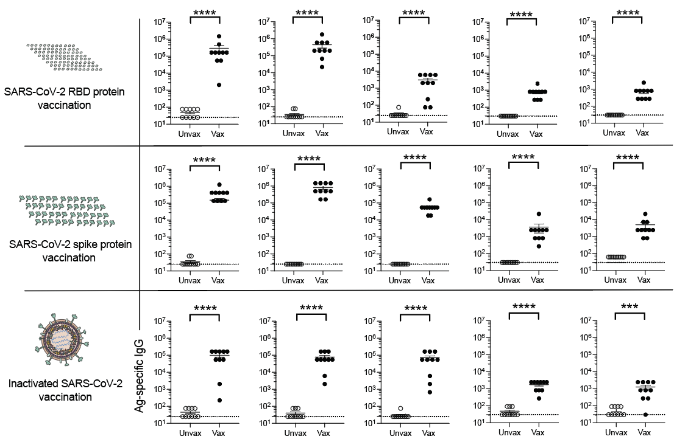
SARS-CoV-2 vaccines also induce cross-reactive antibody in mice

Slide 25
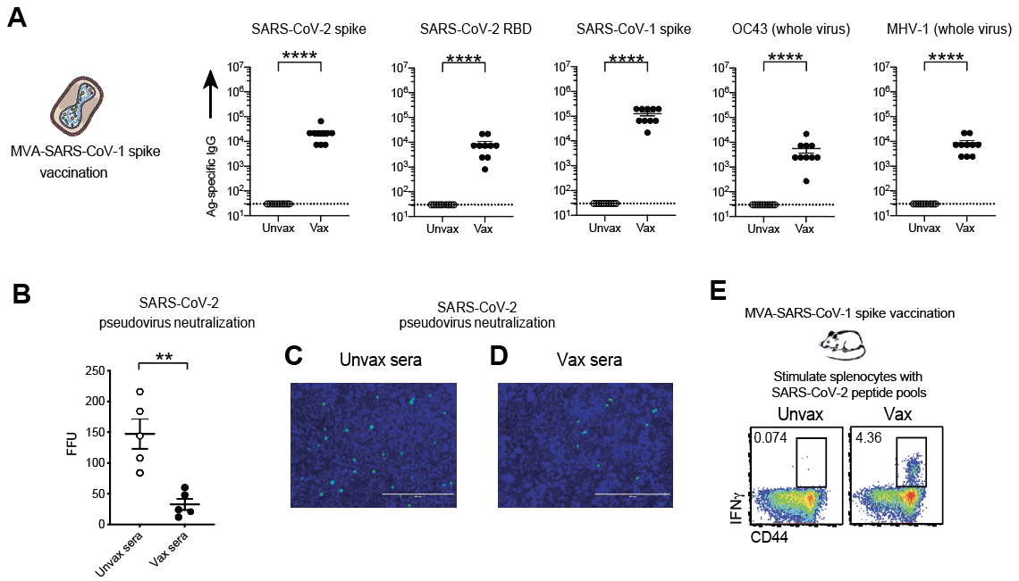
A SARS-CoV-1 vaccine also induces cross-reactive antibody in mice

Slide 26
Does a SARS-CoV-1 vaccine protect against SARS-CoV-2?

Slide 27
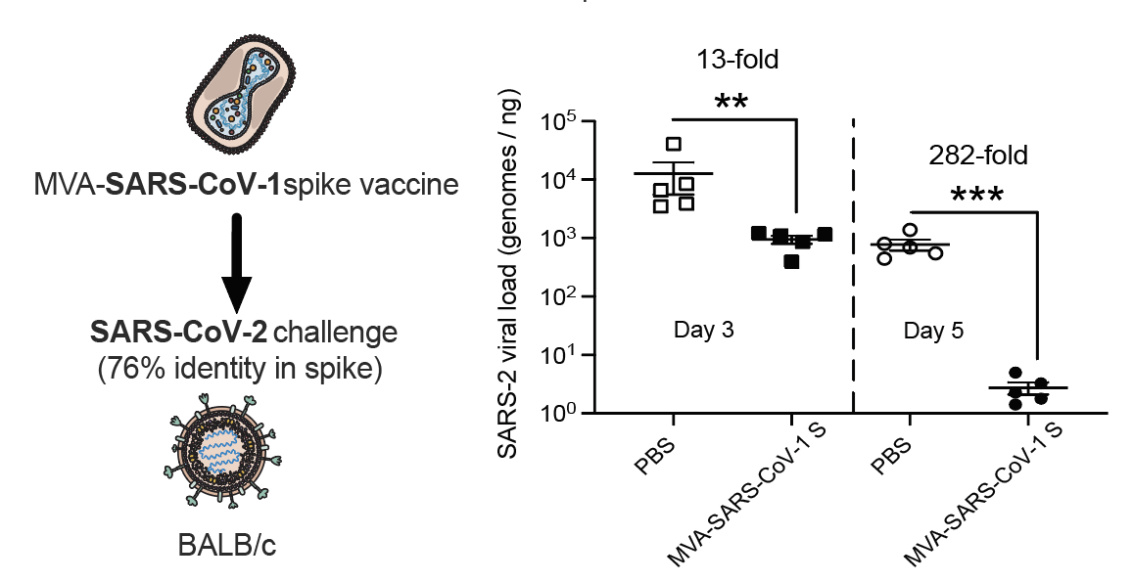
A SARS-CoV-1 vaccine protects against SARS-CoV-2
Mouse Adapted (MA) SARS-CoV-2

Slide 28
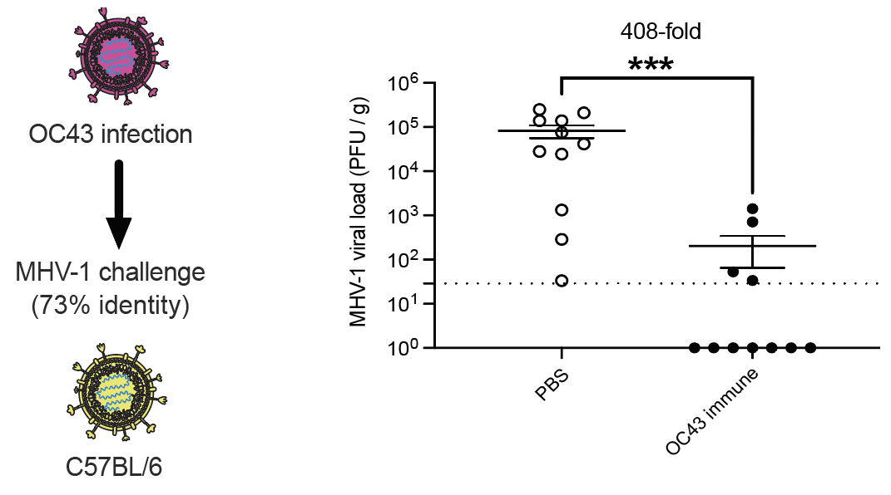
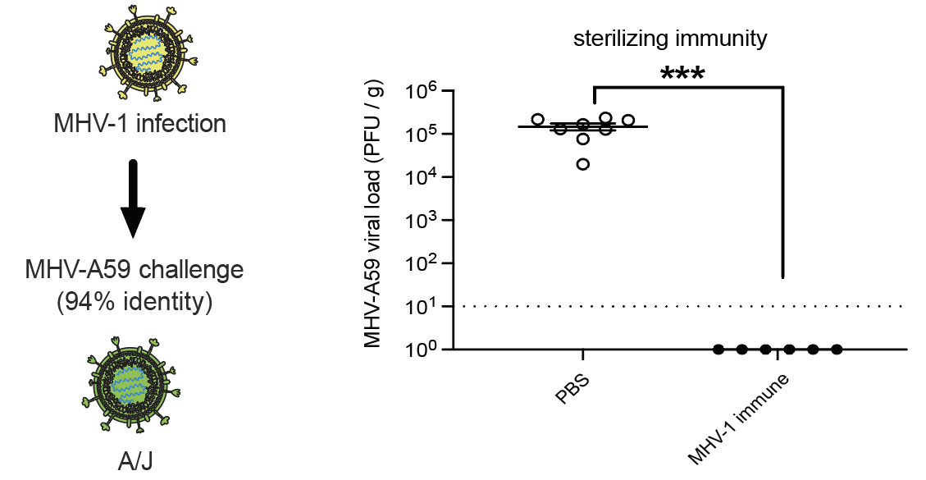
Do prior coronavirus infections protect against other coronaviruses?

Slide 29
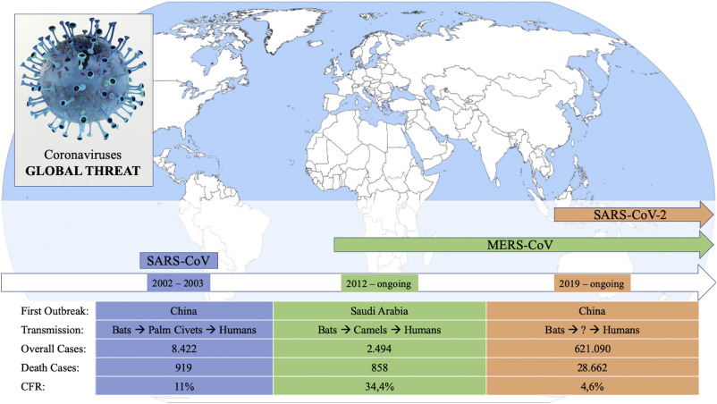
Conclusions:
These data warrant the inclusion of nucleocapsid in next generation
coronavirus vaccines.
Dose sparing an Ad-based vaccine confers an unexpected immunological benefit.
Coronavirus vaccines do not need to be 100% Ag-matched – Consider making a stockpile of vaccine candidates based on known viral sequences; could be rapidly tested in future epidemics?
SARS-CoV-3 ?

Slide 30
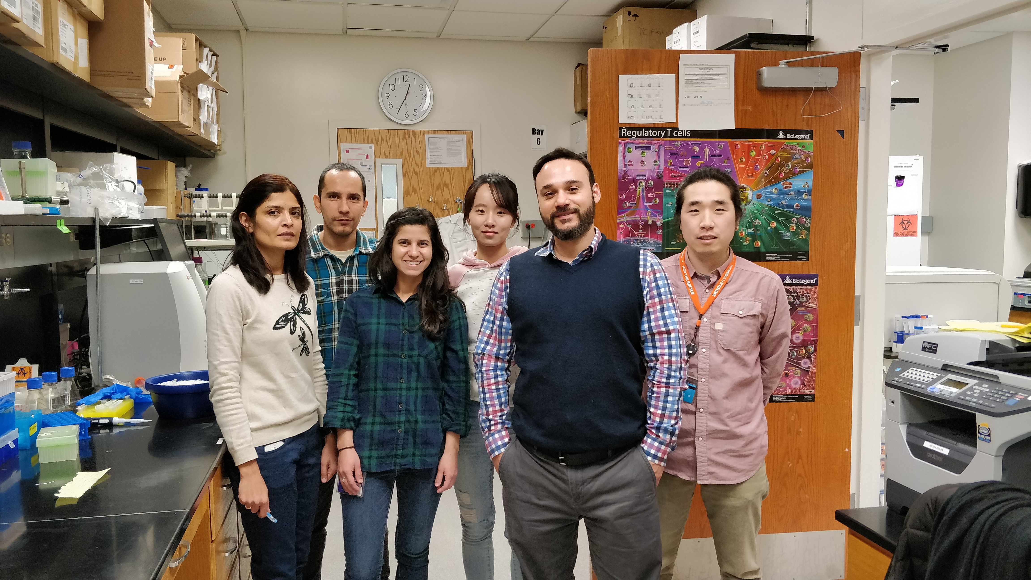
Acknowledgements:
Penaloza Lab
Nicole Palacio
Tanushree Dangi
Sarah Sanchez
Mincheol Park
Young Rock Chung
Bakare Awaikoaiye
NIH Tetramer Core
University of Pennsylvania:
Susan Weiss
Loyola:
Tom Gallagher
Northwestern University
Igor Koralnik/Lavanya Visvarathy
University of Illinois in Chicago
Justin Richner
Disclosure:
Peñaloza-MacMaster holds provisional patent application to improve
CoV vaccines by IFN-I modulation.
Funding (Current):
-NIH New Innovator Award (Avenir DP2)
-Diversity Supplement DP2
-Emerging and Re Emerging Pathogens Program (EREPP)
-U54 RADx with Dr. Robert Murphy
-Northwestern Startup funds
Prior:
Third Coast Centers for AIDS Research (CFAR)
American Cancer Society (ACS)
NIH (R21)
NIH (K22)

