Slide 1
The Public’s Attitudes About and Experiences with Covid 19 Vaccinations
KFF COVID-19 Vaccine Monitor
Mollyann Brodie, PhD
EVP, COO, Executive Director Public Opinion and Survey Research

Slide 2
KFF COVID-19 Vaccine Monitor: Project Overview
KFF is a nonprofit organization focusing on national health issues. We develop and run our own policy analysis, journalism and communications programs, sometimes in partnership with major news organizations.
Our Vaccine Monitor uses monthly surveys to track the dynamic nature of public opinion/experience on COVID-19 vaccines, including:
vaccine confidence and intentions
trusted messengers and messages
information needs
experiences
Method: probability-based sampling, RDD cell phone and landline, English and Spanish
Special focus on at-risk populations, Black and Latino adults, rural residents, parents
Goal: To provide public health, policy, advocacy and community organizations and communication experts with in-depth data to help them meet people where they are, so individuals can make decisions that best protect themselves and their families.

Slide 3
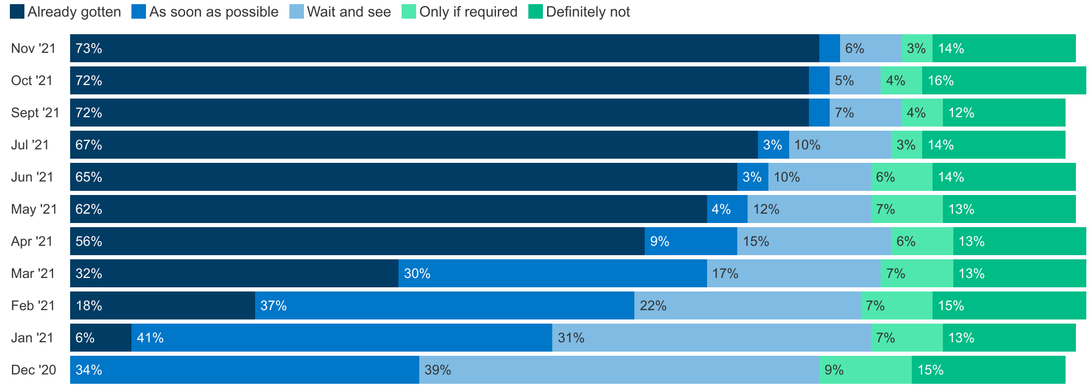
Trends In COVID-19 Vaccine Uptake And Intentions
Have you personally received at least one dose of the COVID-19 vaccine, or not? As you may know, an FDA-authorized vaccine for COVID-19 is now available for free to all adults in the U.S. Do you think you will…?
4%
4%
3%
NOTE: See topline for full question wording.
SOURCE: KFF COVID-19 Vaccine Monitor

Slide 4
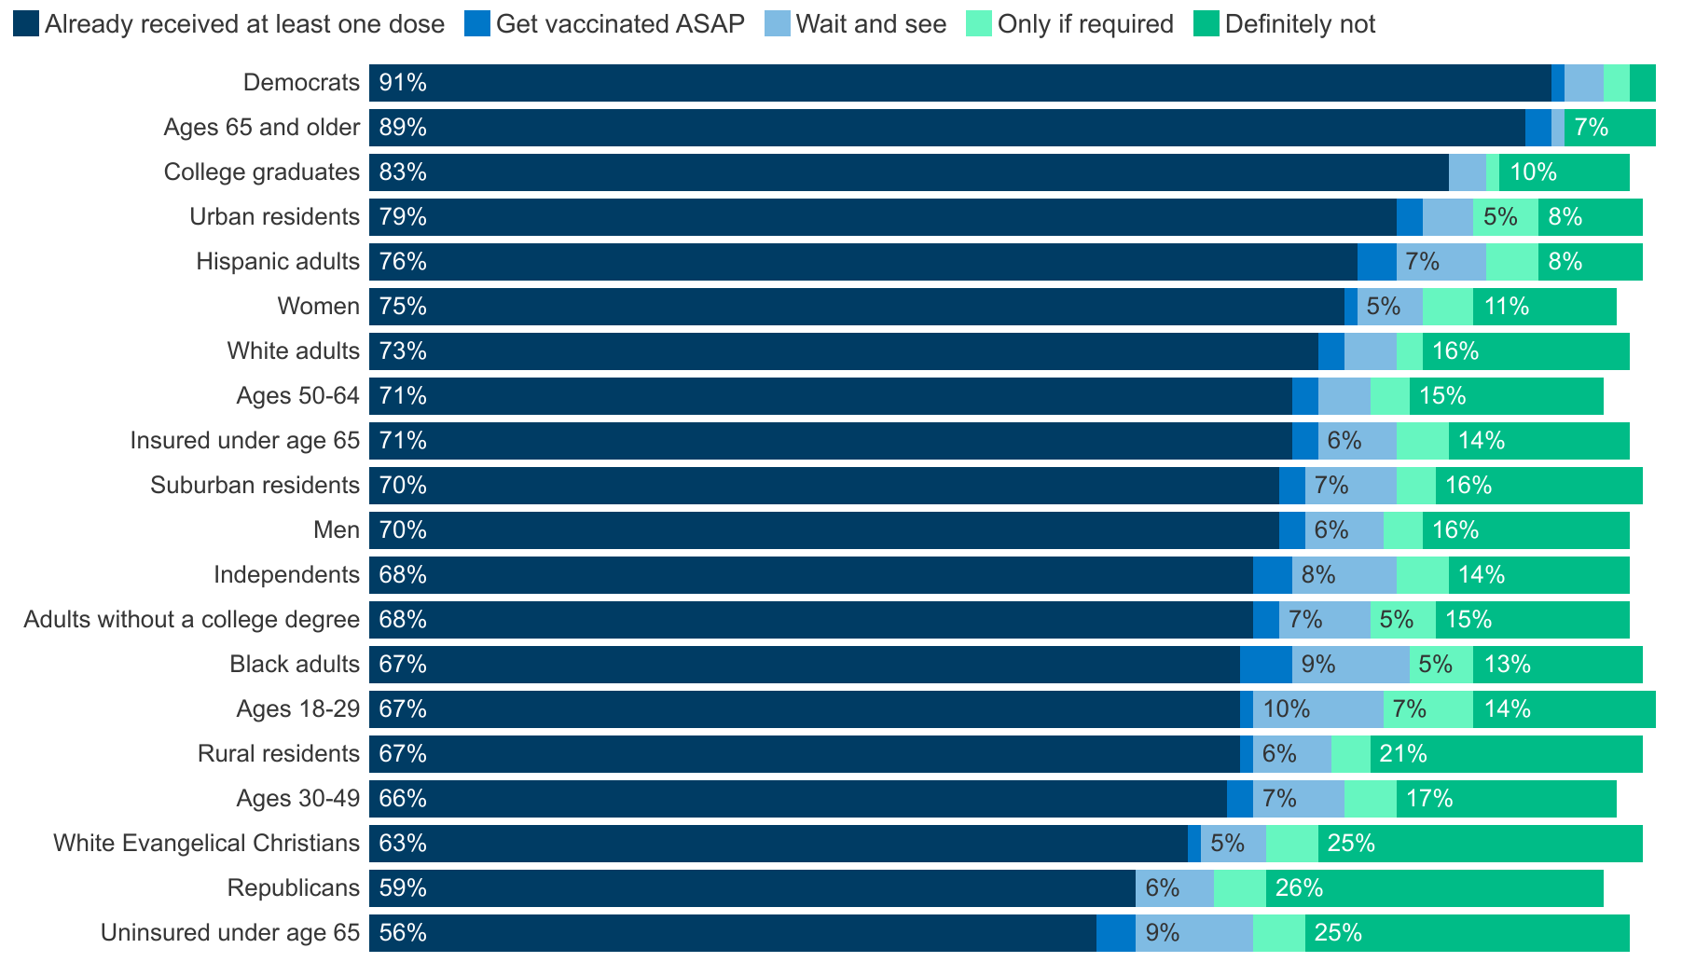
Who Is Most/Least Likely To Be Vaccinated?
NOTE: See topline for full question wording.
SOURCE: KFF COVID-19 Vaccine Monitor (November 8-22, 2021)

Slide 5
Partisan Makeup Of Unvaccinated Has Become Increasingly Republican Over Time
NOTE: Party identification includes independents who lean towards either party. The difference between percent unvaccinated in Sept. (25%) and Oct. (27%) is within the margin of error. See topline for full question wording.
SOURCE: KFF COVID-19 Vaccine Monitor, 2021
Notes:
Partisanship also an issue for booster doses and shots for kids

Slide 6
Why Unvaccinated Won’t Get a Vaccine?
The vaccine is too new
They are worried about side effects
Misinformation about the vaccine’s safety and effectiveness, including that it causes infertility
They “just don’t want to get the vaccine”
They do not trust the government
They don’t believe the COVID-19 vaccine is safe or don’t trust vaccines in general
Concerns about accessibility, having to miss work to get it or recover from side effects
Too busy to get vaccinated, or cannot get an appointment at a convenient time or place they trust
Barriers to access including worries about having to show ID or prove citizenship, worries that they will have to pay out-of-pocket for the vaccine

Slide 7
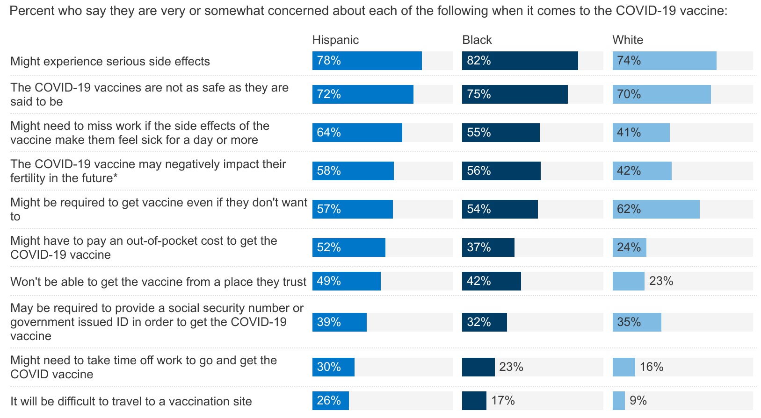
Concerns/Barriers Vary Widely By Race/Ethnicity
NOTE: Among those who have not been vaccinated for COVID-19. *Item only asked of those ages 18-49. See topline for full question wording.
SOURCE: KFF COVID-19 Vaccine Monitor (April 15-29, 2021)

Slide 8
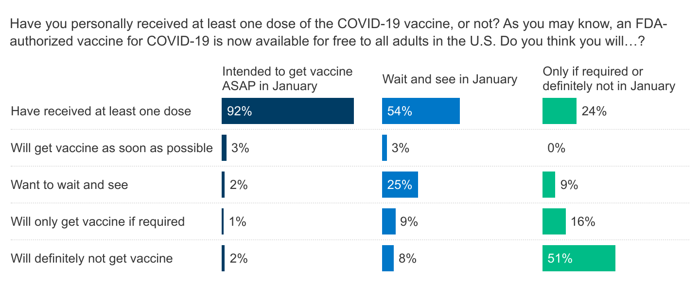
Capturing Dynamic Nature: By June, Vast Majority Of January ASAP Group And About Half Of "Wait And See“ Group Got Vaccinated
NOTE: See topline for full question wording.
SOURCE: KFF COVID-19 Vaccine Monitor (Jan. 14-18, 2021 and June 15-23, 2021)

Slide 9
Family, Friends, And Conversations With Doctors Were Key In People’s Decisions About Getting Vaccinated
Q: What did you learn or hear that persuaded you to get vaccinated?
I became convinced that some of the rumored side effects were not true..
My daughter is a doctor and she got vaccinated which was reassuring that it was okay to get vaccinated.
My family persuaded me because of my sick kids.
Almost all of my friends were vaccinated with no side effects.
My husband bugged me to get it and I gave in.
My asthma doctor recommended I get it.
NOTE: See topline for full question wording.
SOURCE: KFF COVID-19 Vaccine Monitor (Jan. 14-18, 2021 and June 15-23, 2021)

Slide 10
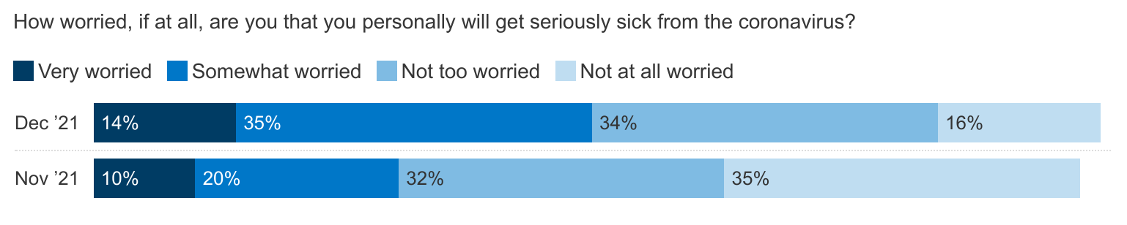
Amidst Omicron Threat, Half Now Say They Are Worried They Will Get Seriously Sick From Coronavirus
NOTE: See topline for full question wording.
SOURCE: KFF COVID-19 Vaccine Monitor

Slide 11
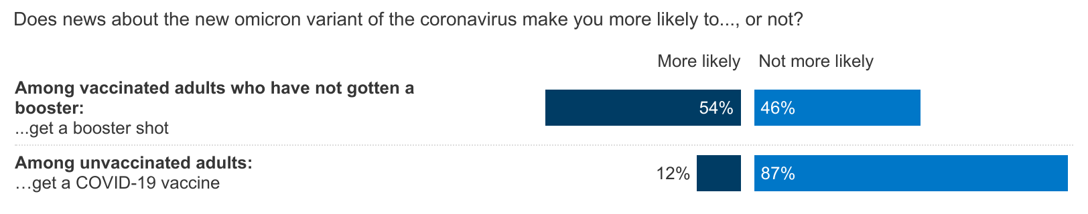
About Half Of Vaccinated Adults Who Aren’t Boosted Say The Omicron Variant Makes Them More Likely To Do So, One In Eight Unvaccinated Adults Say Omicron Motivates Them To Get Vaccinated
NOTE: Vaccinated adults are those who have received at least one dose of a COVID-19 vaccine. See topline for full question wording.
SOURCE: KFF COVID-19 Vaccine Monitor: Early Omicron Update (Dec. 15-20, 2021)

Slide 12
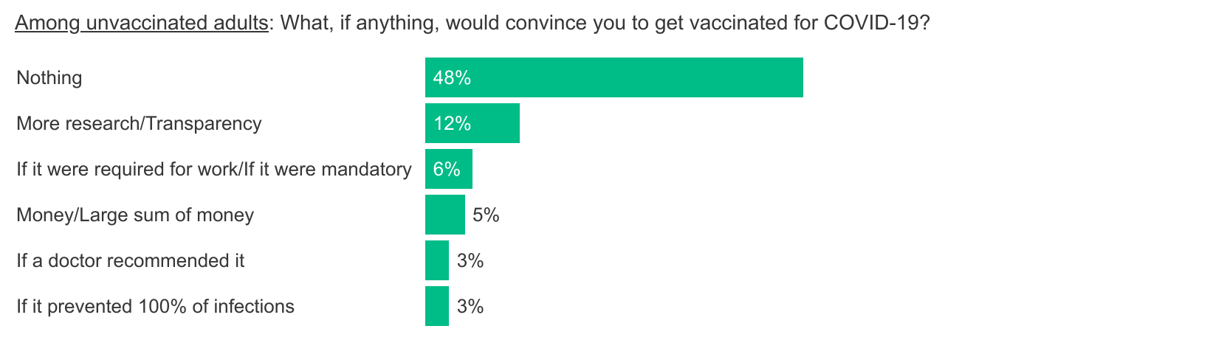
About Half Of Unvaccinated Adults Say Nothing Will Convince Them To Get A COVID-19 Vaccine
NOTE: Among adults who have received at COVID-19 vaccine. Responses over 2% shown. See topline for full question wording.
SOURCE: KFF COVID-19 Vaccine Monitor: Early Omicron Update (Dec. 15-20, 2021)

Slide 13
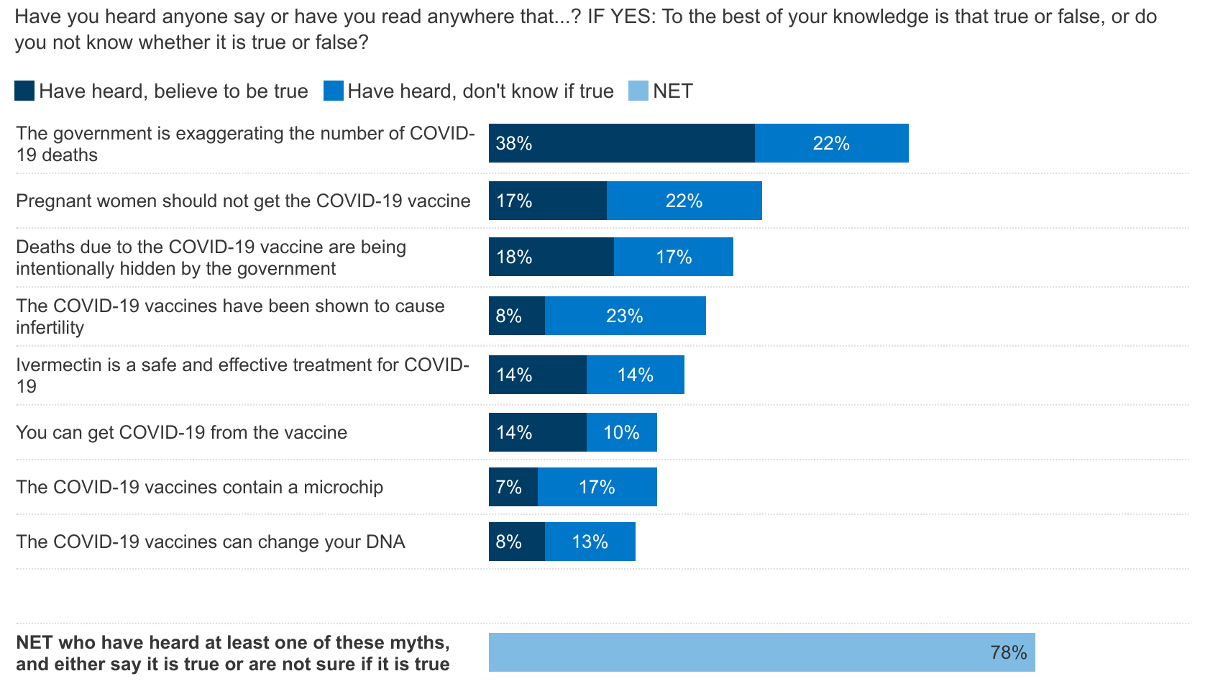
Nearly Eight In Ten Believe Or Are Unsure About At Least One Common Falsehood About COVID-19 Or The Vaccine
NOTE: See topline for full question wording.
SOURCE: KFF COVID-19 Vaccine Monitor (October 14-24, 2021)

Slide 14
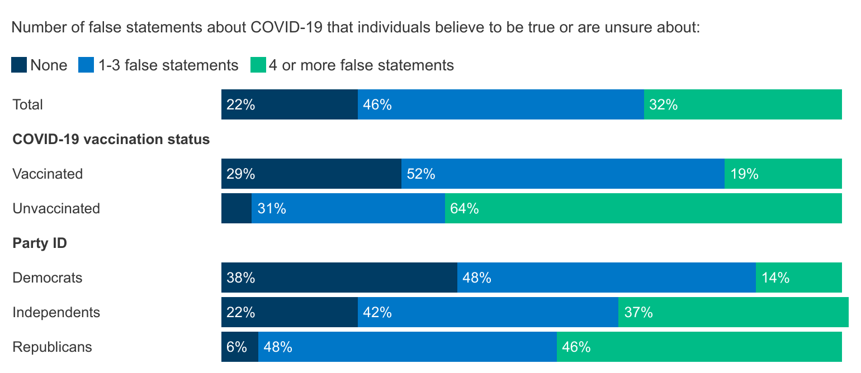
One-Third Believe Or Are Unsure Of 4+ False Statements About COVID-19, Higher Among Republicans And Unvaccinated
5%
NOTE: Vaccinated adults are those who have received at least one dose of a COVID-19 vaccine. See topline for full question wording.
SOURCE: KFF COVID-19 Vaccine Monitor (October 14-24, 2021)

Slide 15
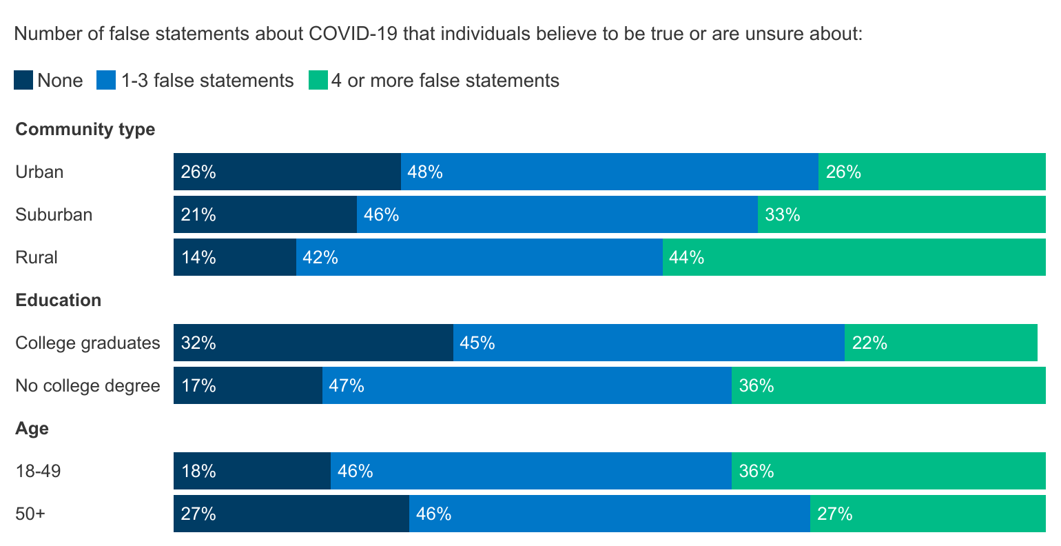
Rural Residents, Those Without College Degrees, And Younger Adults Somewhat More Likely To Believe COVID-19 Misinformation
NOTE: See topline for full question wording.
SOURCE: KFF COVID-19 Vaccine Monitor (October 14-24, 2021)

Slide 16
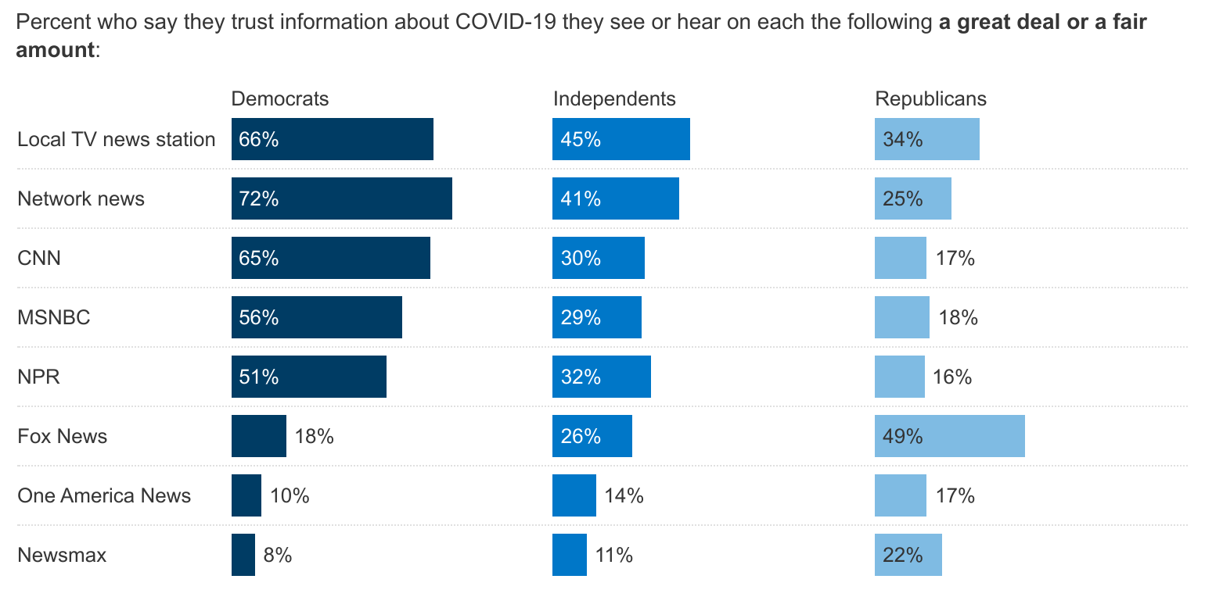
Democrats And Republicans Trust Different News Sources For COVID-19 Information
NOTE: See topline for full question wording.
SOURCE: KFF COVID-19 Vaccine Monitor (October 14-24, 2021)

Slide 17
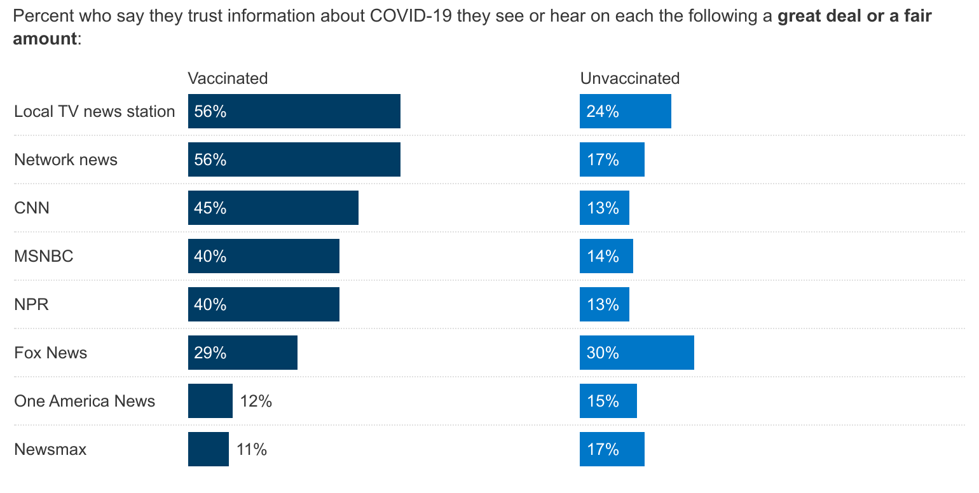
Unvaccinated Adults Have Lower Trust In Most News Sources For COVID-19 Information Compared To Vaccinated Adults
NOTE: Vaccinated adults are those who have received at least one dose of a COVID-19 vaccine. See topline for full question wording.
SOURCE: KFF COVID-19 Vaccine Monitor

Slide 18
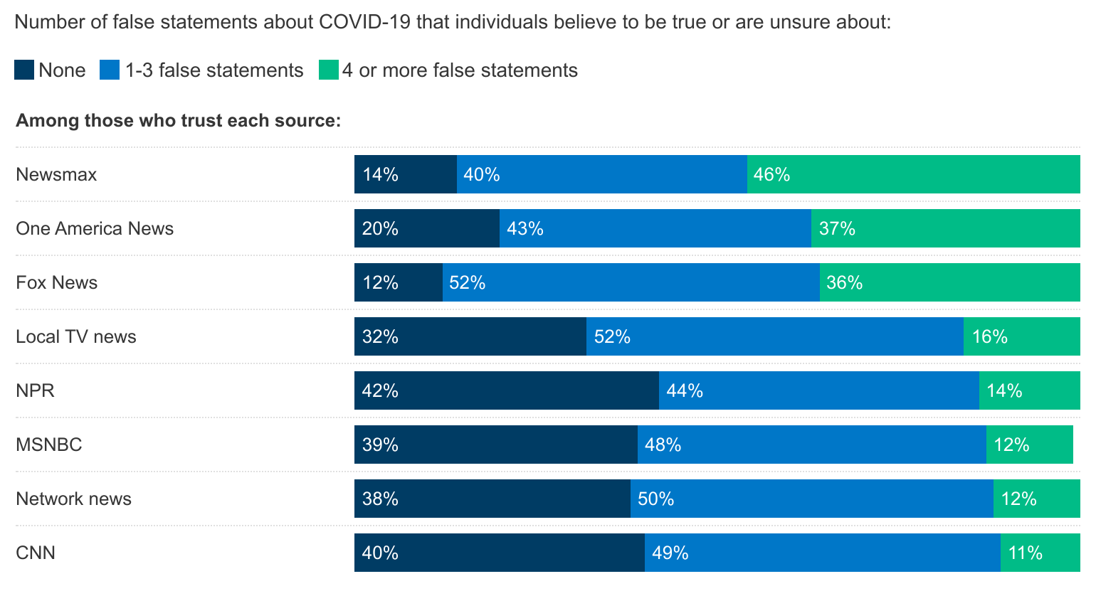
Belief In Misinformation Differs Based On Trusted News Sources For COVID-19 Information
NOTE: Group that trusts each media source defined as those who say they trust COVID-19 information they see or hear from this source “a great deal” or “a fair amount.” See topline for full question wording.
SOURCE: KFF COVID-19 Vaccine Monitor (October 14-24, 2021)

Slide 19
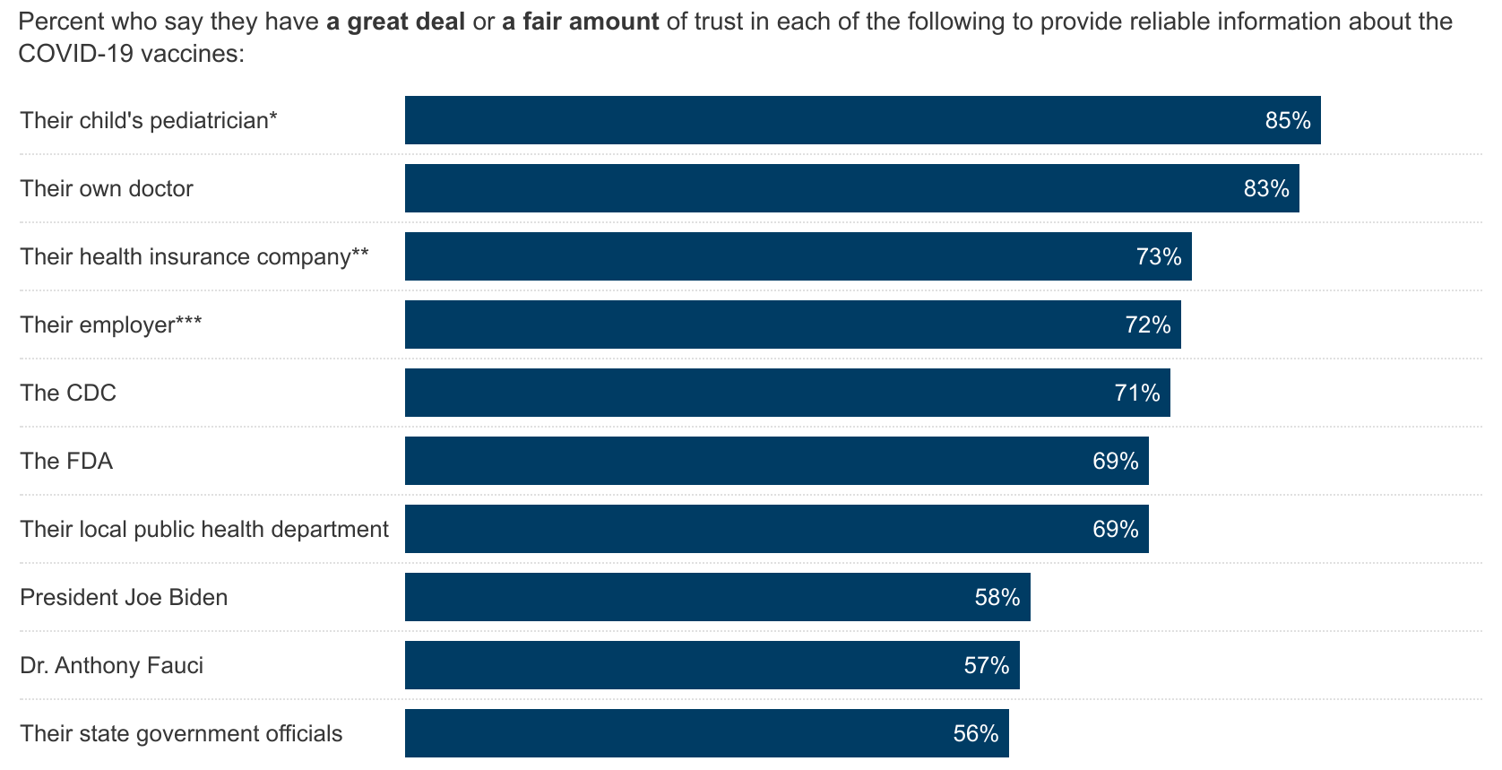
Personal Doctors And Pediatricians Are The Most Trusted Source For Reliable COVID-19 Vaccine Information
-12 since April 2020
-21 since April 2020
NOTE: *Among parents. **Among insured. ***Among those who are employed and not self-employed. See topline for full question wording.
SOURCE: KFF COVID-19 Vaccine Monitor (June 8-21, 2021)

Slide 20
Unvaccinated Adults And Republicans Less Likely To Trust Government Sources Of Information On COVID-19 Vaccines
 | Vaccinated | Unvaccinated | Democrats | Republicans
% who trust each of the following to provide reliable information about COVID-19 vaccines:
Their own doctor | 89% | 69% | 88% | 82%
Their health insurance company | 79 | 60 | 82 | 63
Their employer | 78 | 61 | 83 | 71
The CDC | 82 | 48 | 91 | 48
The FDA | 79 | 51 | 83 | 56
Their local public health department | 80 | 49 | 86 | 52
President Joe Biden | 72 | 32 | 91 | 22
Dr. Anthony Fauci | 74 | 27 | 87 | 30
Their state government officials | 64 | 41 | 71 | 45
NOTE: See topline for full question wording.
SOURCE: KFF COVID-19 Vaccine Monitor (June 8-21, 2021)

Slide 21
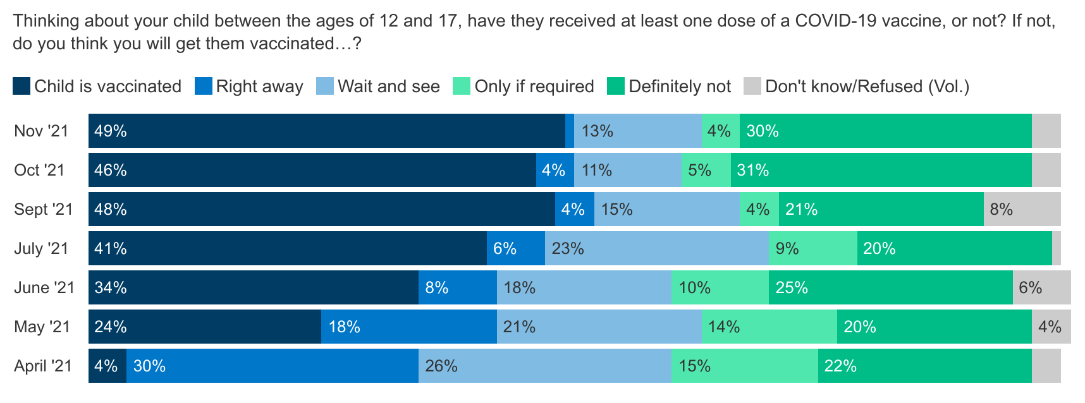
Slowdown In Parents’ Reported Uptake Of COVID-19 Vaccine For 12-17 Year-Olds
NOTE: Among parents or guardians between the ages of 12 and 17. April 2021 question wording: “Once there is a COVID-19 vaccine authorized and available for your child’s age group, do you think you will…?" See topline for full question wording.
SOURCE: KFF COVID-19 Vaccine Monitor

Slide 22
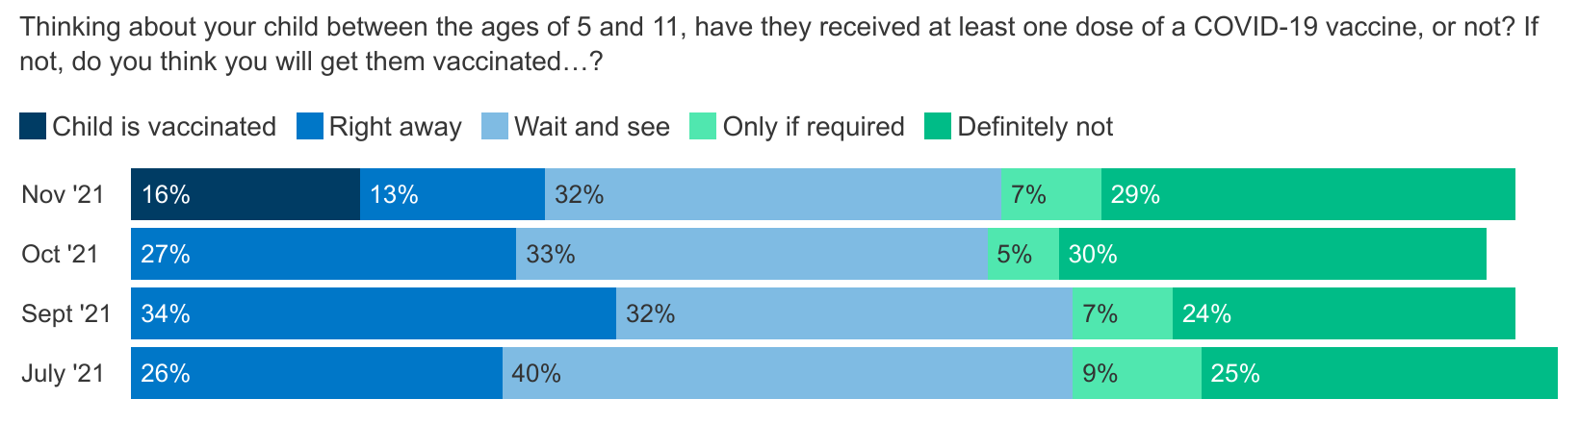
Parents Of 5-11 Year-Olds Split Roughly Into Thirds In Intention To Vaccinate Their Child For COVID-19
NOTE: Among parents or guardians of children between the ages of 5 and 11. Jul.-Oct. 2021 question wording: “Once there is a COVID-19 vaccine authorized and available for your child’s age group, do you think you will…?” See topline for full question wording.
SOURCE: KFF COVID-19 Vaccine Monitor

Slide 23
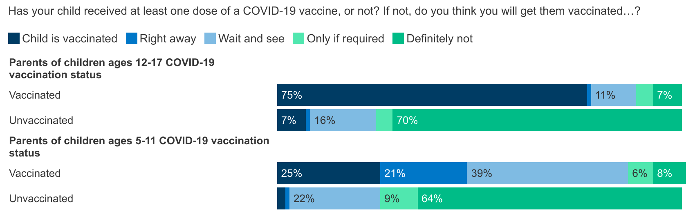
Parents’ Intentions To Vaccinate Kids Largely Lines Up With Their Own Vaccination Status
NOTE: Among parents or guardians of children ages 5-17. See topline for full question wording.
SOURCE: KFF COVID-19 Vaccine Monitor: Winter Update on Parents’ Views (November 8-23, 2021)

Slide 24
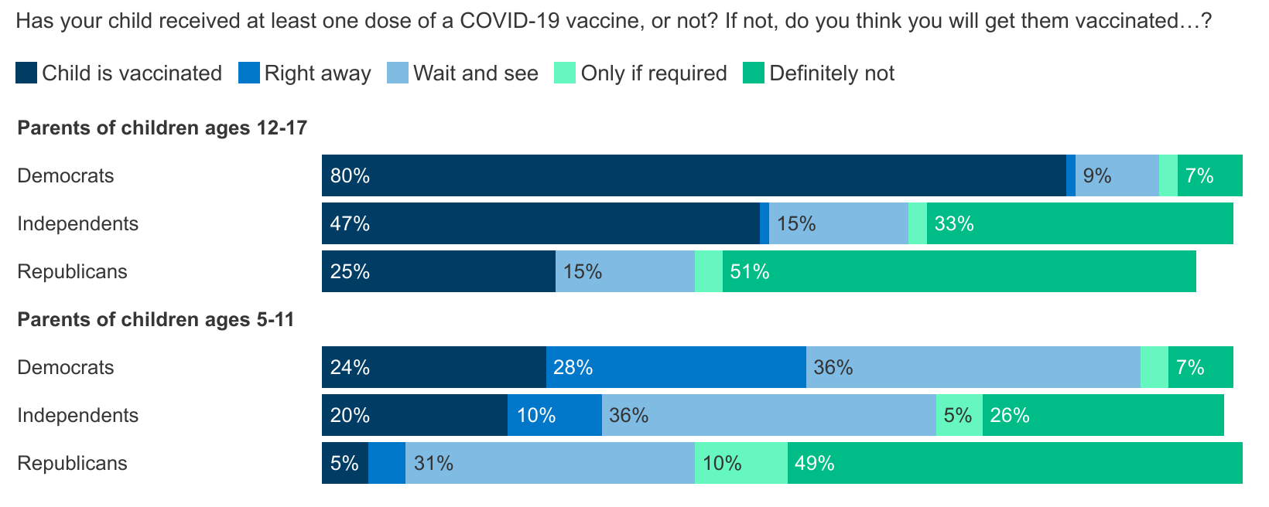
Parents’ Political Identity Factors Heavily Into COVID-19 Vaccination Intention For Kids
NOTE: Among parents or guardians of children ages 5-17. See topline for full question wording.
SOURCE: KFF COVID-19 Vaccine Monitor: Winter Update on Parents’ Views (November 8-23, 2021)

Slide 25
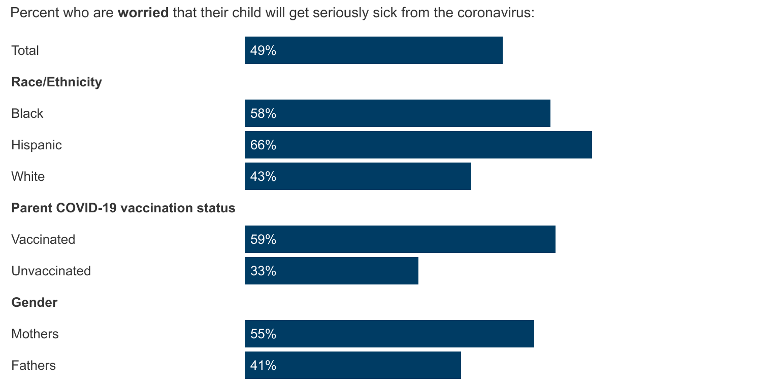
Parents Of Color, Mothers, And Vaccinated Parents Are More Likely To Worry About Their Child Getting Sick From COVID-19
NOTE: Among parents or guardians of children ages 5-17. See topline for full question wording.
SOURCE: KFF COVID-19 Vaccine Monitor: Winter Update on Parents’ Views (November 8-23, 2021)

Slide 26
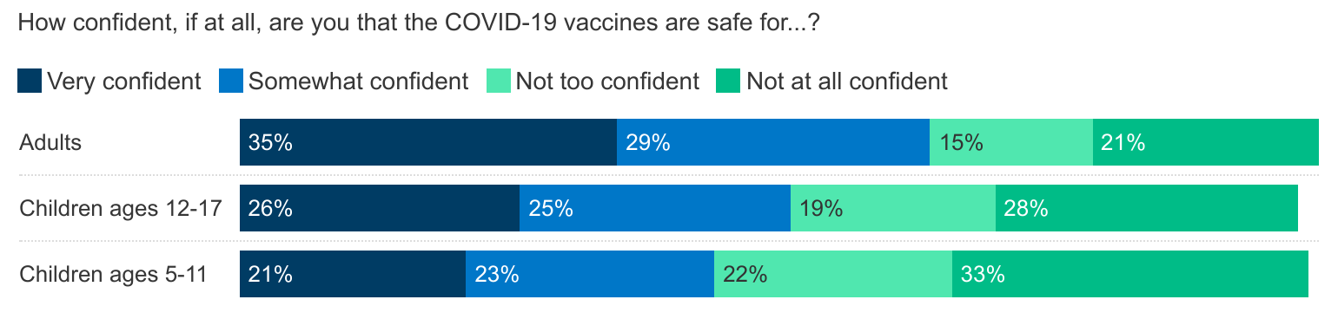
CHALLENGE: Parents Are Less Confident That The COVID-19 Vaccines Are Safe For Children, Particularly At Younger Ages
NOTE: Among parents or guardians of children under 18. See topline for full question wording.
SOURCE: KFF COVID-19 Vaccine Monitor: Winter Update on Parents’ Views (November 8-23, 2021)

Slide 27
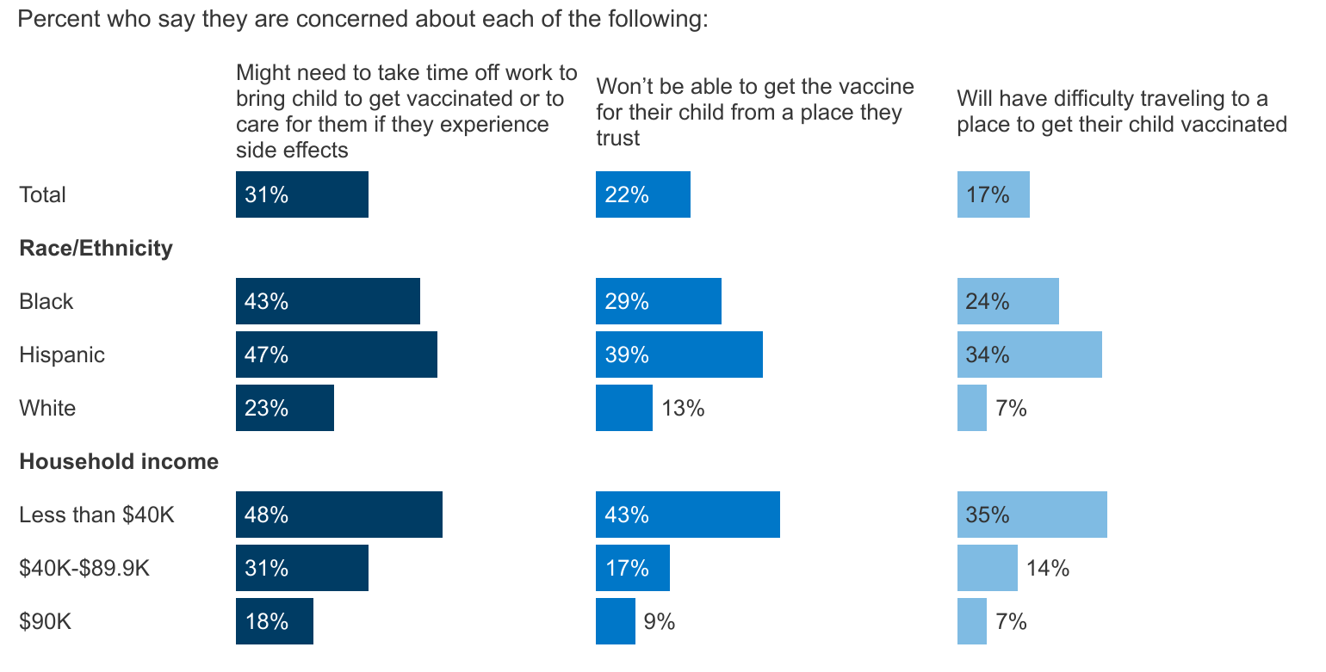
CHALLENGE: Black, Hispanic, And Lower Income Parents Are Concerned About Access Issues In Getting Children Vaccinated
NOTE: Among parents or guardians of children ages 5-17 who have not gotten the COVID-19 vaccine. See topline for full question wording.
SOURCE: KFF COVID-19 Vaccine Monitor: Winter Update on Parents’ Views (November 8-23, 2021)

Slide 28
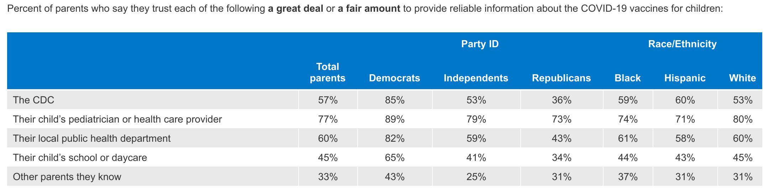
OPPORTUNITY: Pediatricians Are The Most Trusted Source Of COVID-19 Vaccine Information For Parents Across Party, Race, And Ethnicity
NOTE: Among parents or guardians of children under 18. See topline for full question wording.
SOURCE: KFF COVID-19 Vaccine Monitor: Winter Update on Parents’ Views (November 8-23, 2021)

Slide 29
OPPORTUNITY: Most Parents Have Not Yet Talked To Their Pediatrician About The COVID-19 Vaccine, And Not All Who Did Talk To A Pediatrician Say They Recommended Vaccination
NOTE: Among parents or guardians of children ages 5-17. See topline for full question wording.
SOURCE: KFF COVID-19 Vaccine Monitor: Winter Update on Parents’ Views (November 8-23, 2021)

Slide 30
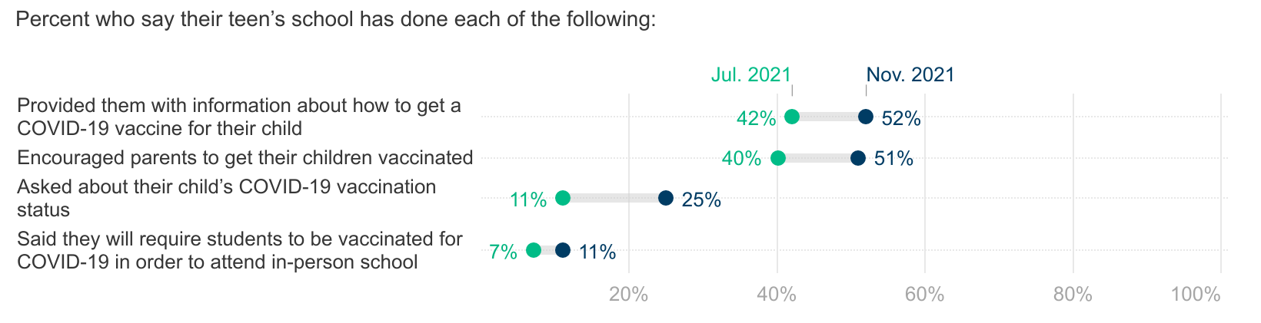
OPPORTUNITY: Many Parents Say Their Child’s School Provided Information Or Encouraged Parents To Vaccinate Their Child For COVID-19
NOTE: Among parents or guardians of children ages 12-17 who are currently enrolled in school. See topline for full question wording.
SOURCE: KFF COVID-19 Vaccine Monitor: Winter Update on Parents’ Views (November 8-23, 2021)

Slide 31
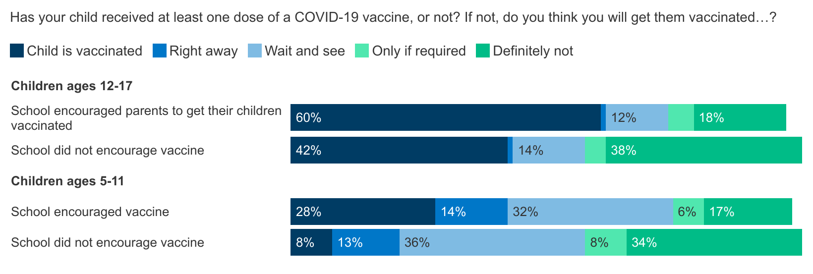
OPPORTUNITY: Parents Whose Child’s School Encouraged COVID-19 Vaccination Are More Likely To Say Child Is Vaccinated
NOTE: Among parents or guardians of children ages 5-17. See topline for full question wording.
SOURCE: KFF COVID-19 Vaccine Monitor: Winter Update on Parents’ Views (November 8-23, 2021)

Slide 32
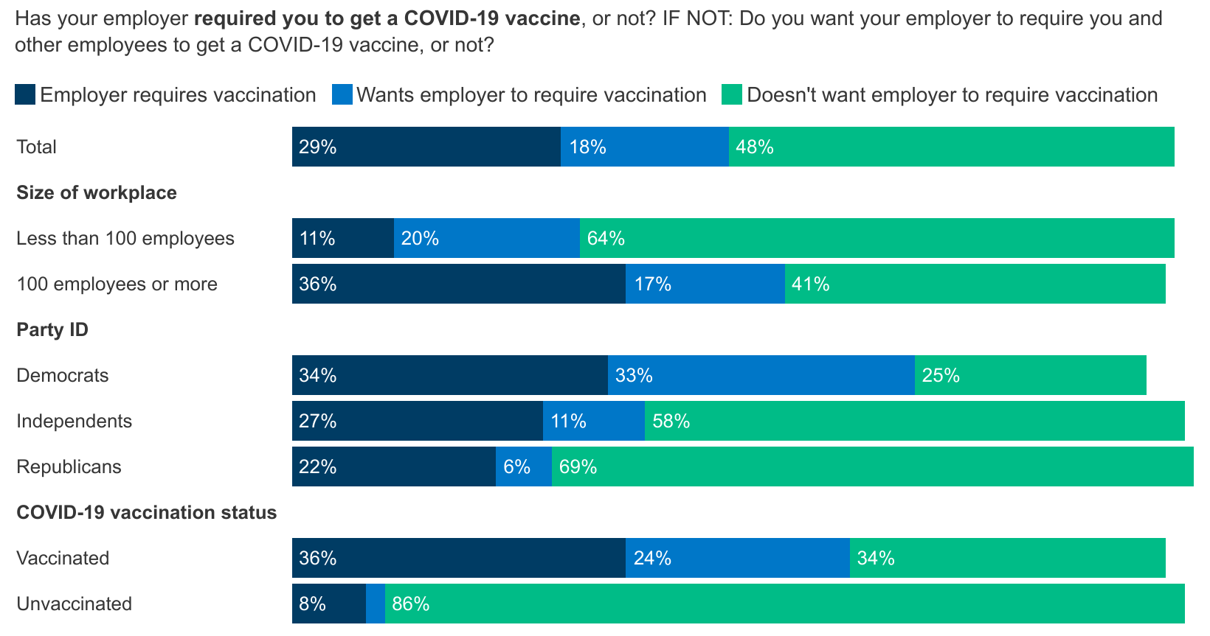
Over A Third Who Work For Larger Employers Say They’re Already Required To Get A Vaccine, Half Of All Workers Say They Don’t Want Their Employer To Require Vaccinations
NOTE: Among those who are employed but not self-employed. Vaccinated adults are those who have received at least one dose of a COVID-19 vaccine. See topline for full question wording.
SOURCE: KFF COVID-19 Vaccine Monitor (November 8-22, 2021)

Slide 33
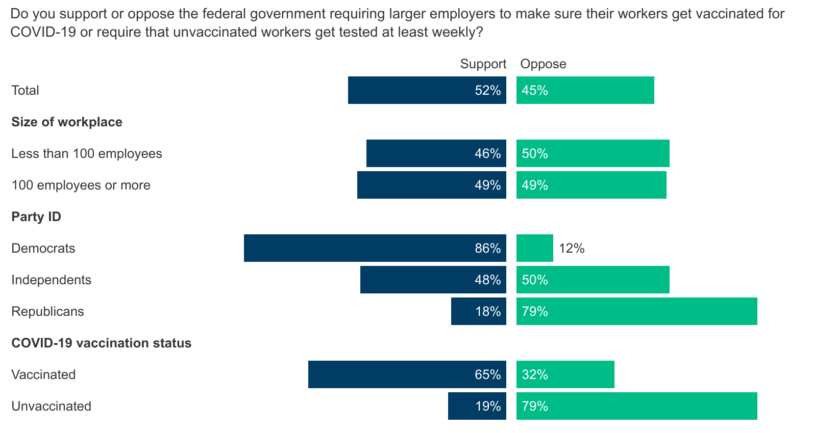
Majorities Of Republicans And Unvaccinated Adults Oppose Federal Workplace Vaccine Mandates
NOTE: Vaccinated adults are those who have received at least one dose of a COVID-19 vaccine. See topline for full question wording.
SOURCE: KFF COVID-19 Vaccine Monitor (November 8-22, 2021)

Slide 34
Potential Inroads? What’s Next?
Small shares “may” still get vaccinated eventually, but still millions of people.
On the other hand, these shares have been stagnant for months, only inching up during Delta and remaining steady so far during Omicron, so further progress may be difficult.
Trust in personal physicians is high, even for unvaccinated
Other entities can play a role:
72% trust their employer for vaccine information. Workers are more likely to be vaccinated if their employer provides information and gives paid time off
Parents whose child’s school encouraged vaccination or provided information are more likely to say their child is vaccinated, even after controlling for demographics
What does “fully vaccinated” mean in a time of boosters and more boosters?
Future of vaccine mandates, requirements?
Pandemic becoming endemic? OR New deadly variant on its way?

Slide 35
Links for more resources from the KFF CVM
COVID-19 Vaccine Monitor Dashboard
Complete list of reports from the CVM

