Slide 1
Pandemic insights from SARS-CoV-2 viral sequencing and genomics
Egon A. Ozer, MD PhD
Department of Medicine, Division of Infectious Diseases
Director, Center for Pathogen Genomics and Microbial Evolution
Northwestern Feinberg School of Medicine, Chicago IL
e-ozer@northwestern.edu

Slide 2
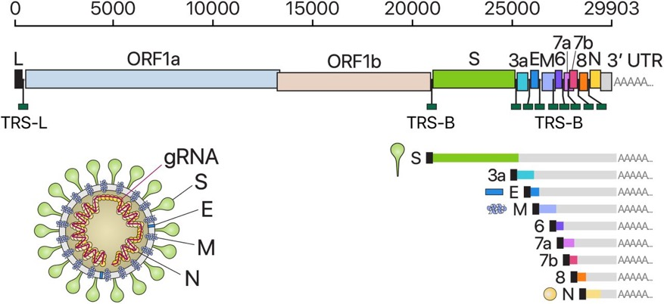
SARS-CoV-2
Betacoronavirus
Positive-sense single-stranded RNA genome
Kim et al., Cell (2020), https://doi.org/10.1016/j.cell.2020.04.011
Pal, M., Berhanu, G., Desalegn, C., & Kandi, V. (2020). Cureus, 12(3), e7423. https://doi.org/10.7759/cureus.7423

Slide 3
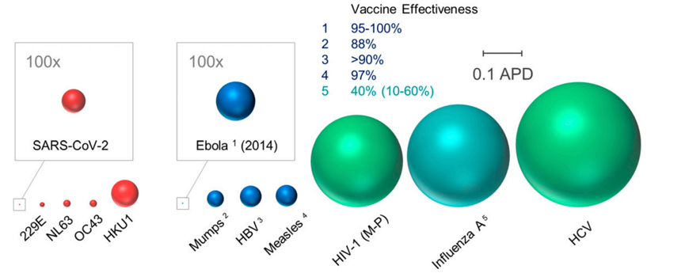
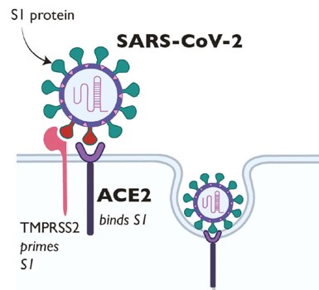
SARS-CoV-2 is always mutating
COVID-19 virus SARS-CoV-2 is one of the slowest-mutating human viruses
Most concerning mutations have been in the spike protein
  Binds ACE2 receptor
  Mediates cell entry
Coronaviruses
Proc Natl Acad Sci U S A. 2020 Oct 6; 117(40): 24614–24616

Slide 4
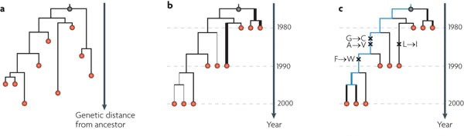
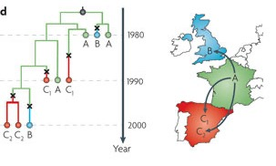
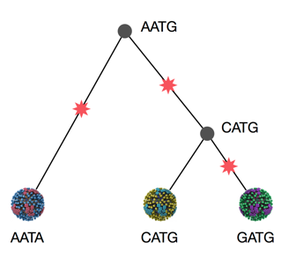
Tracking mutations using whole genome sequencing can provide insights into the molecular epidemiology of pathogens
Ancestry
Timing
Mutations
Geographical Spread
Pybus, O., Rambaut, A. 2009 Nat. Rev. Genet.

Slide 5
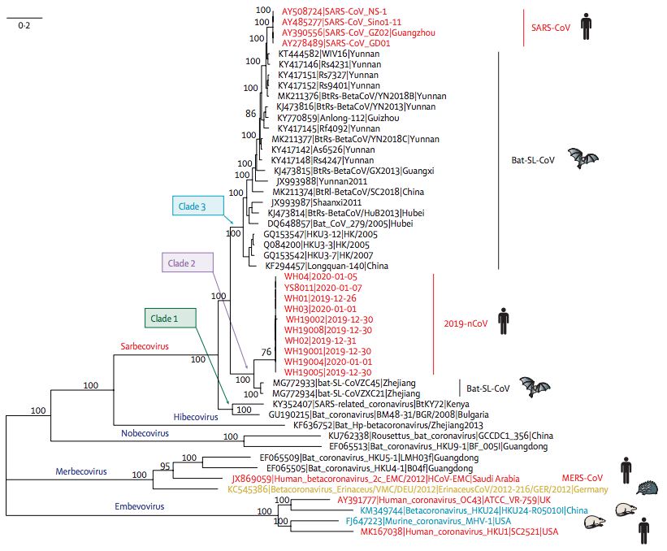
Origins of SARS-CoV-2
Phylogenetic comparison to other betacoronaviruses
Lu R et al. Lancet. 2020 Feb 22;395(10224):565-574

Slide 6
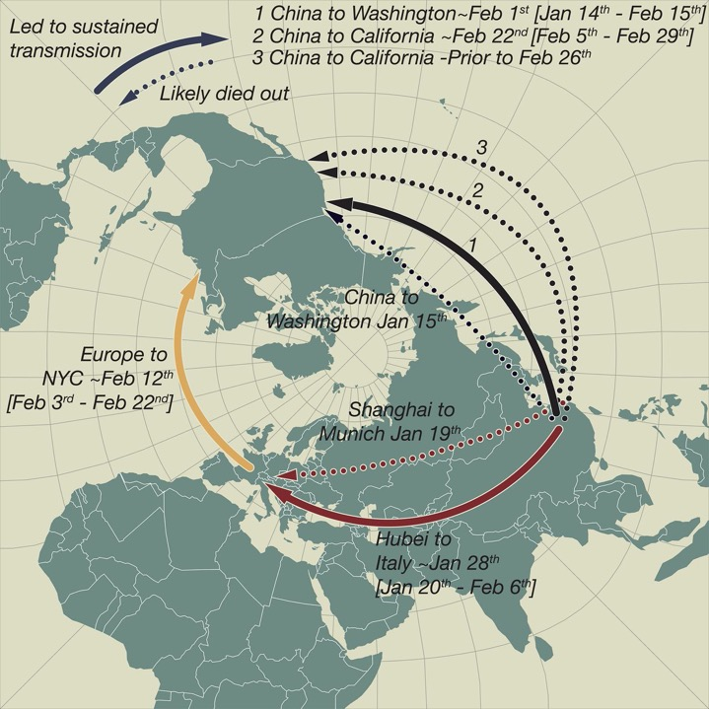
Multiple early global introductions
“Dead-end” introductions into Europe and US followed later by sustained transmissions
Worobey et al, Science, 30 Oct 2020:564-570

Slide 7
The second confirmed case of COVID-19 in the US was in Chicago, but deaths and cases were slow to rise compared to Washington and New York
https://covidtracking.com/data

Slide 8
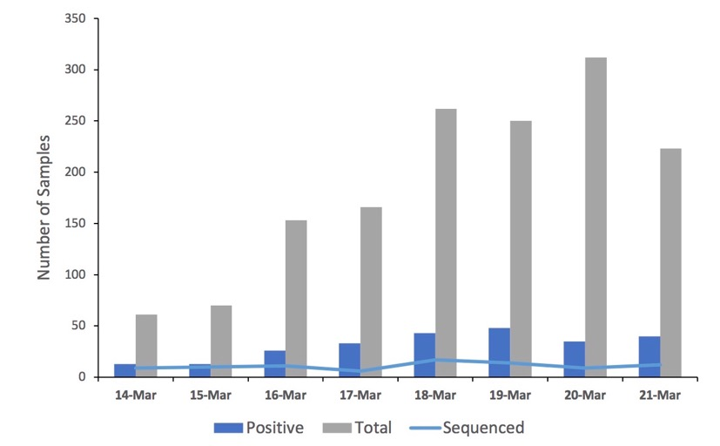
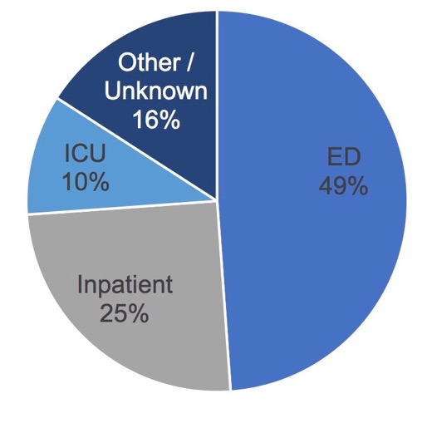
Characteristics of 88 sequenced isolates from Northwestern Medicine March 2020
Lorenzo-Redondo R, et al. EBioMedicine. 2020 Dec;62:103112

Slide 9
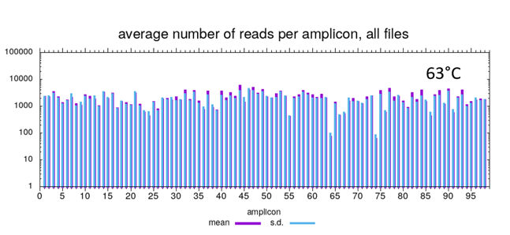

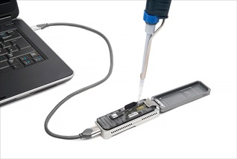

SARS-CoV-2 Whole Genome Sequencing Strategy
127
88
Required 10-fold coverage over 90% of the genome
Average median depth: 348 reads
https://artic.network/ncov-2019

Slide 10
Whole genome sequencing of SARS-CoV-2 isolates from patients in Chicago revealed three distinct clades
Lorenzo-Redondo R, et al. EBioMedicine. 2020 Dec;62:103112
Notes:
Clade 1: B.1 / 20A & 20C
Clade 2: A.3 / 19B
Clade 3: A.1 / 19B

Slide 11
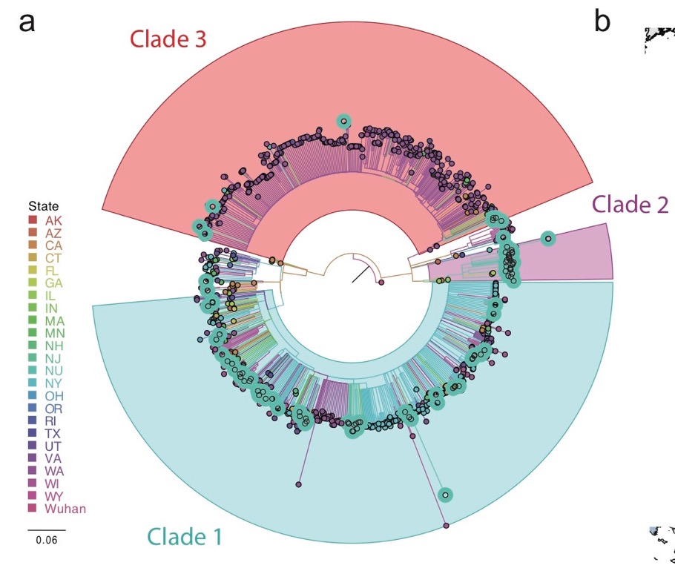

Chicago sequences in the context of the US epidemic
Compared to 901 US SARS-CoV-2 isolates as of April 4, 2020
Lorenzo-Redondo R, et al. EBioMedicine. 2020 Dec;62:103112

Slide 12
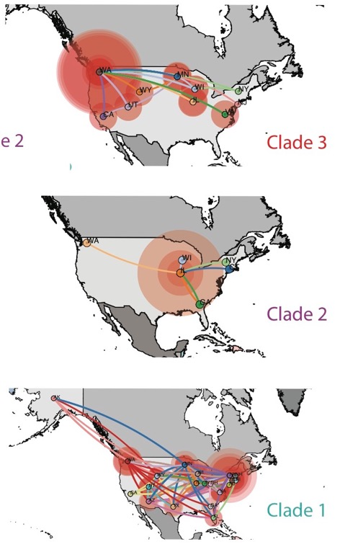
Clade 2 is centered in the Chicago area
Centered around WA, moderate expansion
Centered around IL, little expansion
Centered around NY, extensive expansion
Lorenzo-Redondo R, et al. EBioMedicine. 2020 Dec;62:103112

Slide 13
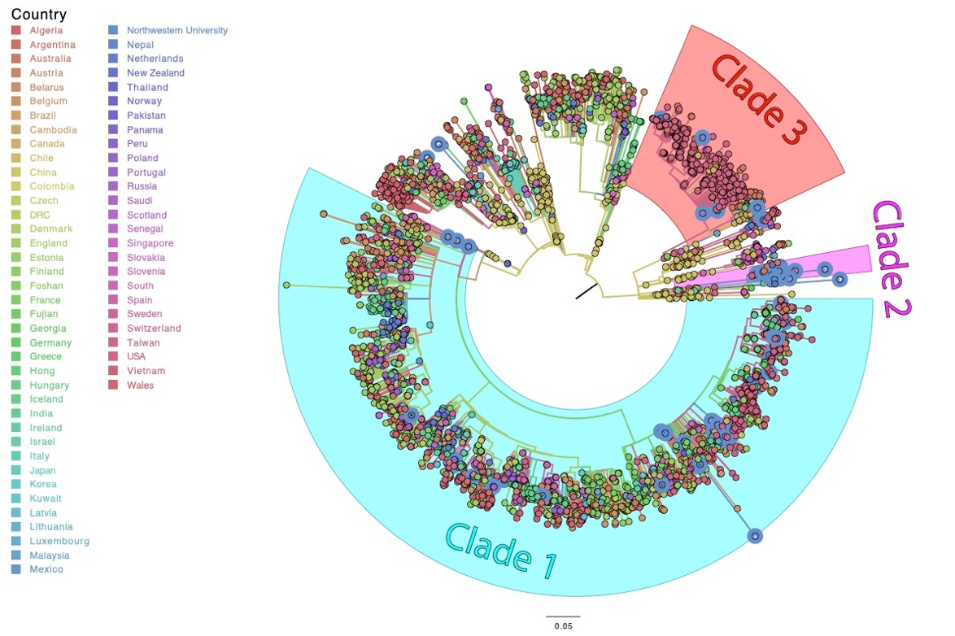
Chicago isolates in the context of global SARS-CoV-2 genomes
Compared to 3,099 global SARS-CoV-2 isolates as of April 4, 2020
Lorenzo-Redondo R, et al. EBioMedicine. 2020 Dec;62:103112

Slide 14
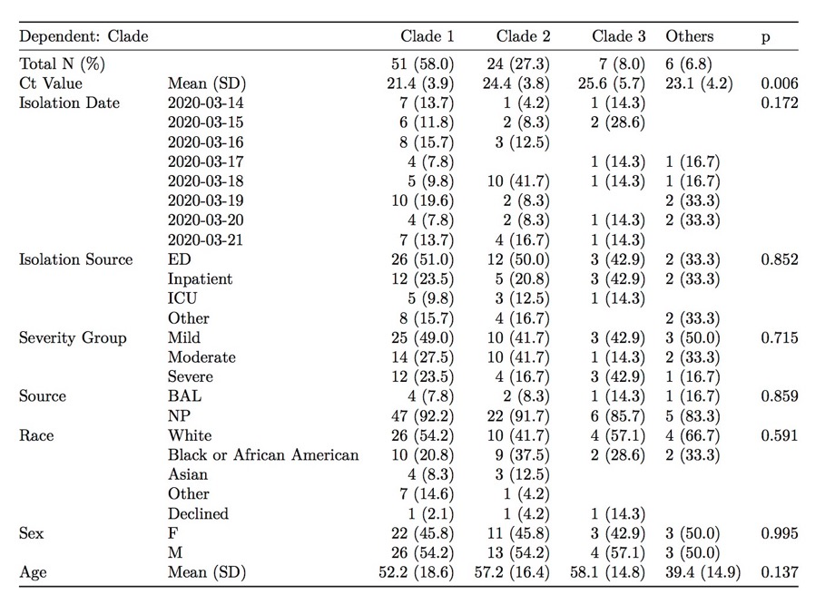
Correlations between clade and clinical characteristics?
Lorenzo-Redondo R, et al. EBioMedicine. 2020 Dec;62:103112

Slide 15
Clade 1 has higher viral loads in the nose and throat than Clade 2
PCR Cycle (Ct value) = Number of rounds of amplification before detected by test instrument
Lorenzo-Redondo R, et al. EBioMedicine. 2020 Dec;62:103112

Slide 16
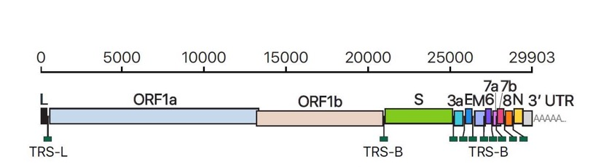
Some clade-defining mutations map to functionally relevant sites in viral enzymes
Lorenzo-Redondo R, et al. EBioMedicine. 2020 Dec;62:103112

Slide 17
D614G mutation in Spike protein defines Clade 1
Spike is the main viral protein required for entry into the host cell
Spike must be cleaved by host proteases to activate it for entry
  AA change modifies cleavage site
BioRxiv doi: 10.20944/preprints202005.0407.v1

Slide 18
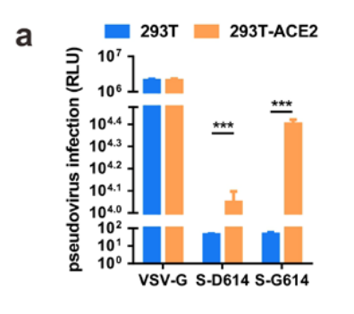
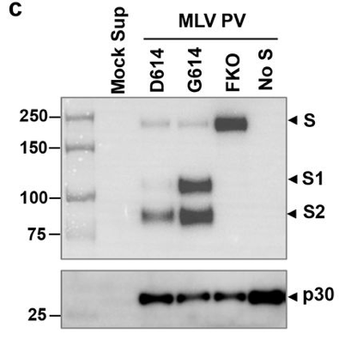
D614G mutation in Spike protein defines Clade 1
Increased infectivity of pseudotyped G614 viruses over D614
S1 domain mediates receptor binding, S2 mediates downstream membrane fusion
G614 thought to stabilize spike protein by reducing S1 shedding.
  No increase in ACE2 binding efficiency over D614
D614G enhances viral replication and produces greater upper airway (but not lower airway) viral titers in animal models
BioRxiv doi: 10.1101/2020.06.20.161323v2, 10.1101/2020.06.12.148726
Plante, J.A., Liu, Y., Liu, J. et al. Spike mutation D614G alters SARS-CoV-2 fitness. Nature (2020)

Slide 19
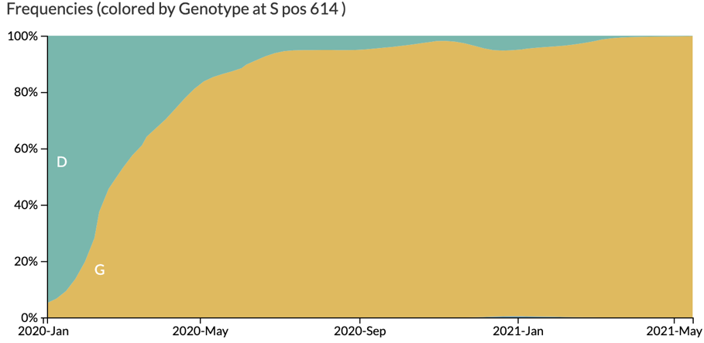
S:614G mutation has become dominant worldwide
Currently < 1% of all isolates globally are S:614D
Strongly suggests early acquisition of beneficial mutation
nextstrain.org

Slide 20
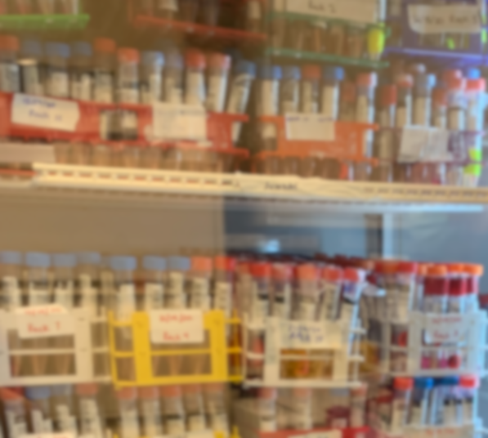
Genomic Surveillance in Chicago
Continued banking of clinical specimens
  Northwestern Medicine Diagnostic Molecular Biology laboratory
    Drive-thru testing, outpatient clinics, immediate care clinics, pre-surgical testing, healthcare workers, NU student health
Over 8,000 positive specimens banked
  Inpatient specimens banked in NM clinical microbiology lab
  Lurie Children’s Hospital

Slide 21
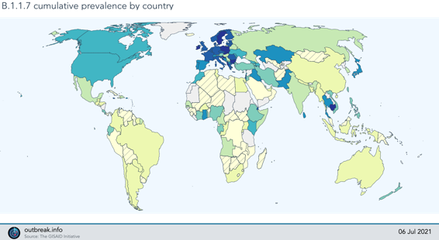

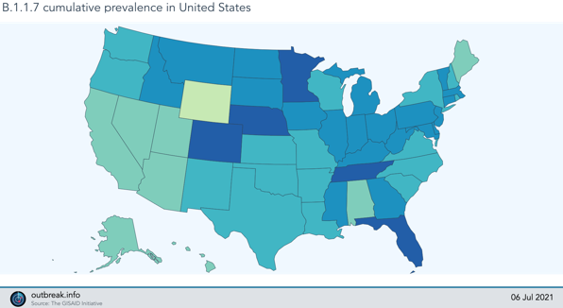
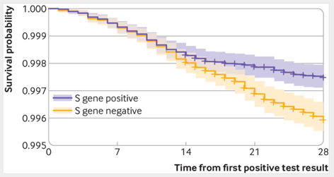
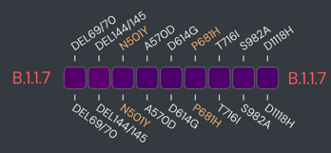
Alpha (B.1.1.7)
Global
First isolated in Southeast UK on Sept 20
Differs by 14 genetic changes from closest relatives
  N501Y in receptor binding domain, ↑ spike affinity for ACE2
Increased transmission, ? increased mortality
Currently dominant variant in the United States
Prevalence
United States
BMJ 2021;372:n579
Notes:
Mortality increased from 2.5/1000 to 4.1/1000

Slide 22
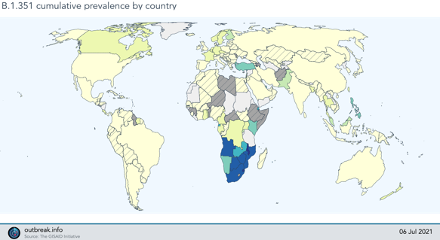
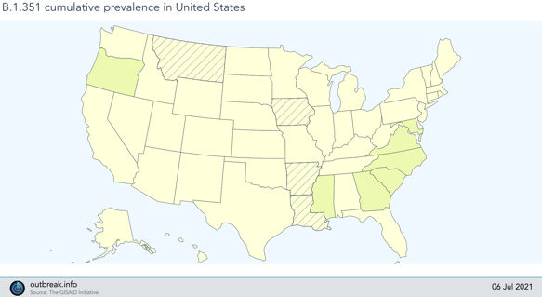
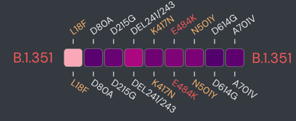
Beta (B.1.351, 501Y.V2)
Global
First identified in Nelson Mandela Bay, South Africa in October
  Rapidly became dominant lineage in South Africa
Eight spike mutations including N501Y and E484K
Remains relatively rare outside of Southern Africa
Prevalence
United States

Slide 23
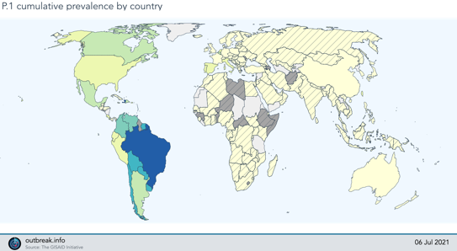
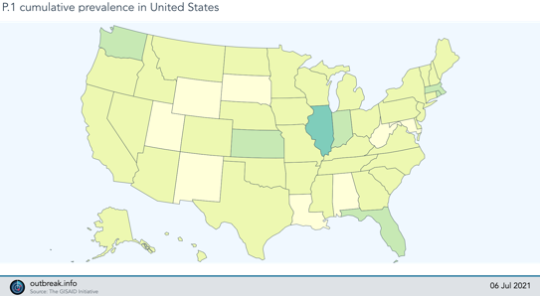
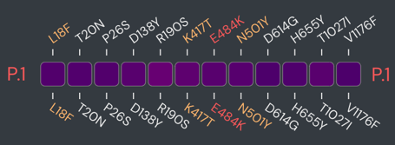
Gamma (P.1 or 501Y.V3)
Global
First identified in Japan in travelers from Brazil Jan 6, 2021
Spike mutations: N501Y, E484K and K417T
Caused reinfections in Brazil in early 2021
Uncommon outside South and North America
  Second or third most common lineage in most US states
Prevalence
United States

Slide 24
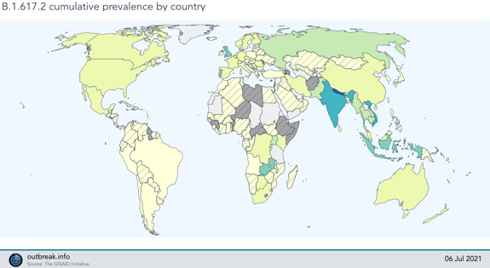
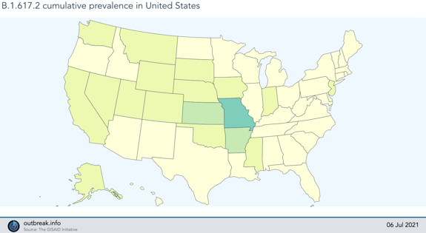
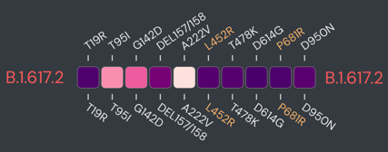
Delta (B.1.617.2, 21A)
Global
First detected in India in late 2020
Spike mutations: L452R, P681R
Approximately 75% more transmissible than original virus
Dominant variant in UK, growing prevalence in US
Prevalence
United States

Slide 25
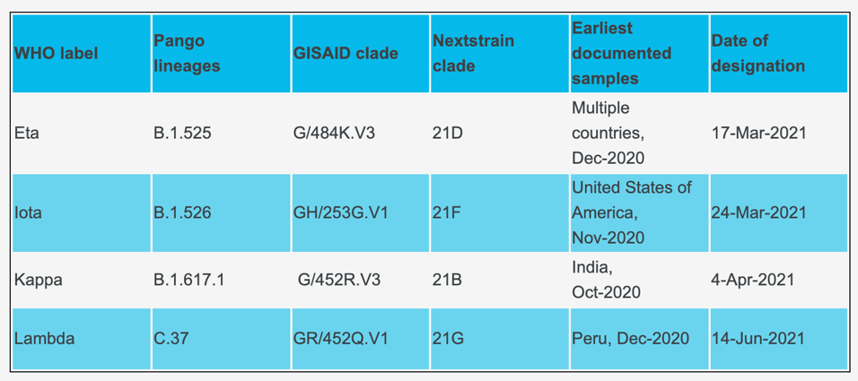
Variants of Interest
Have genetic changes associated with increased transmissibility, immune escape, or disease severity
Epidemiologic features suggesting emerging global risk
https://www.who.int/en/activities/tracking-SARS-CoV-2-variants/

Slide 26
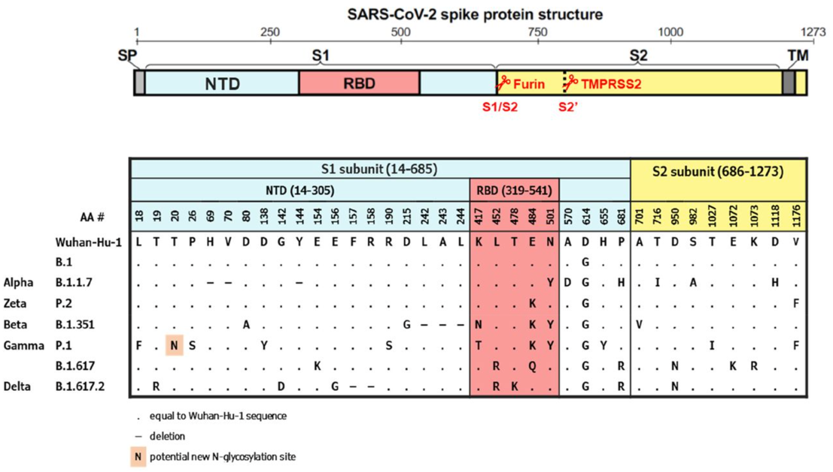
Summary of Spike Protein Mutations
https://doi.org/10.1101/2021.07.01.450707

Slide 27
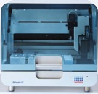
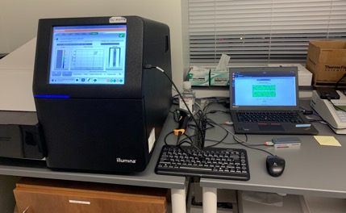
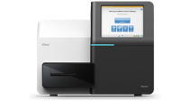
Biobanking and Sequencing Pipeline
QiaCube HT
Viral RNA
Extraction
Biobanking
qPCR
determination of viral loads
Nasopharyngeal Swabs
Viral
RNA
cDNA synthesis
and Multiplex PCR
Whole Genome Sequencing on MiSeq or Nanopore

Slide 28
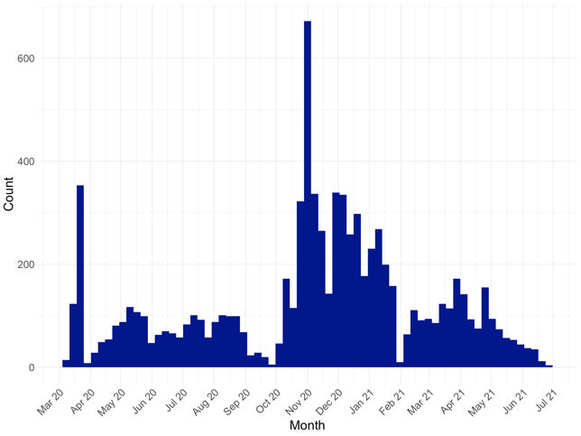
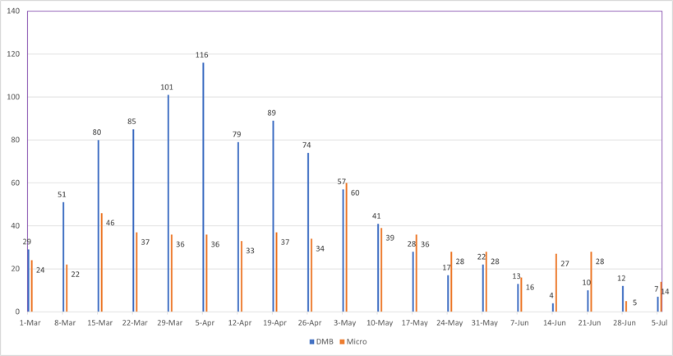
SARS-CoV-2 Genomic Surveillance at Northwestern
Northwestern Medicine
  Banked 8,555 positive specimens (3/14/20 – 7/6/21)

Slide 29
Banked positive isolates at Northwestern
Cook County

Slide 30
Clade / Lineage distribution in Chicago (by month)
Proportion
Total

Slide 31
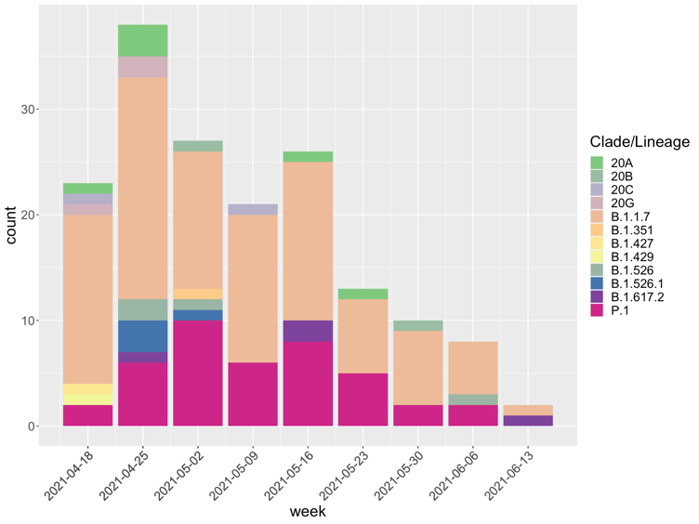
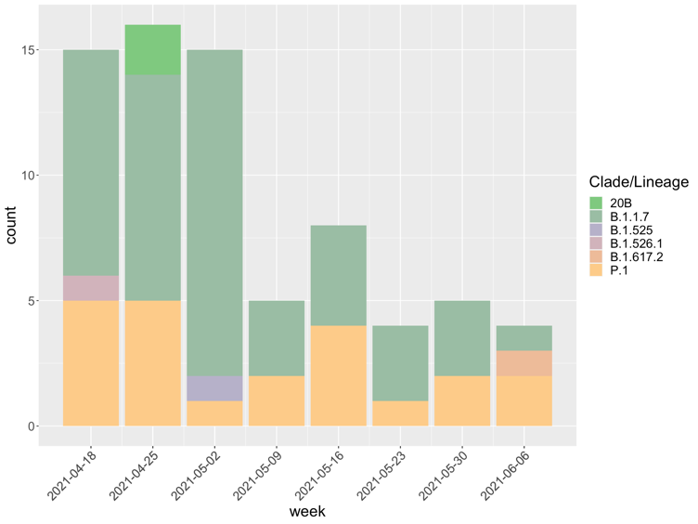
Clade / Lineage distribution in Chicago
Clade / Lineage distribution in Chicago (by month)
Northwestern
Lurie Children’s

Slide 32
SARS-CoV-2 Genomic Surveillance, Global and USA
Data Source: GISAID, June 7, 2021

Slide 33
SARS-CoV-2 Genomic Surveillance, Illinois
Data Source: GISAID, June 7, 2021

Slide 34
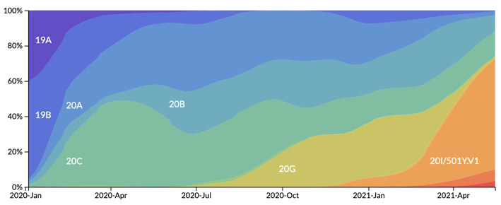
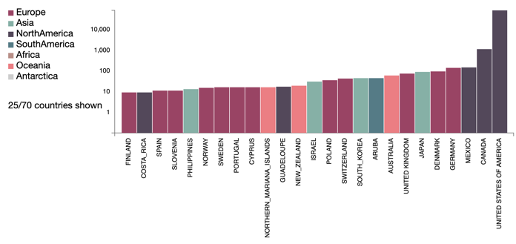
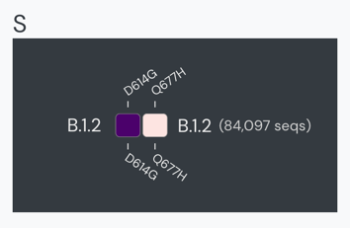
20G / B.1.2 lineage
North America
One of the most abundant single lineages in United States Nov 2020 – Mar 2021
  Most abundant lineage in Chicago area
95% of all isolates worldwide from the US
No major spike mutations:
  100% D614G
  10% Q677H
Nextstrain.org
https://cov-lineages.org/lineages/lineage_B.1.2.html
https://outbreak.info/compare-lineages?pango=B.1.2

Slide 35
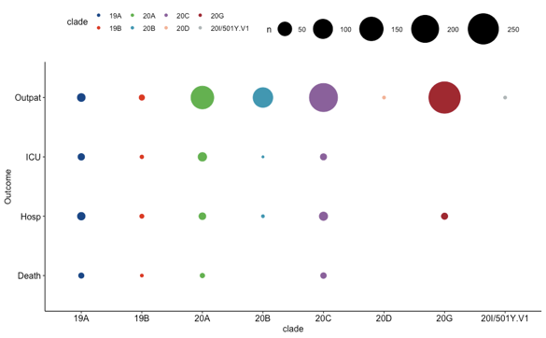
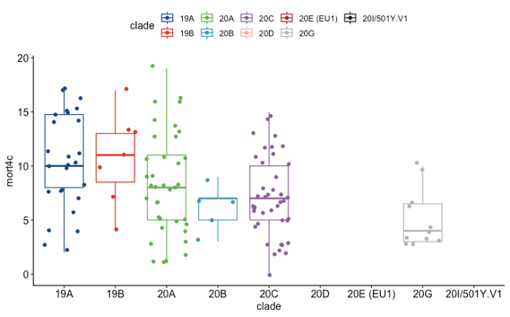
20G / B.1.2 lineage clinical features
1,104 isolates with clinical data from Northwestern (Mar 2020 – Mar 2021)
Viral loads lower in clade 19 isolates, no differences among clade 20 isolates
Fewer hospitalizations among patients infected with 20G isolates
  Lower disease severity score (4C) among hospitalized with 20G

Slide 36
Intra-host Variability
34 hospitalized individuals enrolled in longitudinal study
  Nasopharyngeal swab collected every 4 days during hospitalization
83 specimens sequenced
  9 participants with evidence of viral diversification
Diversification not associated with infection outcome (no ICU, ICU, or death)
Simons et al, MedRxiv: https://doi.org/10.1101/2021.07.02.21259665

Slide 37
SARS-CoV-2 sequencing in Nigeria
Little genomic surveillance in Nigeria
  300 public genome sequences through Feb 2021
80 specimens from collaborators in Ibadan, Oyo state, Nigeria
  Olubusuyi M. Adewumi , Univ of Ibadan
  Collected Jan 2nd – Jan 14th 2021
Sequenced 74 isolates
Ozer et al, MedRxiv 4/23/21 10.1101/2021.04.09.21255206

Slide 38
SARS-CoV-2 sequencing in Nigeria
Isolates from other states in Nigeria confirmed recent emergence of B.1.1.7 and B.1.525
Both appeared monophyletic
  Suggest single introduction
Ozer et al, MedRxiv 4/23/21 10.1101/2021.04.09.21255206

Slide 39
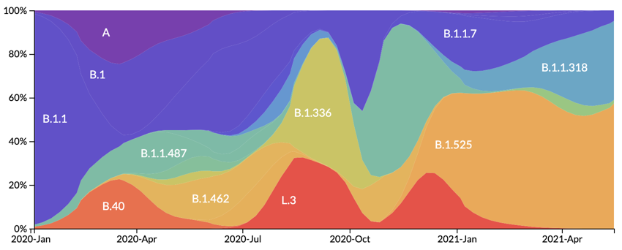
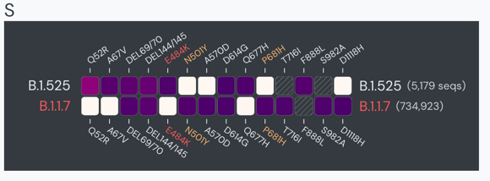
B.1.525
Most prevalent lineage in Nigeria
May be outcompeting B.1.1.7
Examine phenotypic features
Nextstrain.org
https://outbreak.info/compare-lineages?pango=B.1.525

Slide 40

B.1.525 cell entry
Generated psedotyped virus with individual B.1.525 spike protein mutations
  Joao Mamede, Rush
Measured cell entry in HeLa-ACE2 cell culture
B.1.525 pseudotyped virus (8Mut) showed the most efficient cell entry
https://outbreak.info/compare-lineages?pango=B.1.525

Slide 41
B.1.525 neutralization escape
Obtained serum from immunized individuals and COVID-19 recovered
  Pfizer vaccine n=4
  Moderna vaccine n=4
    Both 2 weeks after second dose
  Convalescent from Oyo State n=9
    7 days – 4 weeks after diagnosis
    May 2020 – Jun 2020
  Incubated pseudotyped virus in sera and measured relative cell entry
  Convalescent serum showed less neutralization of B.1.525

Slide 42

West Africa SARS-CoV-2 Sequencing
Obtained 100 SARS-CoV-2 isolates each from Mali and Guinea
  Collected between Dec 2020 and April 2021
  Average ages: Mali 56 (19-81), Guinea 34 (16-74)
Every patient treated with chloroquine, azithromycin and vitamin C
Only 1 death in Mali cohort (40 yo M with no comorbidities), 0 deaths in Guinea cohort
Most specimens were either high Ct or stored in wrong transport media
  Only could sequence 4 from Mali and 19 from Guinea

Slide 43

Alpha
Eta, B.1.525,
”Nigeria”
Clade 19
Mostly extinct?

Slide 44


Clade 19 isolates
N501Y
Alpha,
Beta,
Gamma
deltaY144
Alpha
R190S
Gamma
H655Y
Gamma
P681H
Alpha
B
B
A
A.27
A.21
A.21
D614N
L452R
Delta
E484K
Beta,
Gamma
https://doi.org/10.1101/2021.07.01.450707

Slide 45
Summary
SARS-CoV-2 is a slowly-mutating virus with emerging variants
Some variants result in phenotype changes:
  Transmission
  Immune escape
Genomic surveillance is necessary to identify and track emerging variants
Sequencing of isolates from Africa and other under-represented locations is important for identifying new and emerging threats

Slide 46





Acknowledgements
Funding Sources:
Chao Qi, PhD
Larry Jennings, MD PhD
Teresa Zembower, MD
Hannah Nam, MD
Scott Roberts, MD
Lindsay Morrison, MD
Taylor Dean
Samuel Gatesy
Sophie Nozick
Bill Muller, MD PhD
Al Hauser, MD PhD
Olubusuyi M. Adewumi, PhD
Joao Mamede, PhD
Northwestern Emerging and Re-emerging Pathogens Program
Dixon Translational Research Award
NUCATS Seed Grant
Cancer Center Supplement Award
Walder Foundation
NIH/NIAID
Ramon Lorenzo-Redondo
Judd Hultquist
Lacy Simons
Mike Ison
Chad Achenbach
Larry Kociolek

Slide 47
Thank You
e-ozer@northwestern.edu

