Slide 1
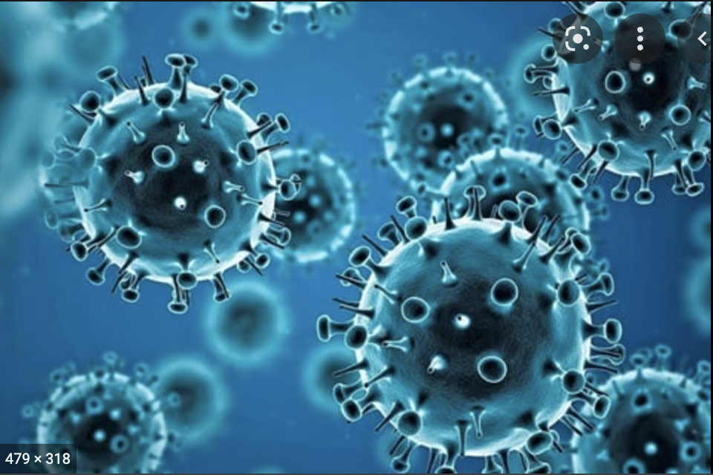
The Intellectual Property Landscape of Covid-19 Vaccines
Laura Pedraza-Fariña
Professor of Law
Northwestern Pritzker School of Law

Slide 2
Incentivizing Vaccine R&D
3 Intellectual Property Levers
Patents
Trade Secrets
Trademarks
Other incentives:
Grants
Subsidies

Slide 3
Patent Law Basics
Single drug or biologic → family of patents (a.k.a. “patent portfolios”)
Most important patent on new chemical drug entity or biological product, but other patents can extend exclusivity (delivery methods, method of use, formulation)
How do patents work?
Give “right to exclude” others from making, using or selling the invention for 20 years from date of first patent application.
No “right to market” --> often much shorter patent term following Food and Drug Administration (FDA) approval.
Rationale: Incentivize risky and uncertain investment in costly R&D by preventing free riding.

Slide 4
Patent Law Basics –Problems for Innovation
Problem of incentivizing clinical trials
Problem of upstream basic research without clear commercial use
Problem of lack of market demand for products or inability to pay
Problem of single use/ preventative medicine
The Patent Bargain Problem: Incentives/Access Trade-off

Slide 5
Patent Law Basics –Problems for Innovation
Problem of incentivizing clinical trials – FDA Drug exclusivities (market and data) and patent term extensions
Problem of upstream basic research without clear commercial use
Problem of lack of market demand for products or inability to pay
Problem of single use/ preventative medicine
The Patent Bargain Problem: Incentives/Access Trade-off

Slide 6
Patent Law Basics –Problems for Innovation
Problem of incentivizing clinical trials
Problem of upstream basic research without clear commercial use (Grants)
Problem of lack of market demand for products or inability to pay
Problem of single use/ preventative medicine
The Patent Bargain Problem: Incentives/Access Trade-off

Slide 7
Patent Law Basics –Problems for Innovation
Problem of incentivizing clinical trials
Problem of upstream basic research without clear commercial use (Grants)
Problem of lack of market demand for products or inability to pay (pre-commitment purchases, public-private partnerships)
Problem of single use/ preventative medicine
The Patent Bargain Problem: Incentives/Access Trade-off

Slide 8
Patent Law Basics –Problems for Innovation
Problem of incentivizing clinical trials
Problem of upstream basic research without clear commercial use (Grants)
Problem of lack of market demand for products or inability to pay
Problem of single use/ preventative medicine (e.g. vaccines)
The Patent Bargain Problem: Incentives/Access Trade-off
Notes:
In the wake of the
2018–2019 measles outbreaks, sales of MMR vaccines (measles-mumpsrubella)
increased by 58 percent in the United States as compared to the previous
year, generating a total of $675 million.37 By contrast, Januvia, a drug
used in the treatment of diabetes, generates close to $6 billion a year.38
Merck’s Keytruda, a biologic used in
oncology, which is projected to become the company’s best-selling drug over
the next few years, is expected to surpass the yearly mark of $20 billion

Slide 9
Patent Law Basics –Problems for Innovation
Problem of incentivizing clinical trials
Problem of upstream basic research without clear commercial use (Grants)
Problem of lack of market demand for products or inability to pay
Problem of single use/ preventative medicine
The Patent Bargain Problem: Incentives/Access Trade-off
Notes:
In the wake of the
2018–2019 measles outbreaks, sales of MMR vaccines (measles-mumpsrubella)
increased by 58 percent in the United States as compared to the previous
year, generating a total of $675 million.37 By contrast, Januvia, a drug
used in the treatment of diabetes, generates close to $6 billion a year.38
Merck’s Keytruda, a biologic used in
oncology, which is projected to become the company’s best-selling drug over
the next few years, is expected to surpass the yearly mark of $20 billion

Slide 10
Trade Secret Law
Crucial piece of vaccine innovation puzzle – vaccines as biological products can require complex manufacturing know-how
Manufacturing techniques often kept as trade secret
Law will protect a trade secret from “misappropriation” so long as the information is not generally known
Methods for producing vaccines can be kept as a trade secret – particularly important for new technologies such as mRNA vaccines

Slide 11
Bottomline Private Incentives for Vaccine Development
Market-driven system that rewards secrecy and enables high prices in return for innovation.
Market signals will push investment in R&D for products with a potential high return on investment.
Creates problem for a number of innovations, including vaccine development and pandemic preparedness.

Slide 12
Covid-19 IP Landscape
Initial difficulties in attracting private investment into vaccine development:
“Companies that have the skill to be able to do [vaccine manufacturing] are not going to just sit around and have a warm facility, ready to go for when [the public sector] need[s] it.”
Dr. Anthony Fauci, Director of the National Institute of Allergy and Infectious Diseases
IP incentives are (market) pull incentives
Vaccine development also requires push-incentives based on government grants and public-private partnerships (crucial in early stages of vaccine development).

Slide 13
R&D Public-Private Partnerships: Coalition for Epidemic Preparedness (CEPI)
Est. 2017 to fund R&D on vaccine for infectious diseases
Funded by the governments of Norway Japan, and Germany; the Bill & Melinda Gates Foundation and the Wellcome Trust and subsidiarily by several other institutions.
Partnership with Moderna and the U.S. National Institute of Allergy and Infectious Diseases to fund Moderna mRNA vaccine development.

Slide 15
ACTIV
Operation Warp Speed
Preclinical Working Group
Therapeutics Clinical Working Group
Moderna
Public
BARDA
NIH
Private
Pfizer
Gilead
Public
BARDA
NIH
Private
Novartis
Amgen
Vaccine R&D + Production
Johnson & Johnson
Pfizer
ACTIV Partnership Leadership Group + Exec Committee
Vaccine R&D + Production
Vaccine Production
Public
NIH
BARDA
FDA
Private
Pfizer
Roche
Takeda
OWS Governing Agencies
DoD
HHS
Novavax
Sanofi and GSK
Clinical Trial Capacity Working Group
Vaccines Working Group
Vaccine R&D + Production
Vaccine R&D + Production
Public
NIH
VA
Private
Sanofi
Merck
Public
NIH
Euro. Med. Acy.
Private
Merck
Moderna
Merck and IAVI
AstraZeneca
Public Data Access
Vaccine R&D + Production
Vaccine R&D + Production
Formal control
Data and inventory sharing
Bilateral contracts and flow of funds
Each working group contains informal information exchange channels, with work products shared with the public in a codified manner through open access portals.
Bilateral contracts define extent of information exchange between the government and private companies. Contracts are not transparent or available to the public. Information is not shared publicly or across participants.
https://www.nih.gov/research-training/medical-research-initiatives/activ
https://www.statnews.com/2020/09/28/operation-warp-speed-vast-military-involvement/
https://www.defense.gov/Explore/Spotlight/Coronavirus/Operation-Warp-Speed/
https://en.wikipedia.org/wiki/Operation_Warp_Speed

Slide 16
NIH/Moderna Patent Landscape

Slide 17
NIH/Moderna Patent Inventorship Dispute
Patent claiming mRNA sequence used in the vaccine does not list NIH scientists as inventors, even though NIH participated in technology development
ALL inventors must be listed in patent, but inventors are different from “authors” in a scientific publication
Inventorship is crucial to patent ownership and assignment

Slide 18
Balancing Push and Pull Incentives
Underlying Public/Private collaborations is a tension between IP and public funding models
IP Protection – investment usually recovered by charging monopoly prices
Upfront Grant funding – subsidizes R&D lessening justification for high prices, making product more widely available.

Slide 19
Addressing Barriers to Equitable Access
Pre-purchase commitments
Patent Pools
Patent Pledges and Waivers
Trade Secrets underexplored barrier to vaccine access
But what about manufacturing?
WHO Technology
Access Pool
TRIPS Waiver
Voluntary pledges

